Slide 1
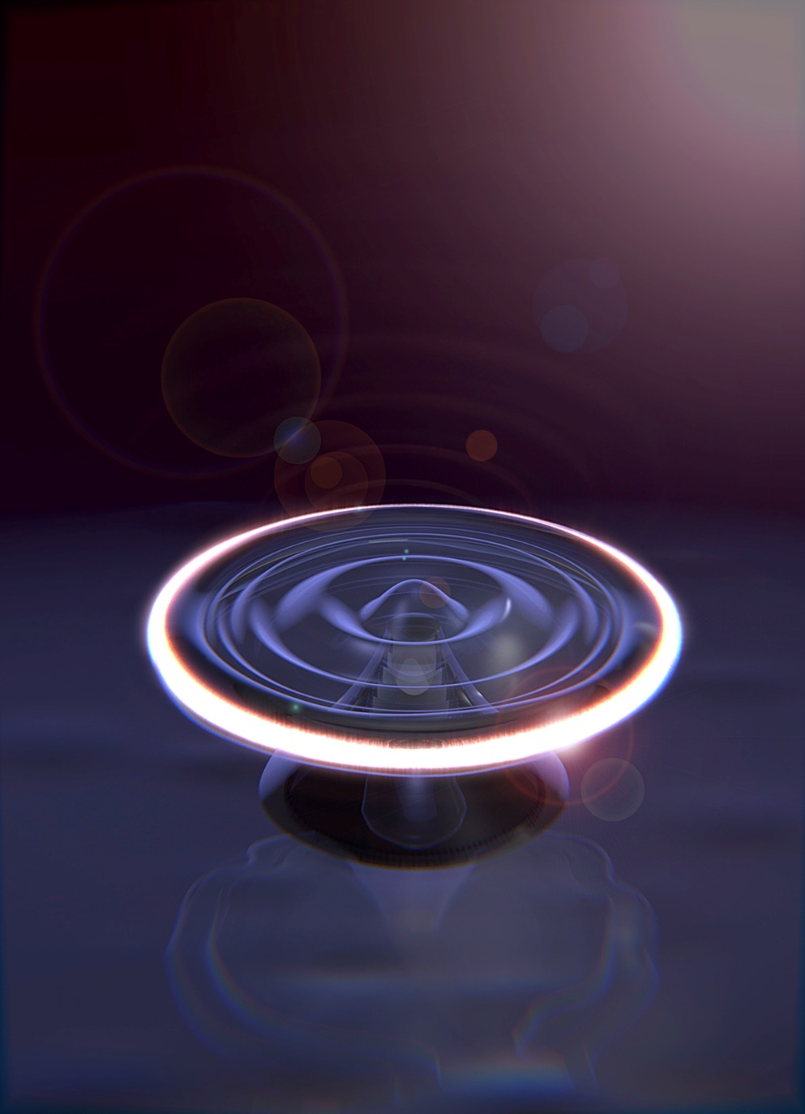
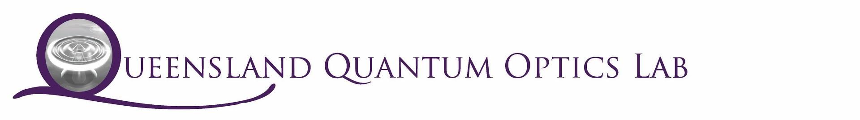
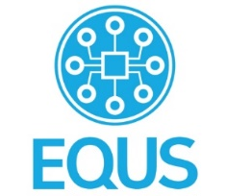


Superfluid optomechanics and Brillouin scattering
Christopher Baker, Glen Harris, Yasmine Sfendla, Walter Wasserman, Andreas Sawadsky, Raymond Harrison, Xin He, David McAuslan, Yauhen Sachkou, Stefan Forstner, and Warwick Bowen
Centre for Engineered Quantum Systems, School of Mathematics and Physics,
University of Queensland, Bisbane, Australia.

Slide 2
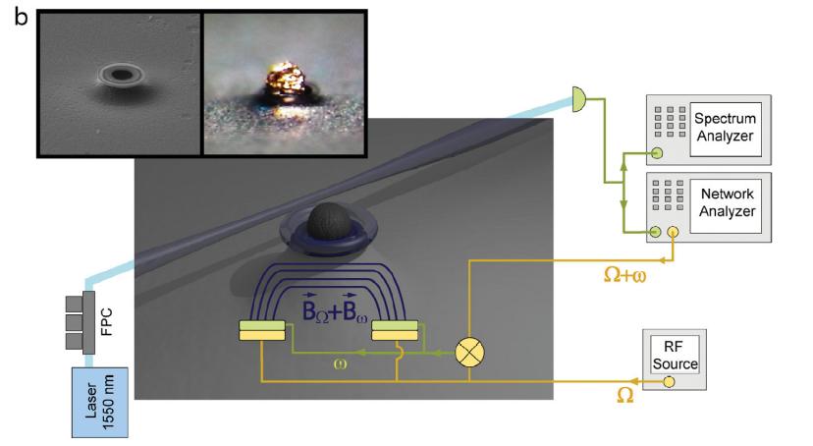
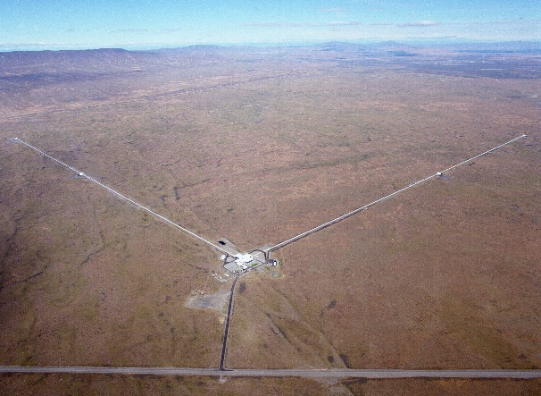
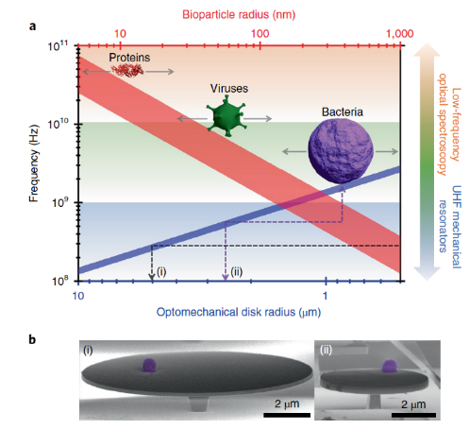
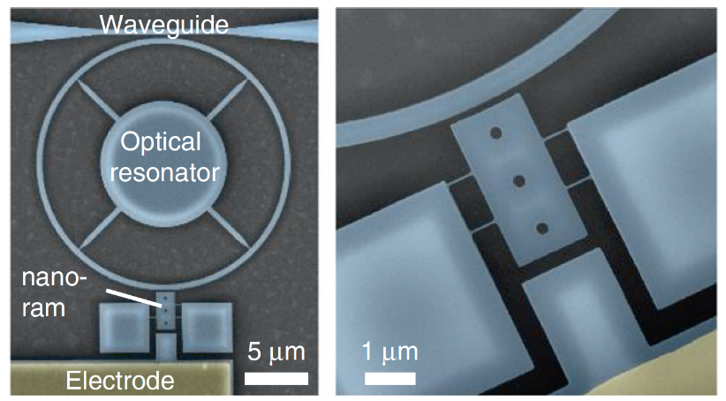
Optomechanical sensing
S. Forstner, E. Sheridan, J. Knittel, C. L. Humphreys, G. A. Brawley, H. Rubinsztein-Dunlop, and W. P. Bowen, Ultrasensitive Optomechanical Magnetometry, Adv. Mater. 26, 6348 (2014).
LIGO Scientific Collaboration and Virgo Collaboration,, Observation of Gravitational Waves from a Binary Black Hole Merger, Phys. Rev. Lett. 116, 061102 (2016).
E. Gil-Santos, J. J. Ruz, O. Malvar, I. Favero, A. Lemaître, P. M. Kosaka, S. García-López, M. Calleja, and J. Tamayo, Optomechanical Detection of Vibration Modes of a Single Bacterium, Nature Nanotechnology 15, 6 (2020).
M. Sansa, M. Defoort, A. Brenac, M. Hermouet, L. Banniard, A. Fafin, M. Gely, C. Masselon, I. Favero, G. Jourdan, and S. Hentz, Optomechanical Mass Spectrometry, Nature Communications 11, 1 (2020).

Slide 3
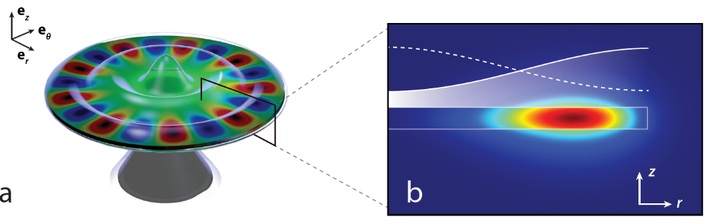
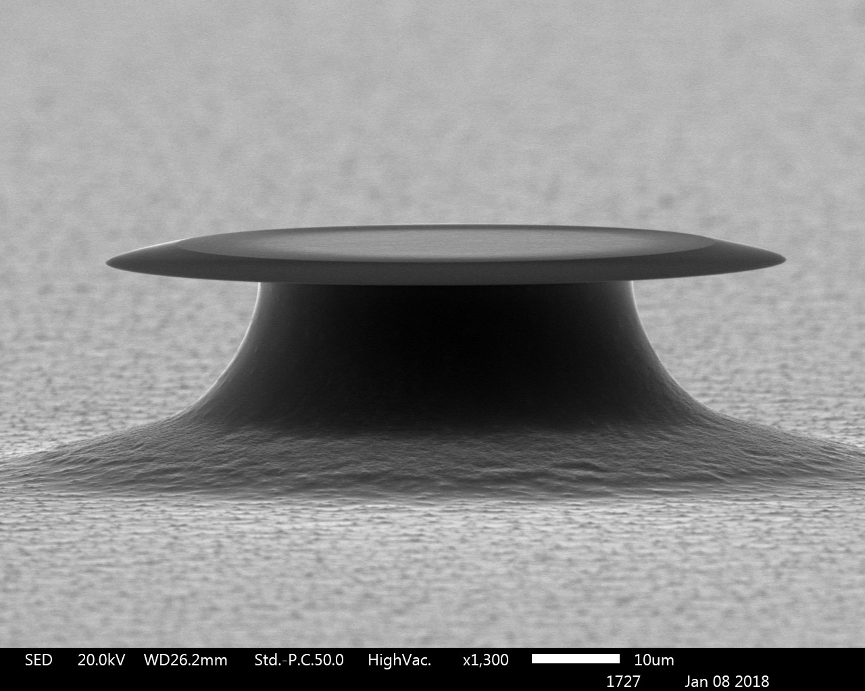
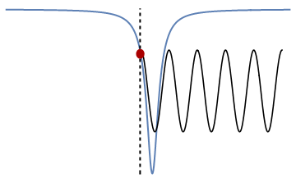
Experimental scheme
10 μm
New Journal of Physics, 18(12):123025, 2016

Slide 4
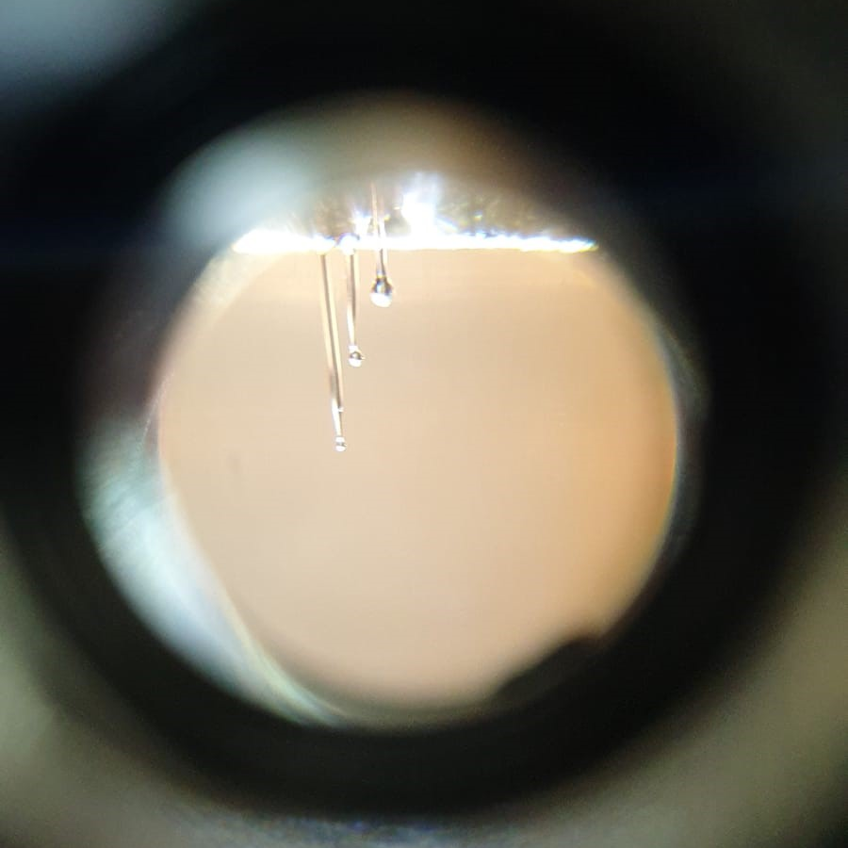
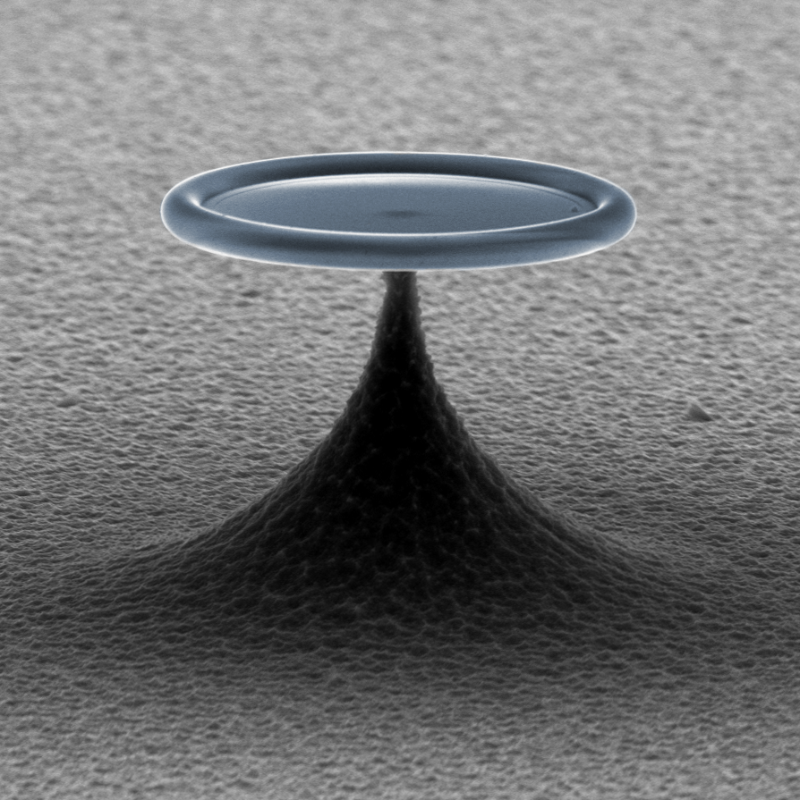
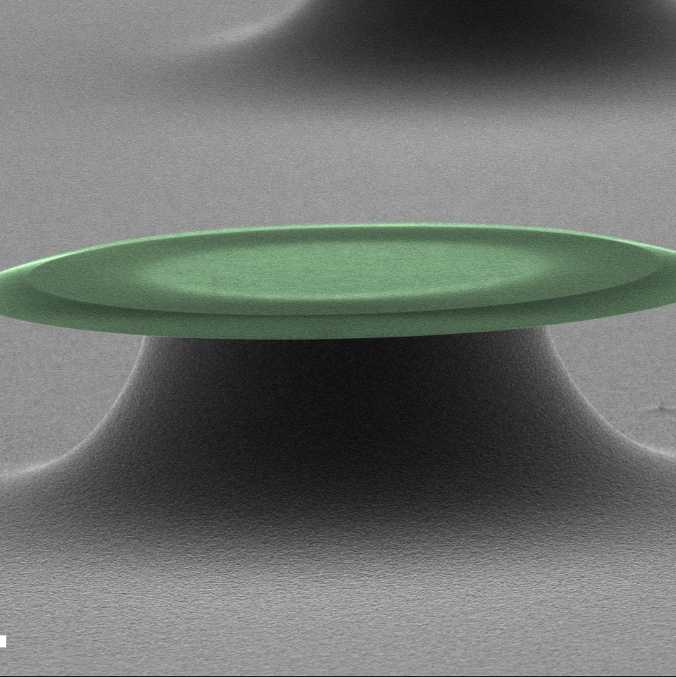
Nature Physics 12, 788, 2016
Physical Review X, 6:021012, 2016
New J. Phys. 18, 123025, 2016.
New J. Phys. 21, 053029, 2019.
Science 366, 1480, 2019.
Nature Physics 16, 4 2020.
Npj Quantum Information 7, 1 2021.

Slide 5
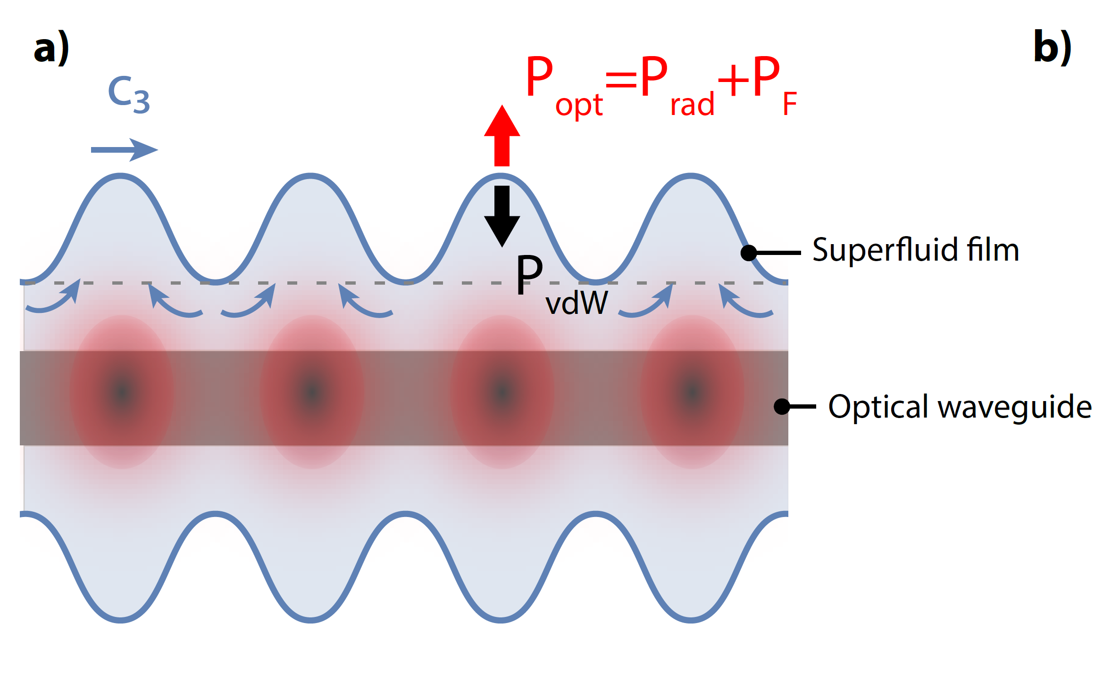
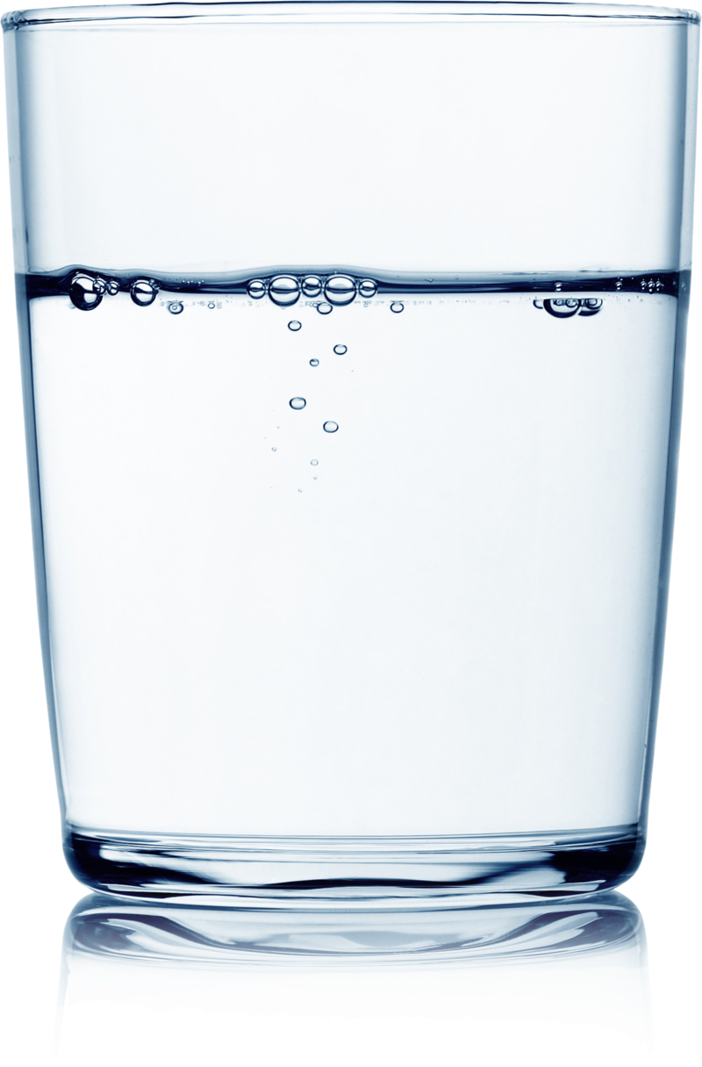
Why superfluid optomechanics ?
Stiffness ~kPa
Stiffness ~100 GPa

Slide 6
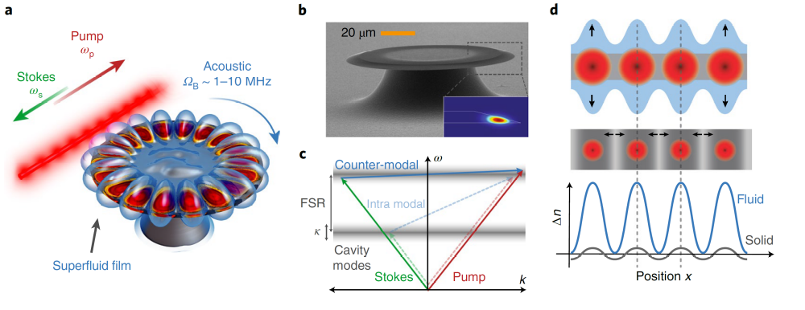
Superfluid Brillouin lasing
X. He, G. I. Harris, C. G. Baker, A. Sawadsky, Y. L. Sfendla, Y. P. Sachkou, S. Forstner, and W. P. Bowen, Strong Optical Coupling through Superfluid Brillouin Lasing, Nature Physics 16, 4 (2020).

Slide 7
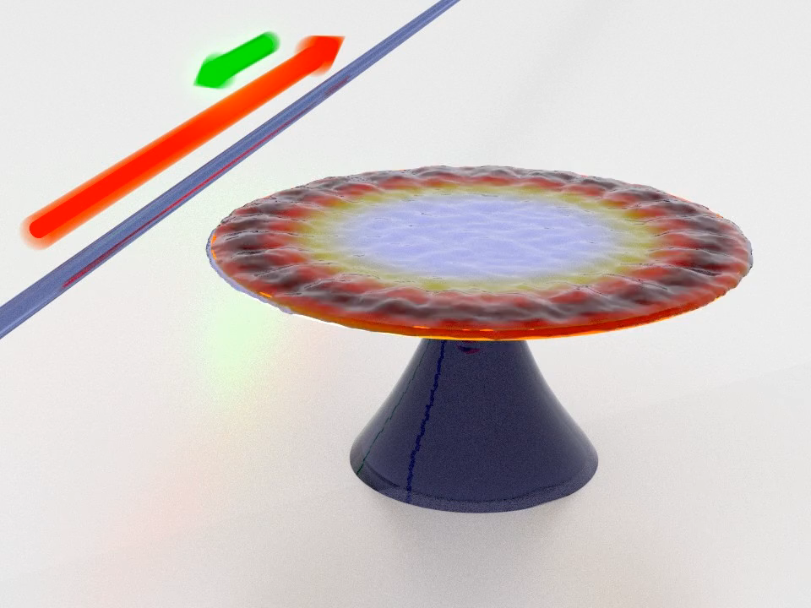
Superfluid Brillouin lasing
Ultralow threshold lasing 1.8 μW
Strong coupling between CW and CCW travelling optical modes
X. He et al, Strong Optical Coupling through Superfluid Brillouin Lasing, Nature Physics 16, 4 (2020).

Slide 8
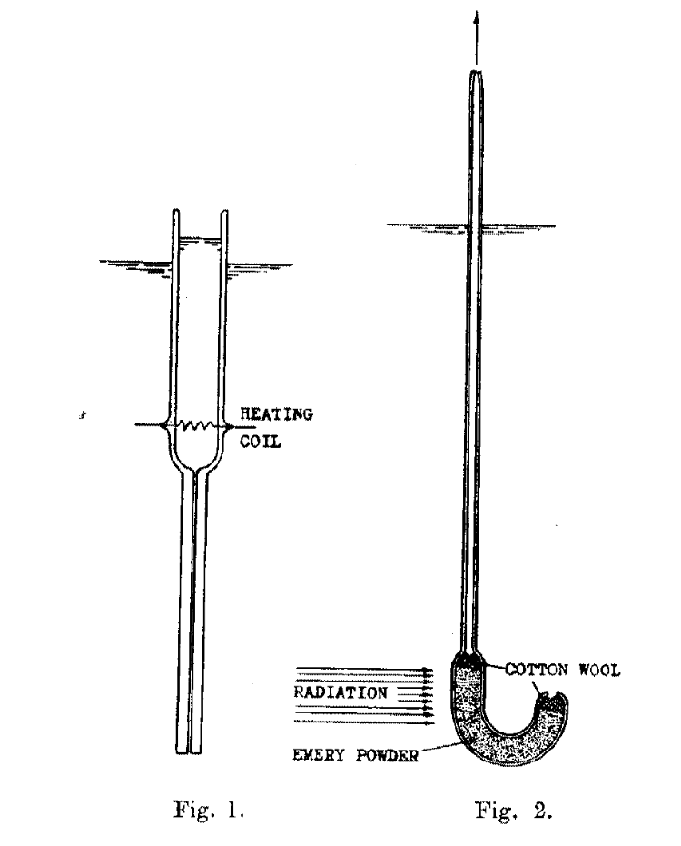
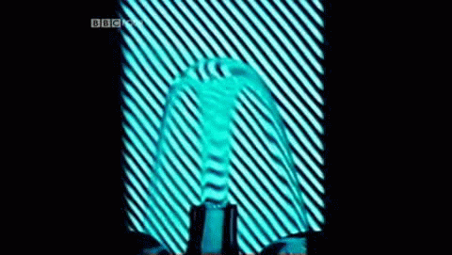

Fountain pressure optomechanics
$$ΔP=ρSΔT$$
J. F. Allen and H. Jones, New Phenomena Connected with Heat Flow in Helium II, Nature 141, 243 (1938).
H. London, Thermodynamics of the Thermomechanical Effect of Liquid He II, Proceedings of the Royal Society of London. Series A, Mathematical and Physical Sciences 484 (1939).

Slide 9
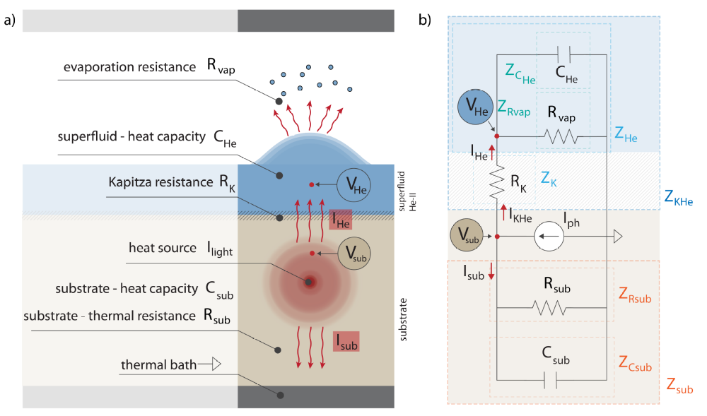

Fountain pressure optomechanics
$$ΔP=ρSΔT$$
Andreas Sawadsky, Raymond Harrison, Glen I. Harris, Walter W. Wasserman,Yasmine L. Sfendla, Warwick P. Bowen, and Christopher G. Baker, in preparation

Slide 10
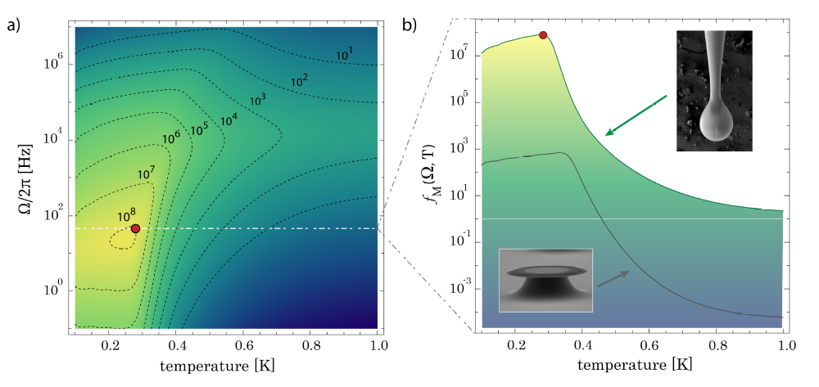
Fountain pressure optomechanics
Andreas Sawadsky, Raymond Harrison, Glen I. Harris, Walter W. Wasserman,Yasmine L. Sfendla, Warwick P. Bowen, and Christopher G. Baker, in preparation

Slide 11
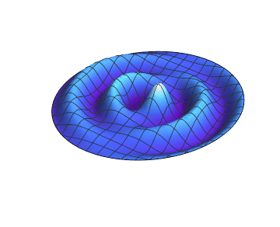
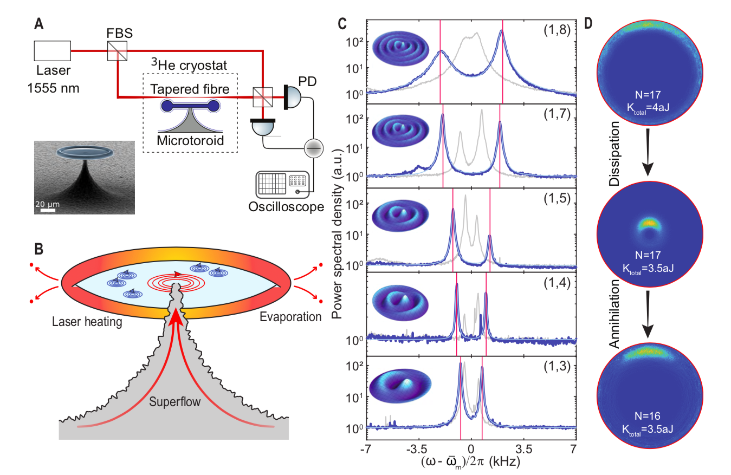
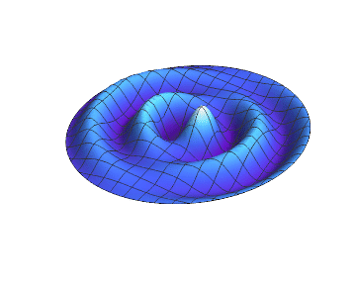
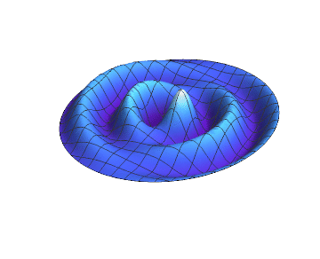
Imaging quantized vortex dynamics
CCW
CW
Y. P. Sachkou, C. G. Baker, G. I. Harris, O. R. Stockdale, S. Forstner, M. T. Reeves, X. He, D. L. McAuslan, A. S. Bradley, M. J. Davis, and W. P. Bowen, Coherent Vortex Dynamics in a Strongly Interacting Superfluid on a Silicon Chip, Science 366, 1480 (2019).
S. Forstner, Y. Sachkou, M. Woolley, G. I. Harris, X. He, W. P. Bowen, and C. G. Baker, Modelling of Vorticity, Sound and Their Interaction in Two-Dimensional Superfluids, New J. Phys. 21, 053029 (2019).

Slide 12
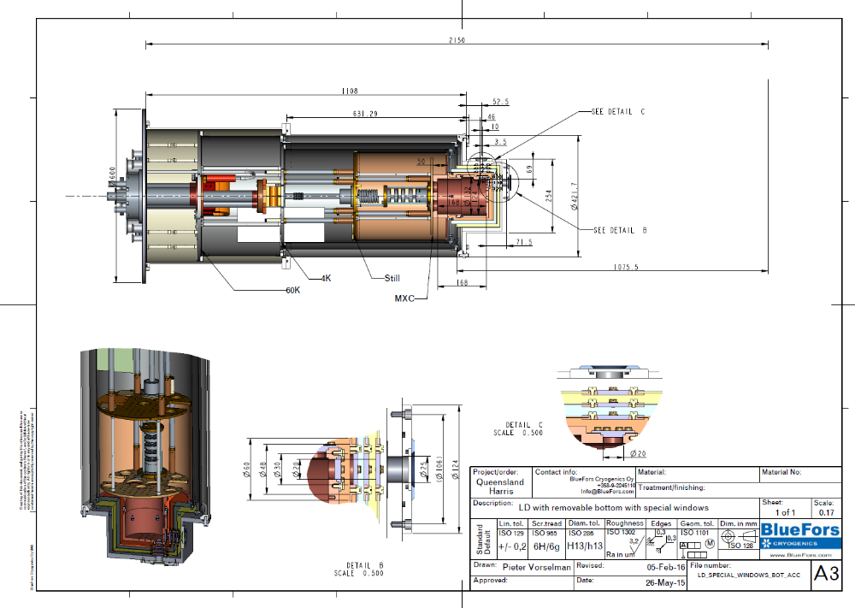
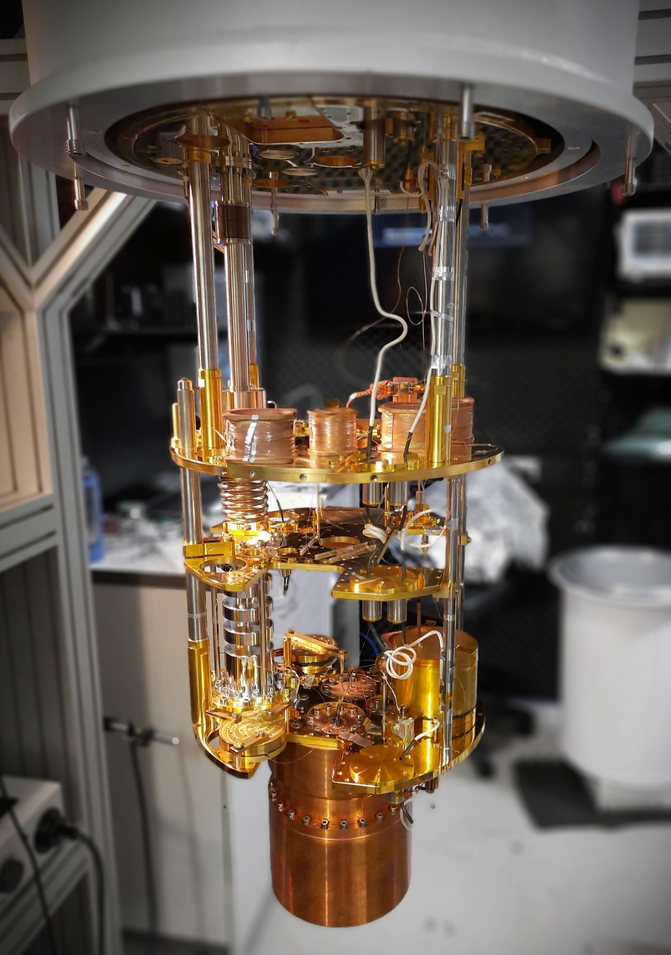
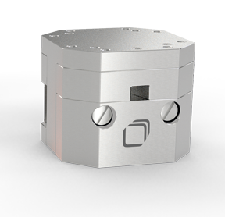
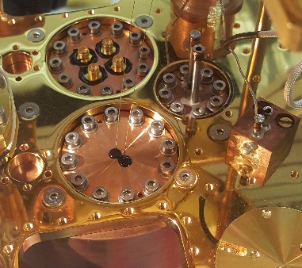
Integration and packaging
Complex requirements:
Optical feedthroughs (fiber)
Electrical feedthroughs
Attocube micropositioners
Helium gas access
Indium seals (leaks)
optical access (5 windows)
Fragile fiber taper

Slide 13
Integration and packaging
Complex requirements:
Optical feedthroughs (fiber)
Electrical feedthroughs
Attocube micropositioners
Helium gas access
Indium seals (leaks)
optical access (5 windows)
Fragile fiber taper

Slide 14
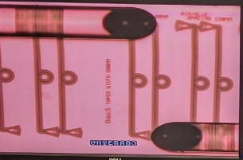
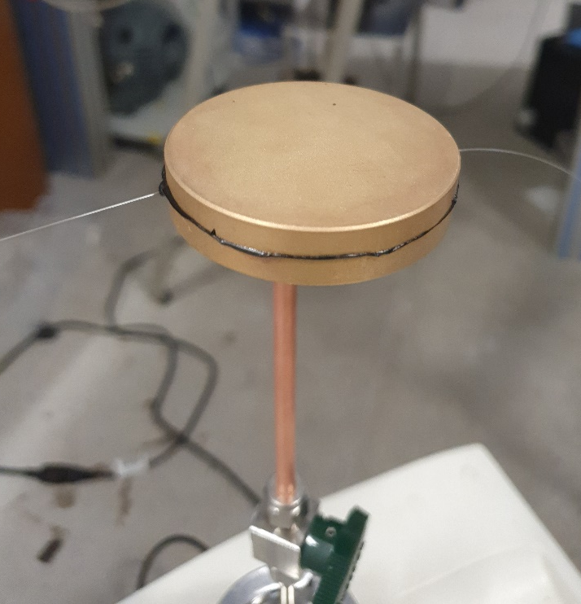

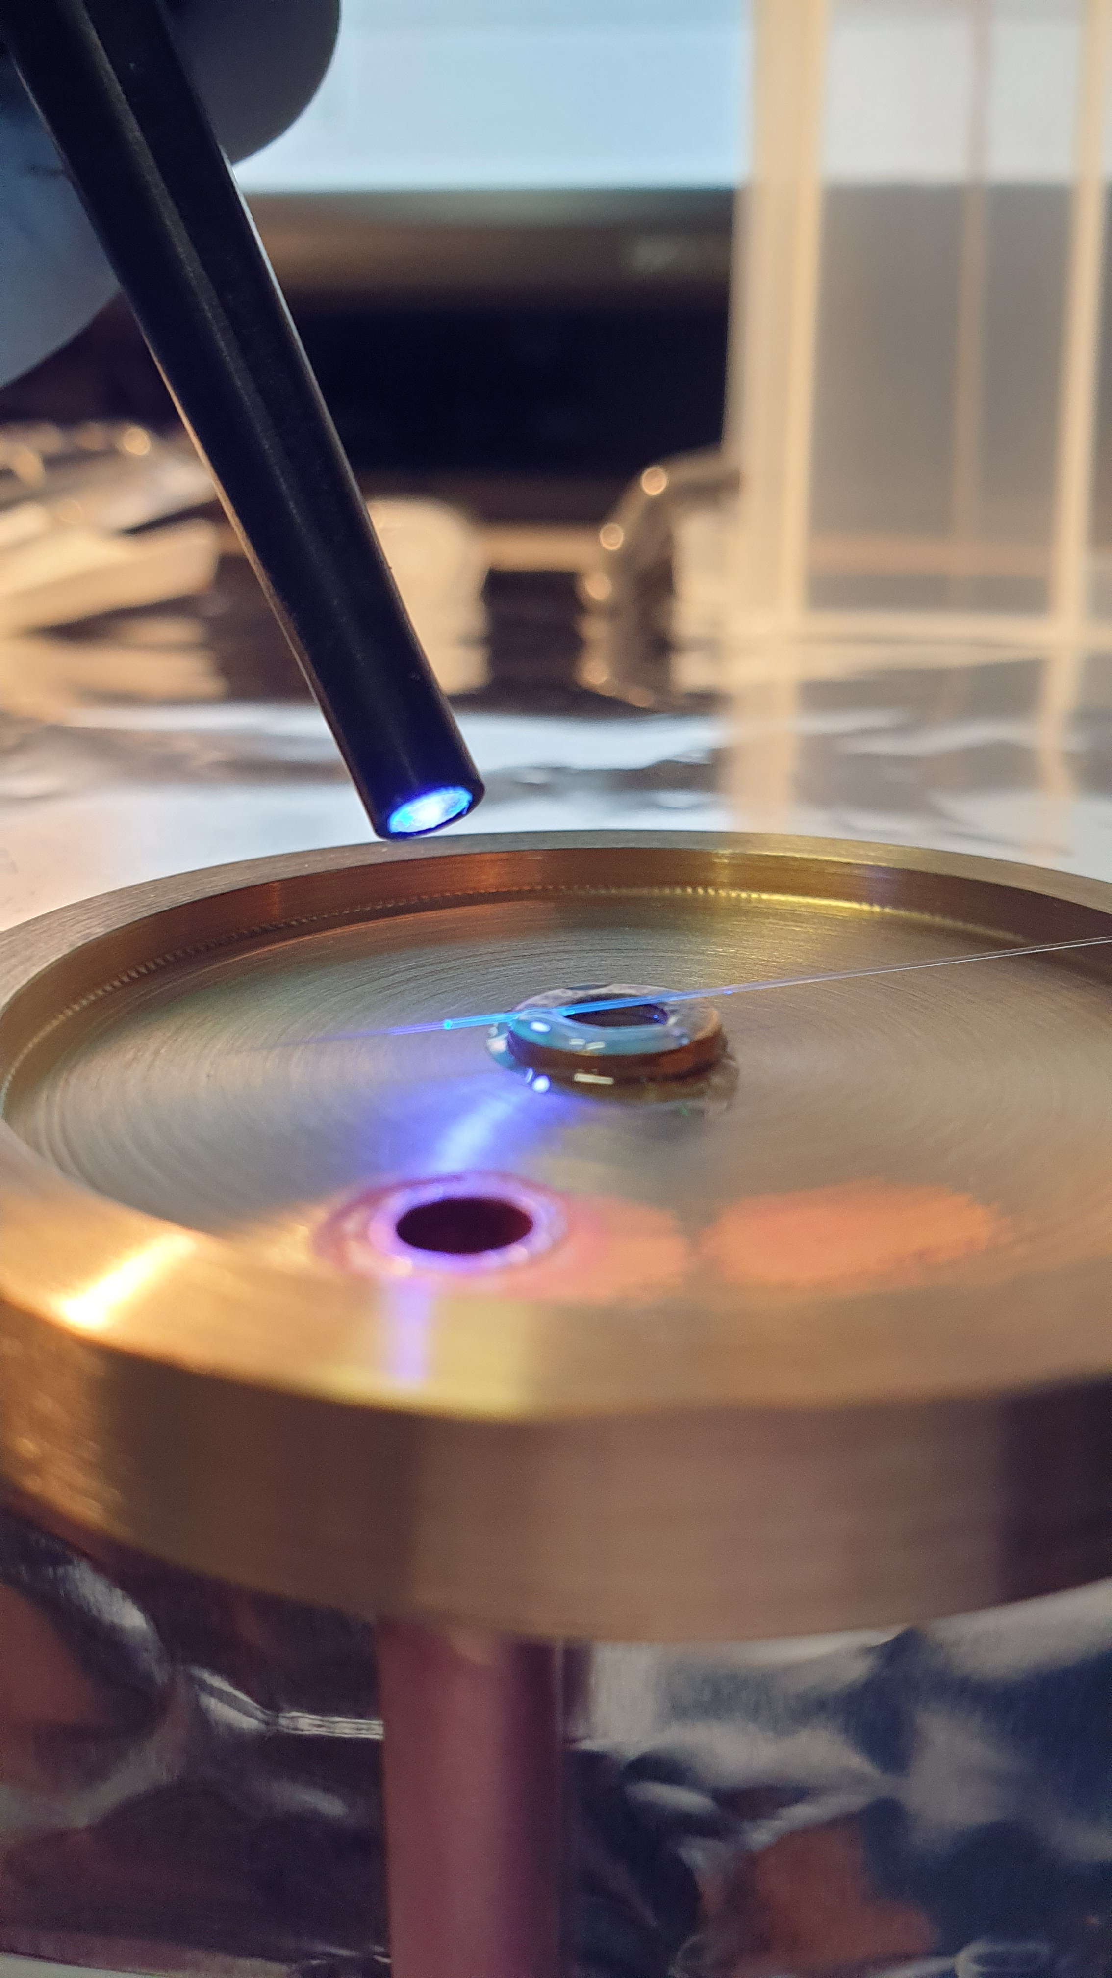
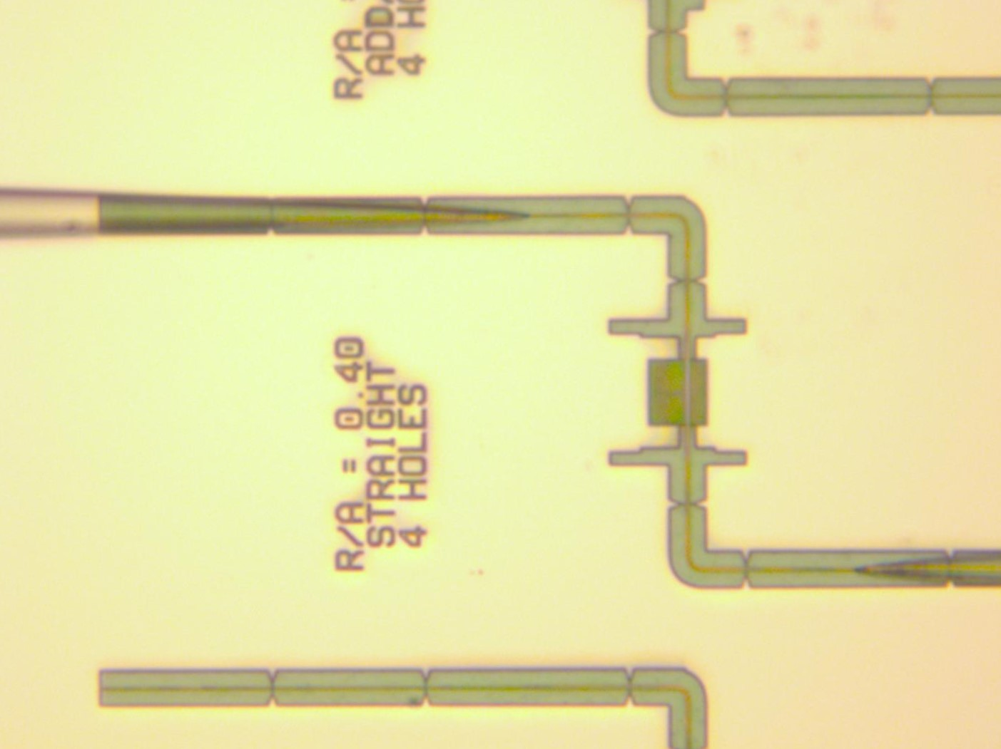
Integration and packaging

Slide 15
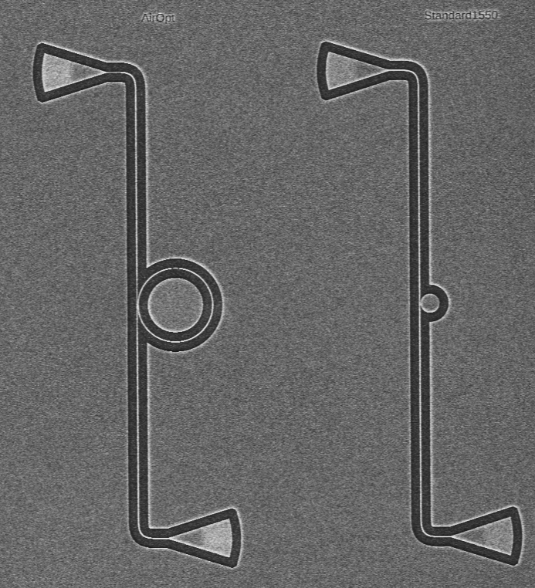
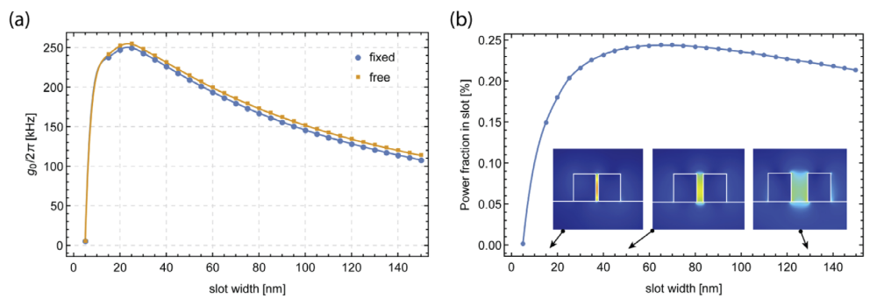
Built on silicon on insulator (SOI) platform
(Predicted parameters:)
g₀/2π up to 250 kHz
C₀>1
2 μm
G. I. Harris, A. Sawadsky, Y. L. Sfendla, W. W. Wasserman, W. P. Bowen, and C. G. Baker, Proposal for a Quantum Traveling Brillouin Resonator, Opt. Express, 28, 22450 (2020).

Slide 16
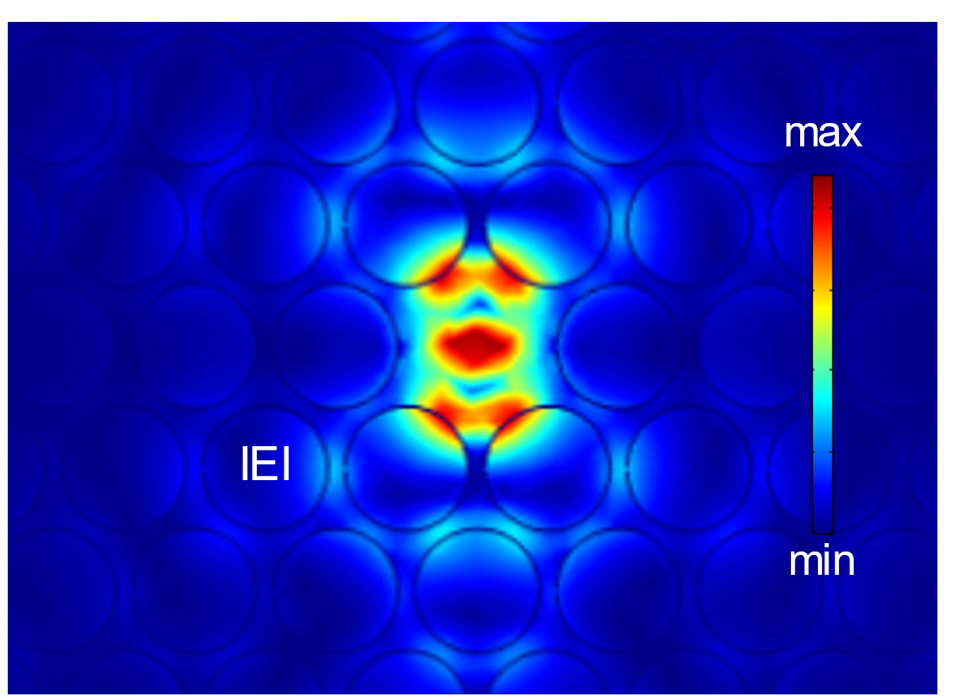
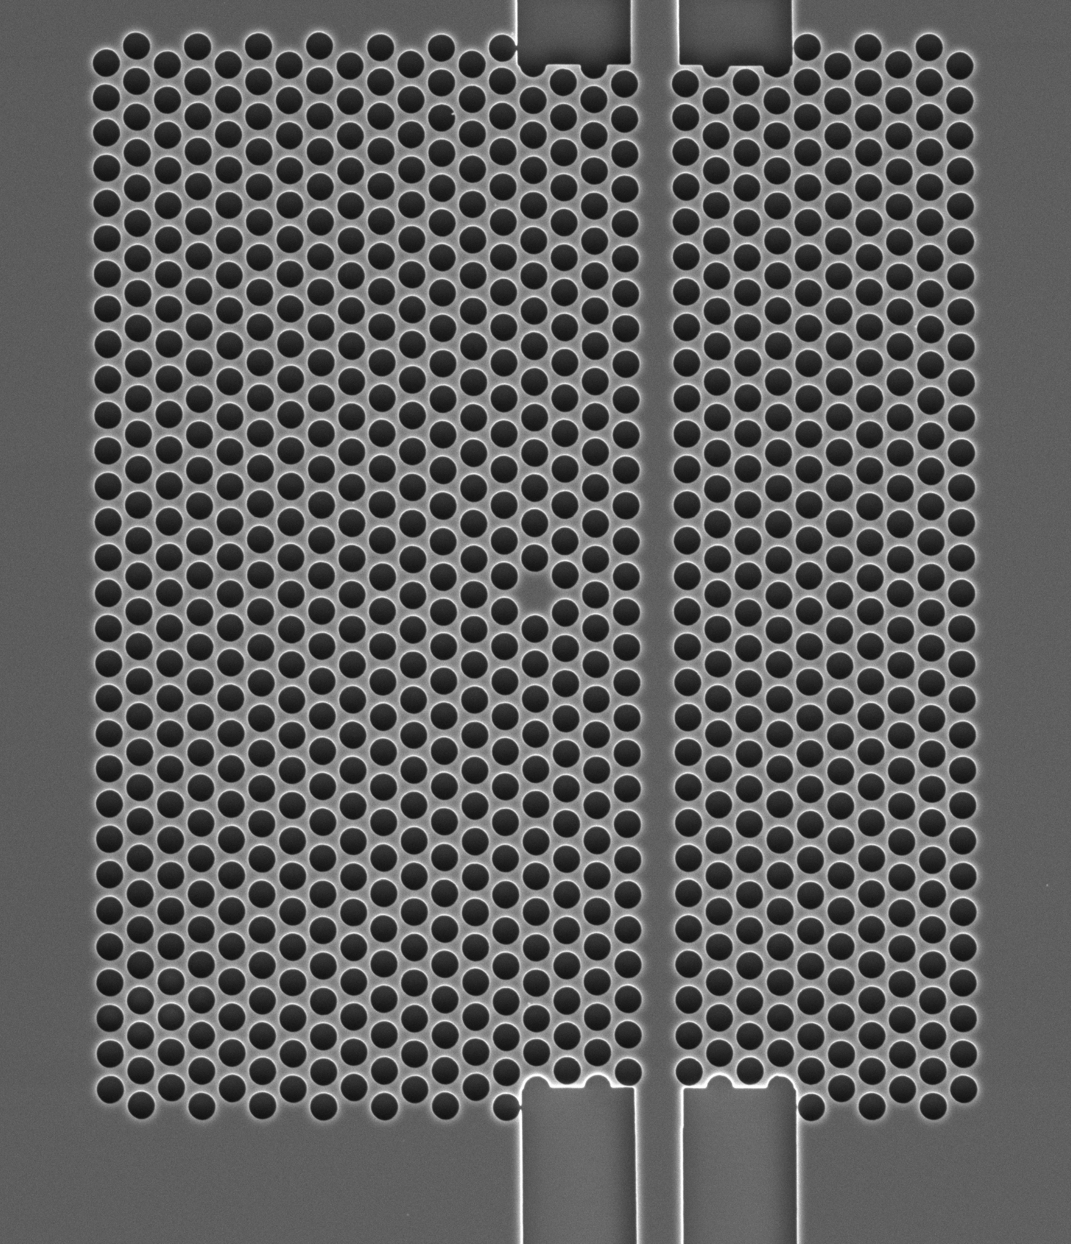
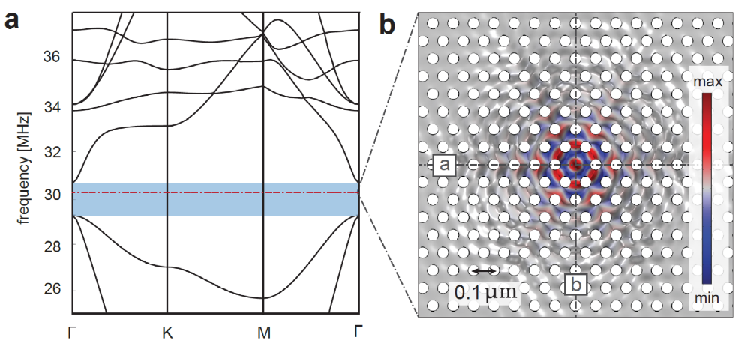
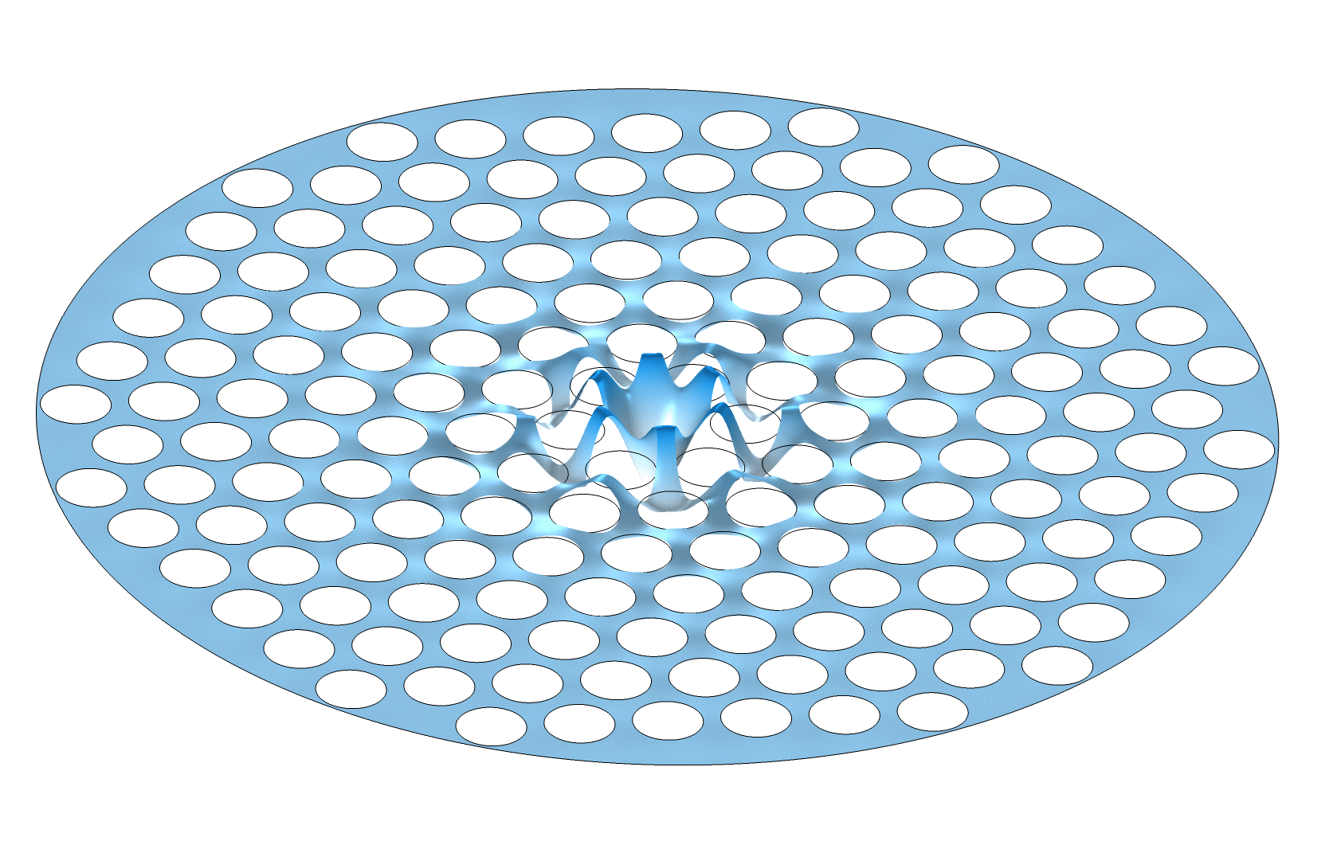
Superfluid Phononic mode
Photonic mode
Defect cavity
5 μm
Y. L. Sfendla et al, Extreme Quantum Nonlinearity in Superfluid Thin-Film Surface Waves, Npj Quantum Information 7, 1 (2021).

Slide 17
Conclusion

Slide 18
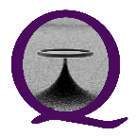
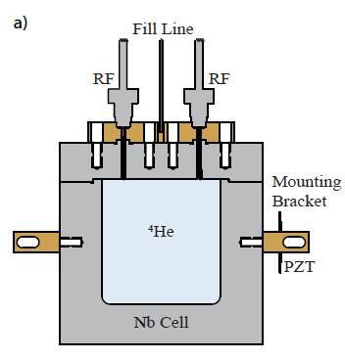
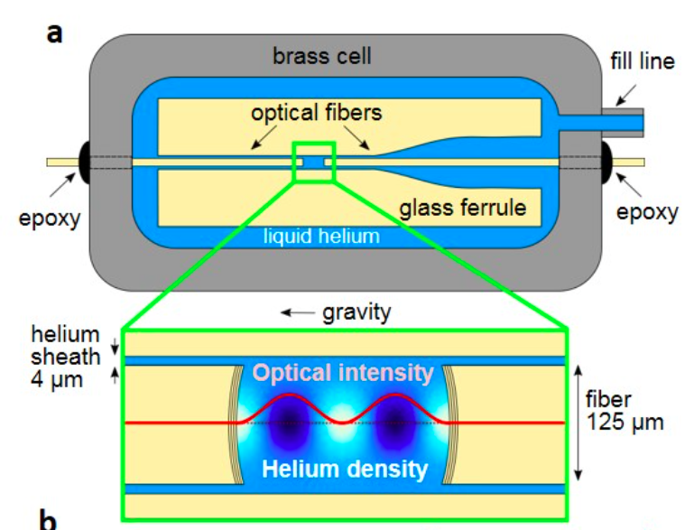
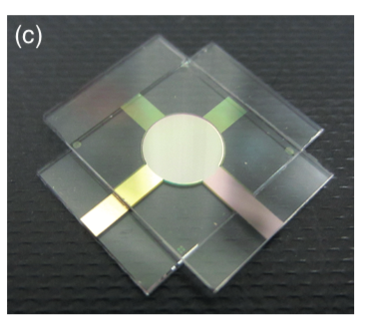
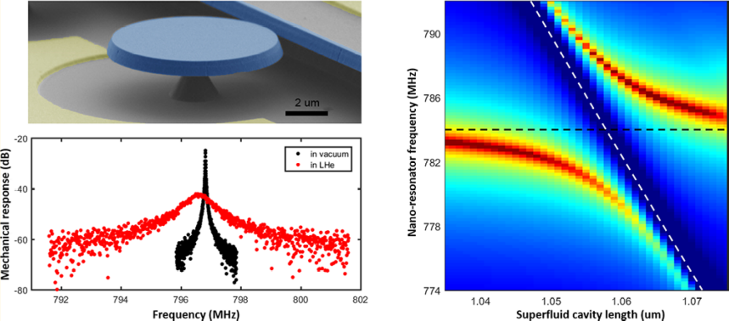
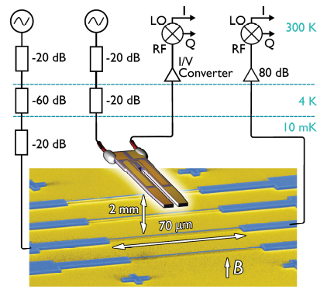
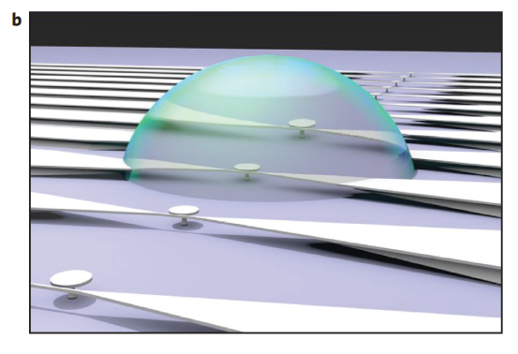
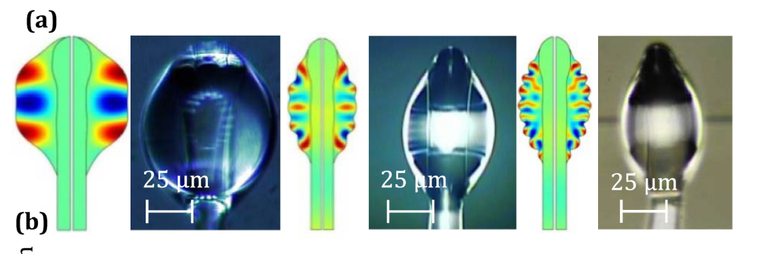
(Super)fluid optomechanics
De Lorenzo, L. A., and K. C. Schwab. "Superfluid optomechanics: coupling of a superfluid to a superconducting condensate." New Journal of Physics 16,11, 113020 (2014)
A.D. Kashkanova et al, Nature Physics 13, 74-79 (2017).
A. B. Shkarin et al, Quantum Optomechanics in a Liquid, Phys. Rev. Lett. 122, 153601 (2019).
Ultra-Low Dissipation Superfluid Micromechanical Resonator, F. Souris, X. Rojas, P.H. Kim and J.P Davis, Phys. Rev. Applied 7, 044008 (2017).
K. Y. Fong, D. Jin, M. Poot, A. Bruch, and H. X. Tang, Phonon Coupling between a Nanomechanical Resonator and a Quantum Fluid, Nano Lett. 19, 3716 (2019).
A. Guthrie et al, Nanoscale Real-Time Detection of Quantum Vortices at Millikelvin Temperatures, Nature Communications 12, 1 (2021).
E. Gil-Santos et al, High-Frequency Nano-Optomechanical Disk Resonators in Liquids, Nat Nano 10, 810 (2015).
S. Kaminski et al, Ripplon Laser through Stimulated Emission Mediated by Water Waves, Nature Photonics 10, 758 (2016).
R. Dahan, L. L. Martin, and T. Carmon, Droplet Optomechanics, Optica 3, 175 (2016).

