Slide 1
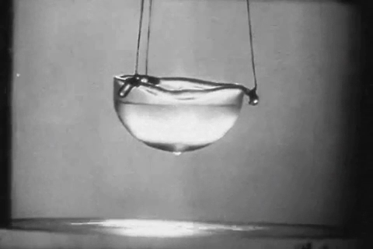
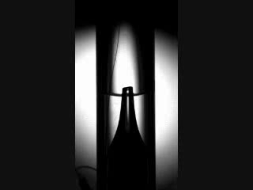
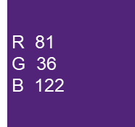


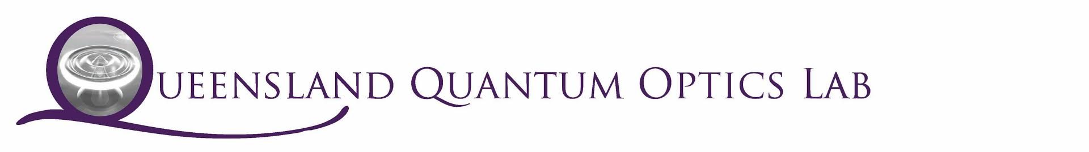

Confining sound in superfluids via optomechanics
AIP/ANZCOP 2022
Raymond Harrison, Walter Wasserman, Glen Harris, Andreas Sawadsky, Warwick Bowen & Christopher Baker

Slide 2
Outline
Superfluid Optomechanics
Fountain Pressure
Eigen-optomechanics
Experimental Design

Slide 3
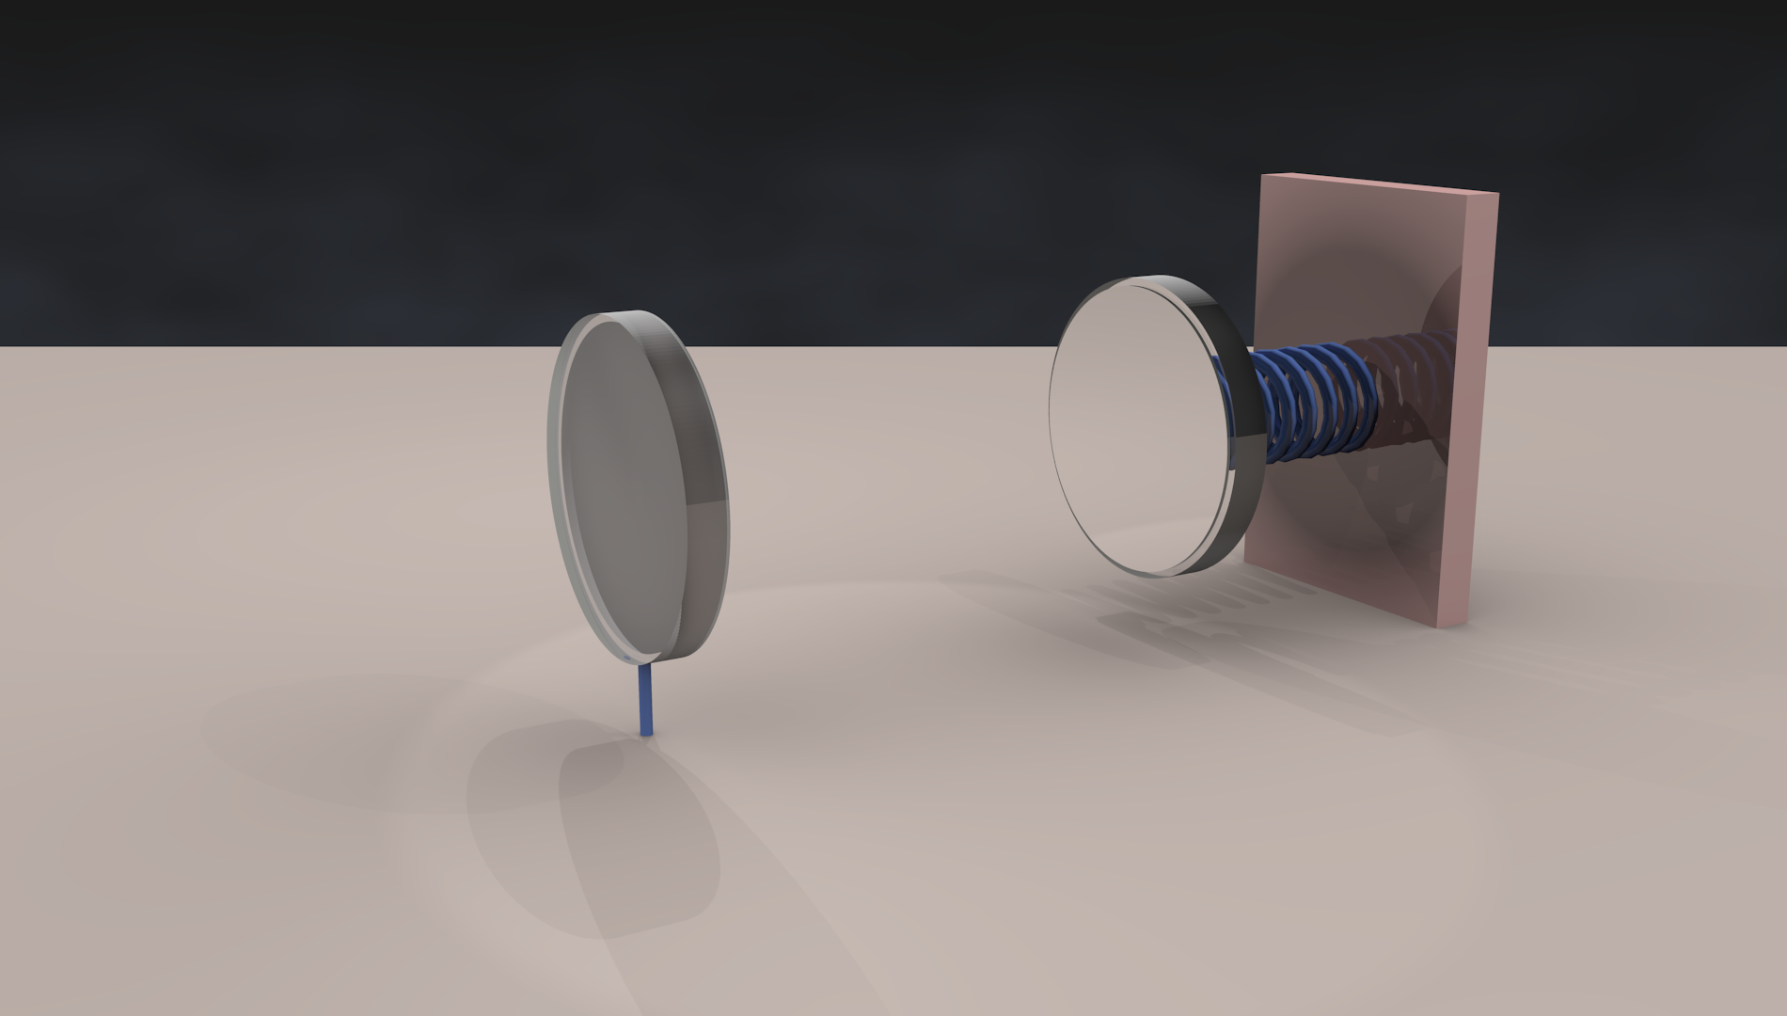
Cavity optomechanics
AIP/ANZCOP 2022

Slide 4
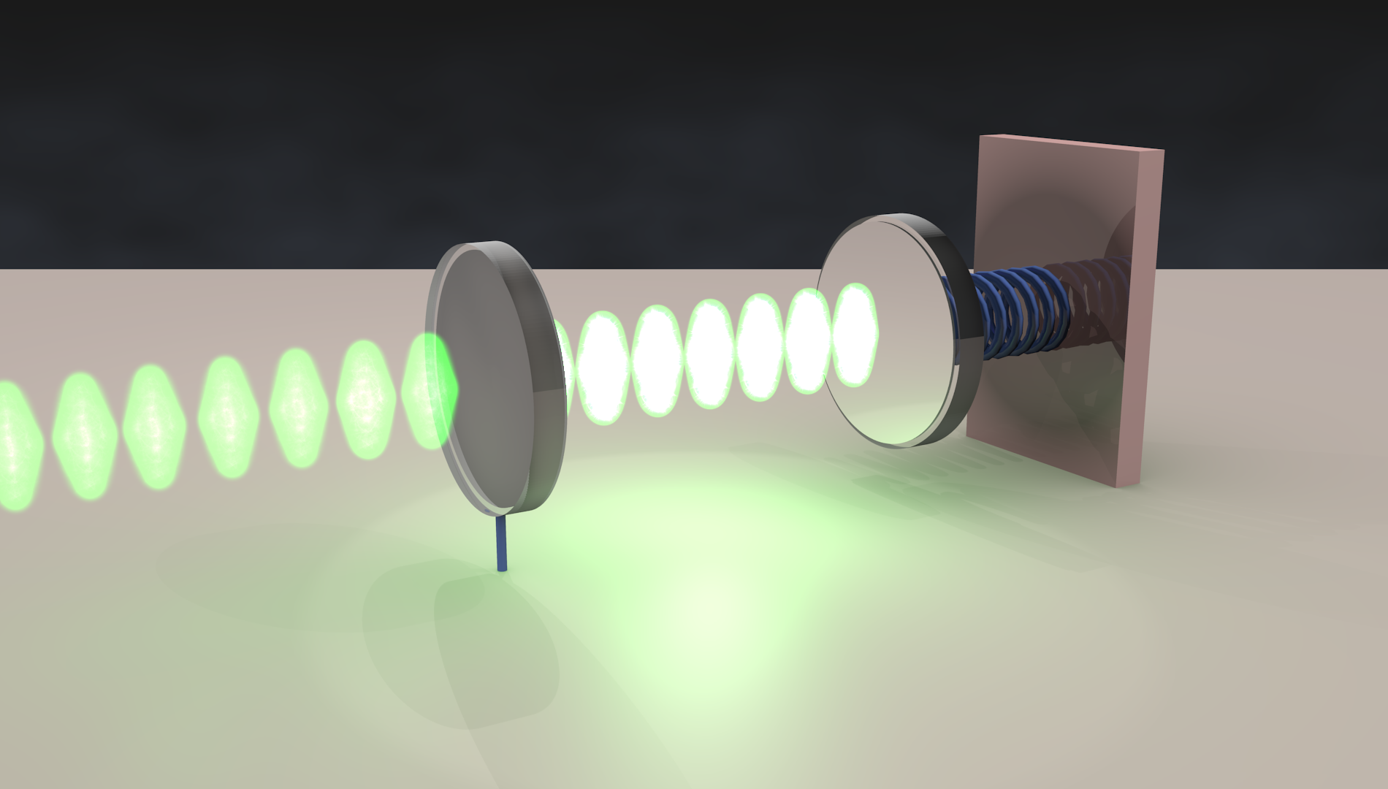
Cavity optomechanics
AIP/ANZCOP 2022

Slide 5
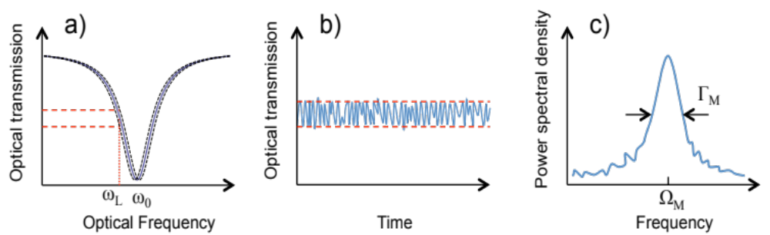
Optomechanical sensing
AIP/ANZCOP 2022

Slide 6
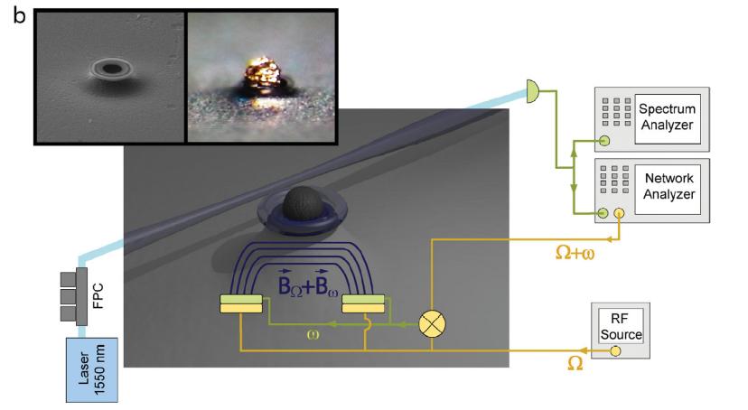
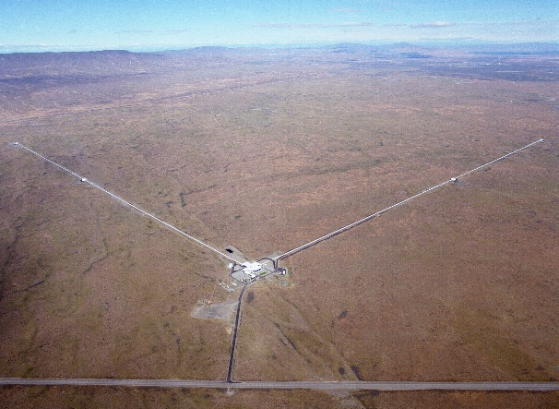
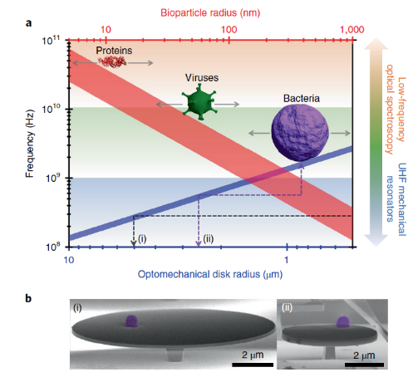
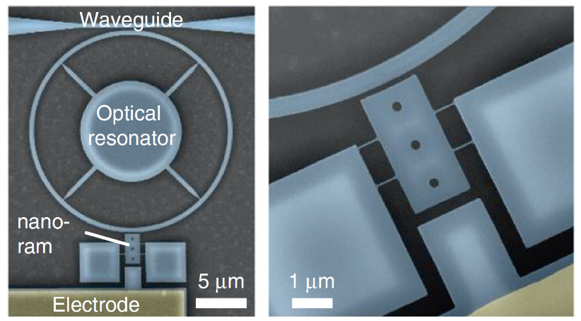
Applications
S. Forstner, E. Sheridan, J. Knittel, C. L. Humphreys, G. A. Brawley, H. Rubinsztein-Dunlop, and W. P. Bowen, Ultrasensitive Optomechanical Magnetometry, Adv. Mater. 26, 6348 (2014).
LIGO Scientific Collaboration and Virgo Collaboration,, Observation of Gravitational Waves from a Binary Black Hole Merger, Phys. Rev. Lett. 116, 061102 (2016).
E. Gil-Santos, J. J. Ruz, O. Malvar, I. Favero, A. Lemaître, P. M. Kosaka, S. García-López, M. Calleja, and J. Tamayo, Optomechanical Detection of Vibration Modes of a Single Bacterium, Nature Nanotechnology 15, 6 (2020).
M. Sansa, M. Defoort, A. Brenac, M. Hermouet, L. Banniard, A. Fafin, M. Gely, C. Masselon, I. Favero, G. Jourdan, and S. Hentz, Optomechanical Mass Spectrometry, Nature Communications 11, 1 (2020).
AIP/ANZCOP 2022
6

Slide 7
Challenges in Optomechanics
Weak optical forces
Rigid materials

Slide 8
Superfluid Optomechanics
Highly complaint mechanics
Strong optical forcing
Eigenmode Optomechanics
Notes:
Strong forces compliance, and even, as ill discuss in the second part of this talk, the ability to optically define sound modes altogether
Ill show how in the first part of this talk Strong forces compliance this can be use to demonstrate the lowest threshold phonon laser to date, and in the second part of this talk
The forces can be strong enough and the fluid compliant enough that these this optical interaction can go beyond simply probing and driving pre-existing acoustic/mechanical modes but actually define its own acoustic landscape progress towards that goal

Slide 9
Self assembly
AIP/ANZCOP 2022

Slide 10
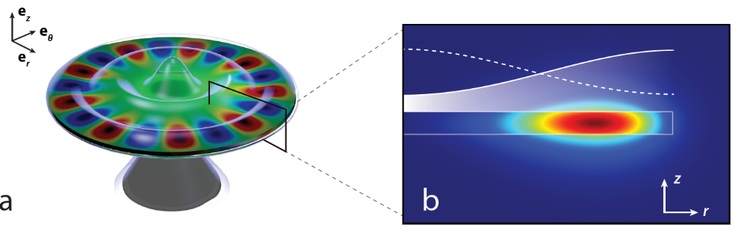
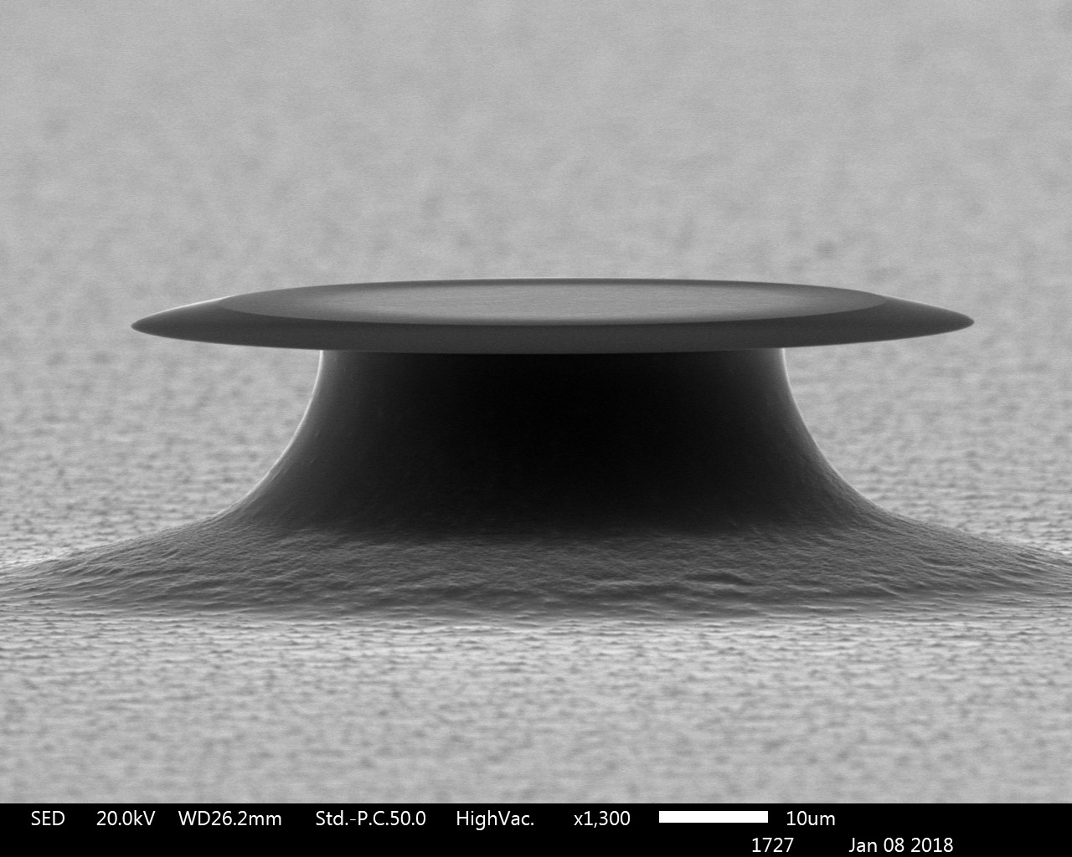
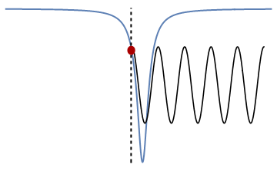
Experimental scheme
10 μm
New Journal of Physics, 18(12):123025, 2016
AIP/ANZCOP 2022

Slide 11
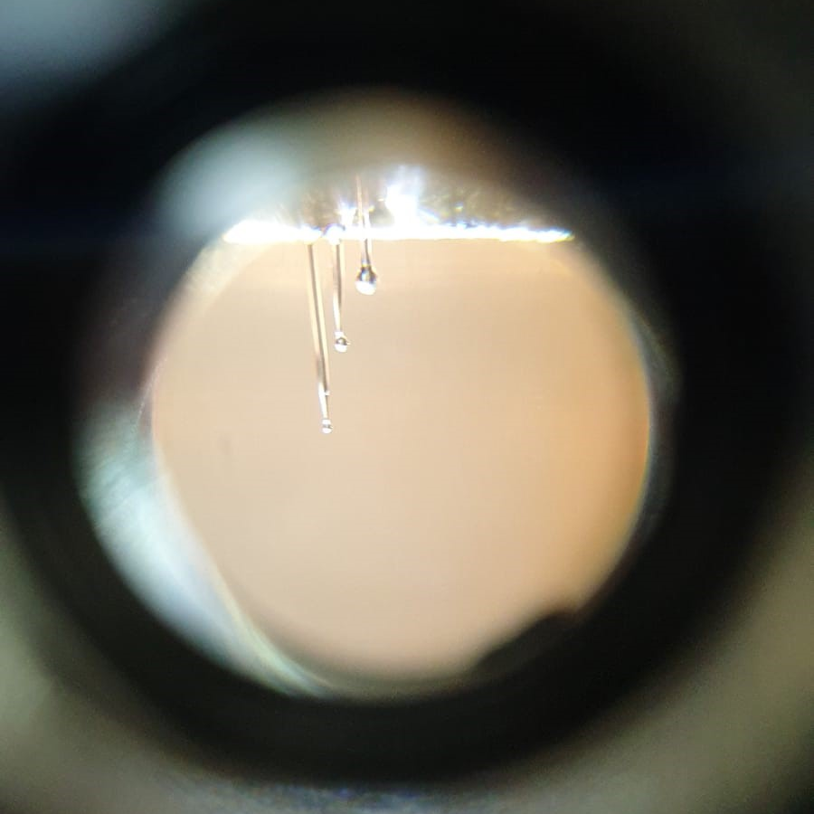
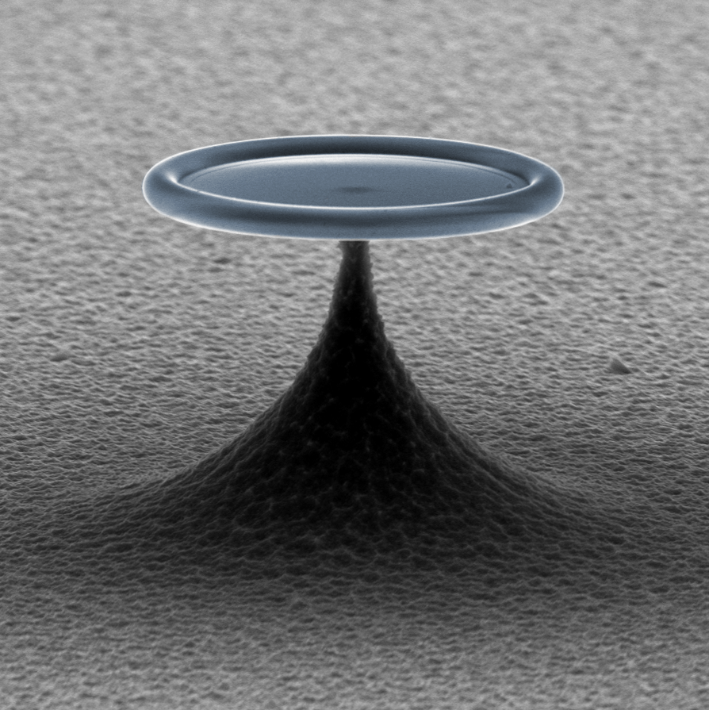
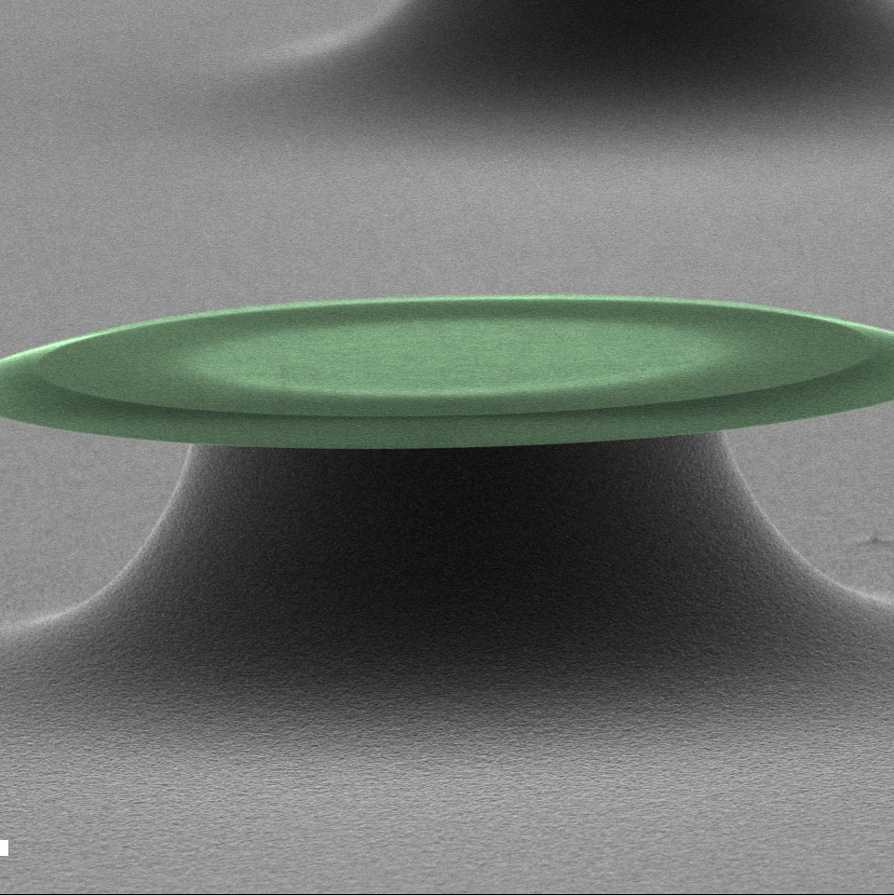
Experimental Geometries
Nature Physics 12, 788, 2016
Physical Review X, 6:021012, 2016
New J. Phys. 18, 123025, 2016.
New J. Phys. 21, 053029, 2019.
Science 366, 1480, 2019.
Nature Physics 16, 4 2020.
Npj Quantum Information 7, 1 2021.
AIP/ANZCOP 2022

Slide 12
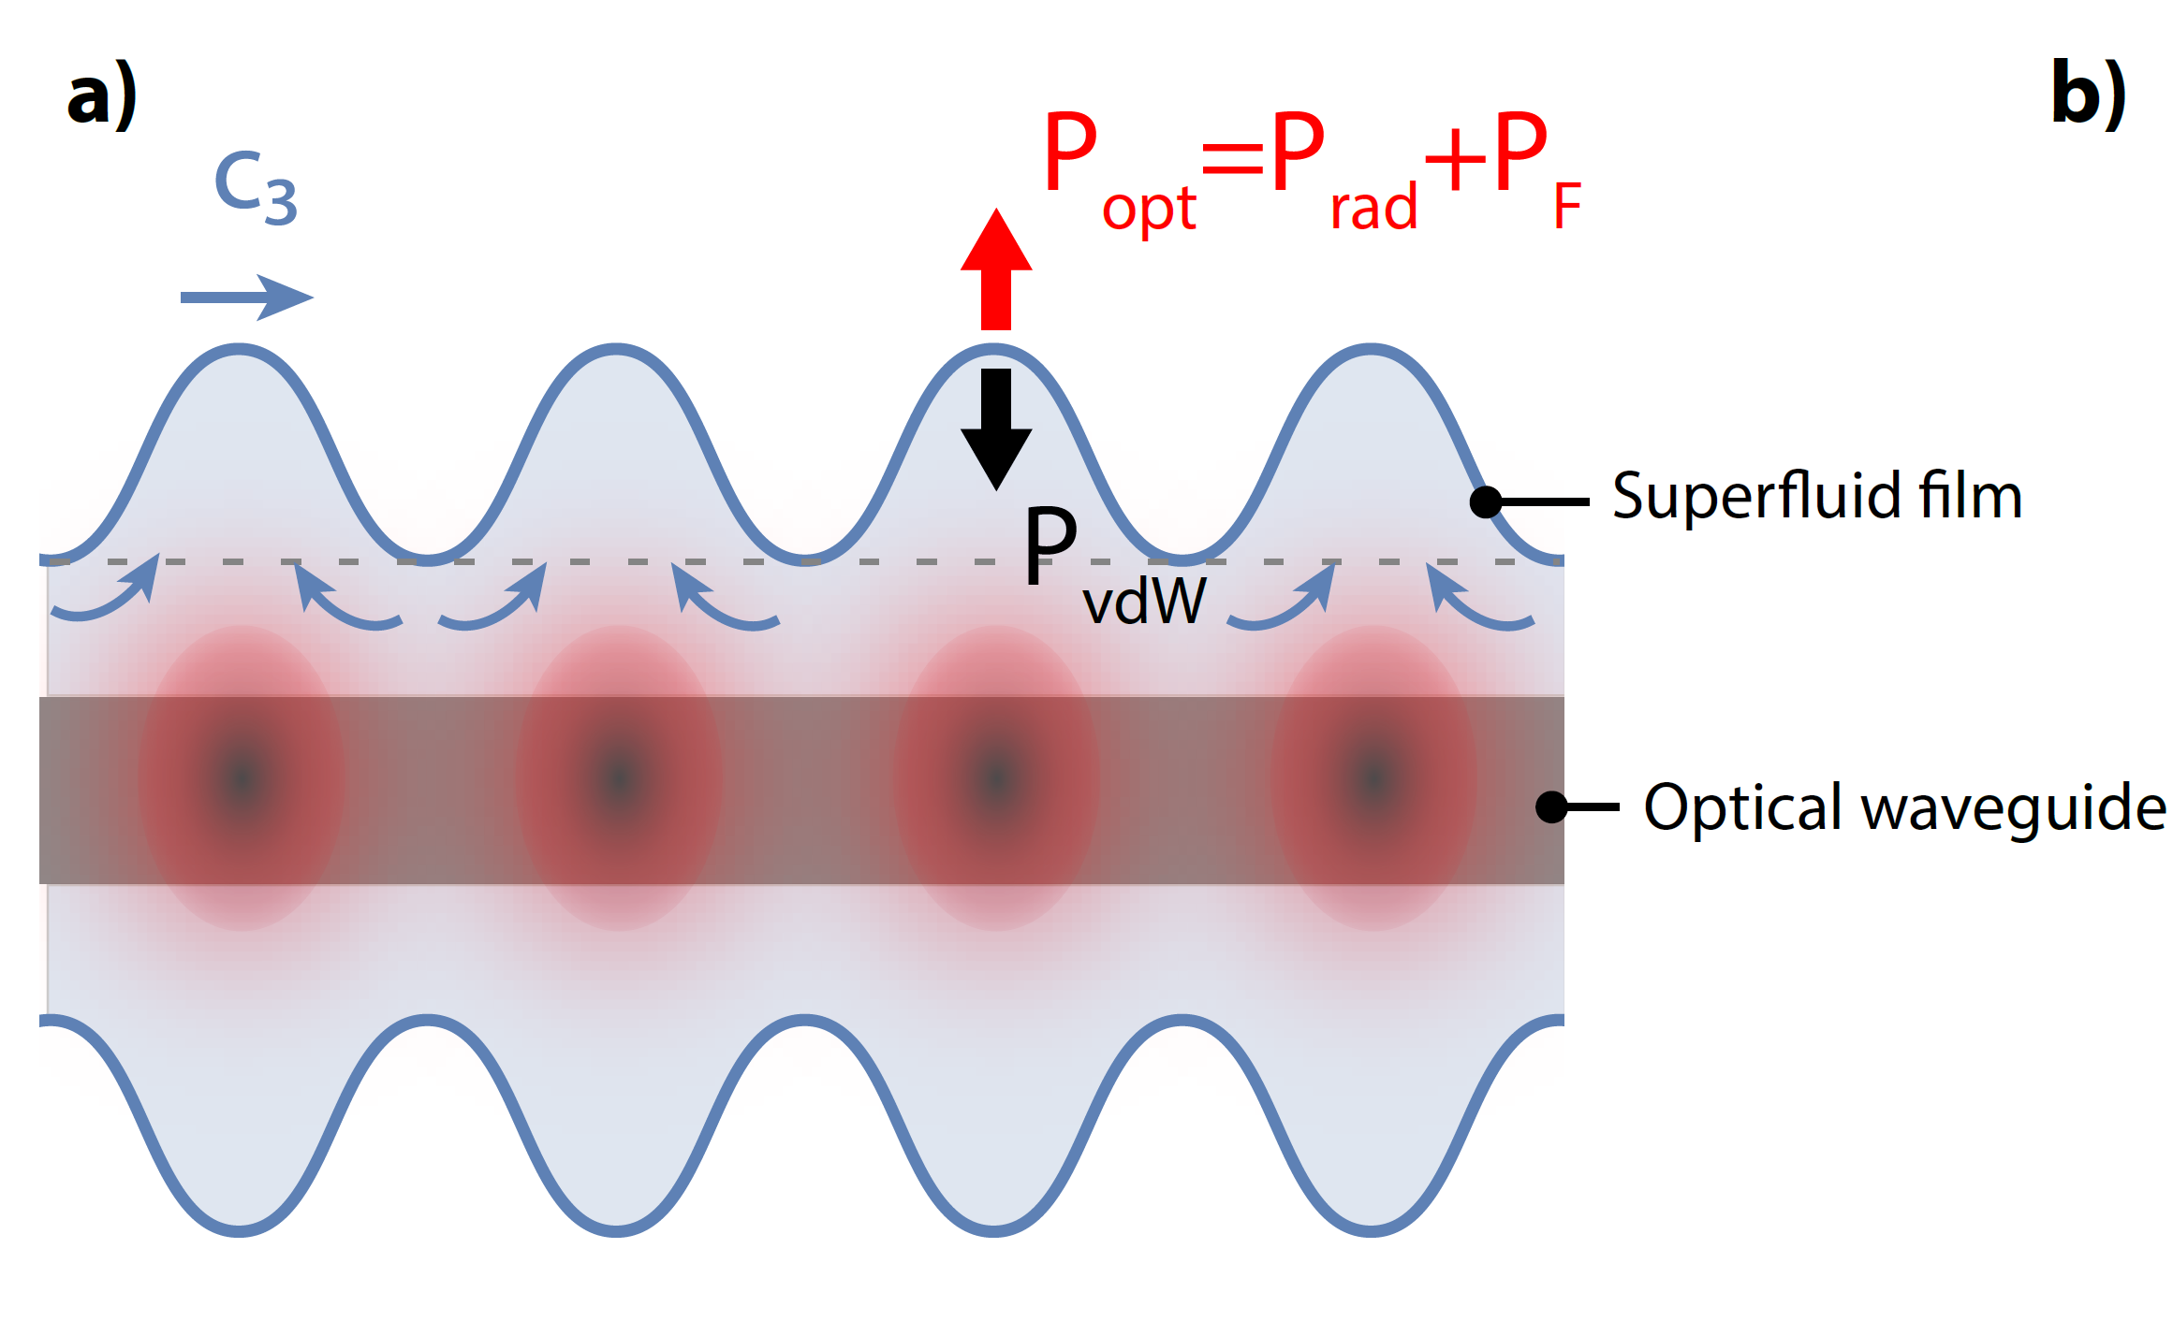
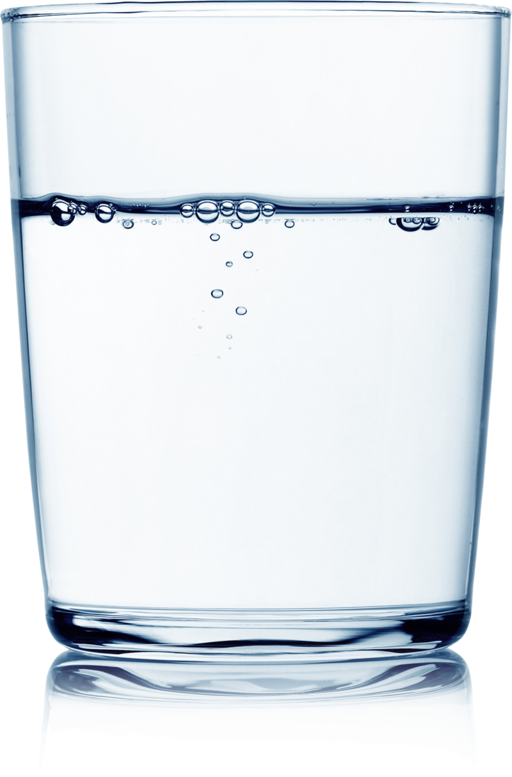
High compliance
Stiffness ~kPa
Stiffness ~100 GPa
AIP/ANZCOP 2022

Slide 13
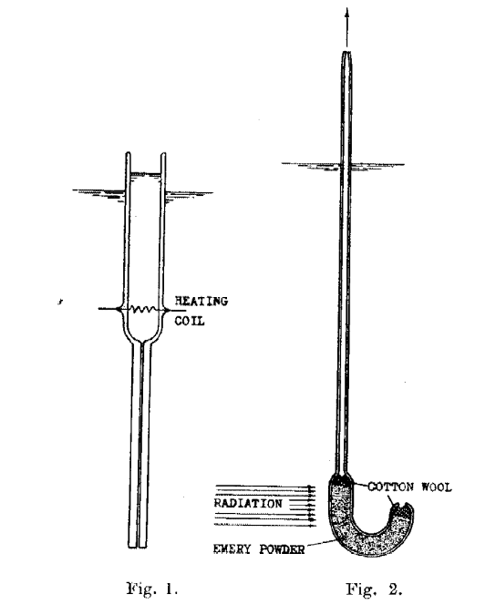
Fountain pressure optomechanics
J. F. Allen and H. Jones, New Phenomena Connected with Heat Flow in Helium II, Nature 141, 243 (1938).
AIP/ANZCOP 2022

Slide 14
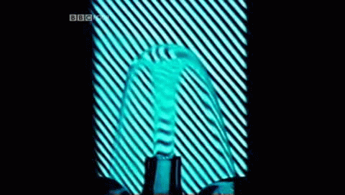
Fountain pressure optomechanics
$$ΔP=ρSΔT$$
J. F. Allen and H. Jones, New Phenomena Connected with Heat Flow in Helium II, Nature 141, 243 (1938).
H. London, Thermodynamics of the Thermomechanical Effect of Liquid He II, Proceedings of the Royal Society of London. Series A, Mathematical and Physical Sciences 484 (1939).
AIP/ANZCOP 2022

Slide 15
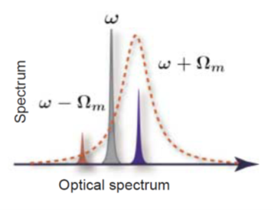



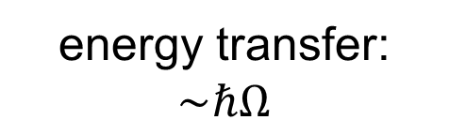
Radiation Pressure vs Fountain Pressure
radiation pressure force
$$F_{rad}$$
mechanics
light
$$Ω$$
$$ω$$
energy transfer: $\sim ℏΩ$
AIP/ANZCOP 2022

Slide 16




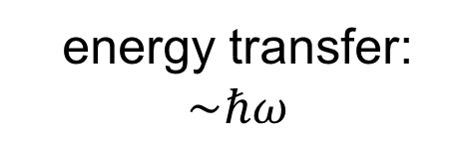
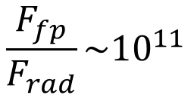
Radiation Pressure vs Fountain Pressure
radiation pressure force
fountain pressure force
$$F_{rad}$$
$$F_{fp}$$
energy transfer: $\sim ℏω$
mechanics
light
photon absorption
$$Ω$$
$$ω$$
energy transfer: $\sim ℏΩ$
Example:
$$\frac{F_{fp}}{F_{rad}}\sim {10}^{11}$$
$$Ω\sim kHz$$
$$ω\sim THz$$
AIP/ANZCOP 2022

Slide 17
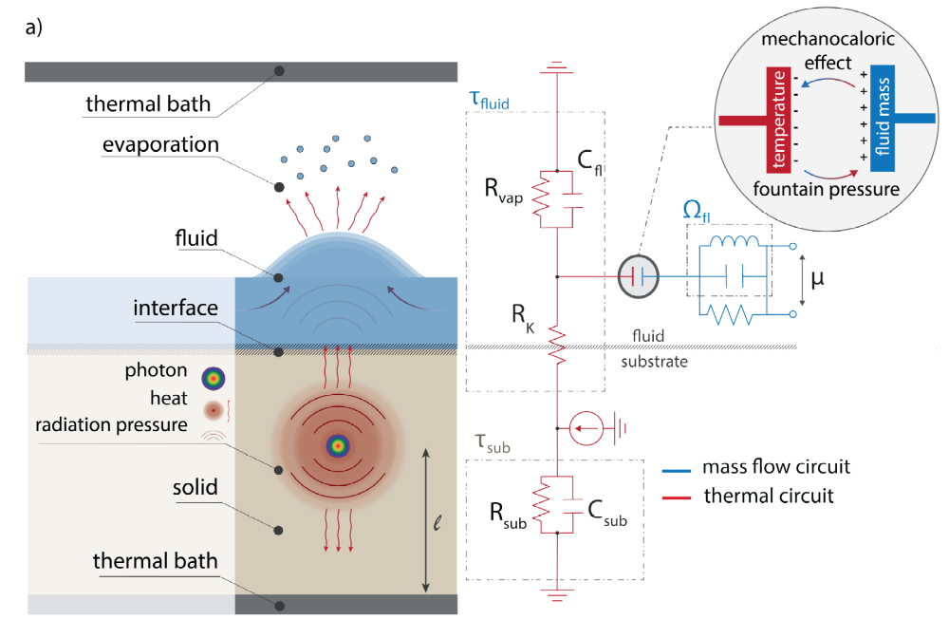
Thermal Modelling
A. Sawadsky, R. A. Harrison, G. I. Harris, W. W. Wasserman, Y. L. Sfendla, W. P. Bowen, and C. G. Baker, Engineered Entropic Forces Allow Ultrastrong Dynamical Backaction, arXiv:2208.05660, Aug (2022).
AIP/ANZCOP 2022

Slide 18
Thermal Modelling
A. Sawadsky, R. A. Harrison, G. I. Harris, W. W. Wasserman, Y. L. Sfendla, W. P. Bowen, and C. G. Baker, Engineered Entropic Forces Allow Ultrastrong Dynamical Backaction, arXiv:2208.05660, Aug (2022).
AIP/ANZCOP 2022

Slide 19
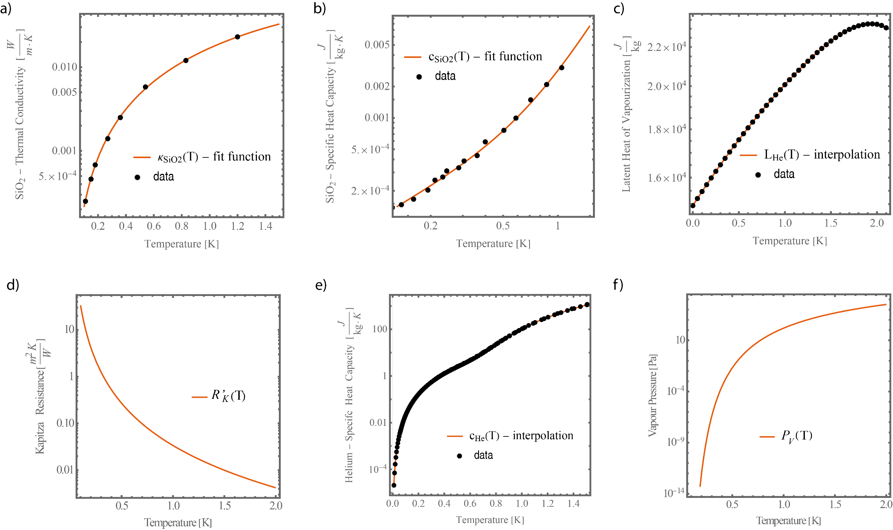
Thermal Properties
A. Sawadsky, R. A. Harrison, G. I. Harris, W. W. Wasserman, Y. L. Sfendla, W. P. Bowen, and C. G. Baker, Engineered Entropic Forces Allow Ultrastrong Dynamical Backaction, arXiv:2208.05660, Aug (2022).
AIP/ANZCOP 2022

Slide 20
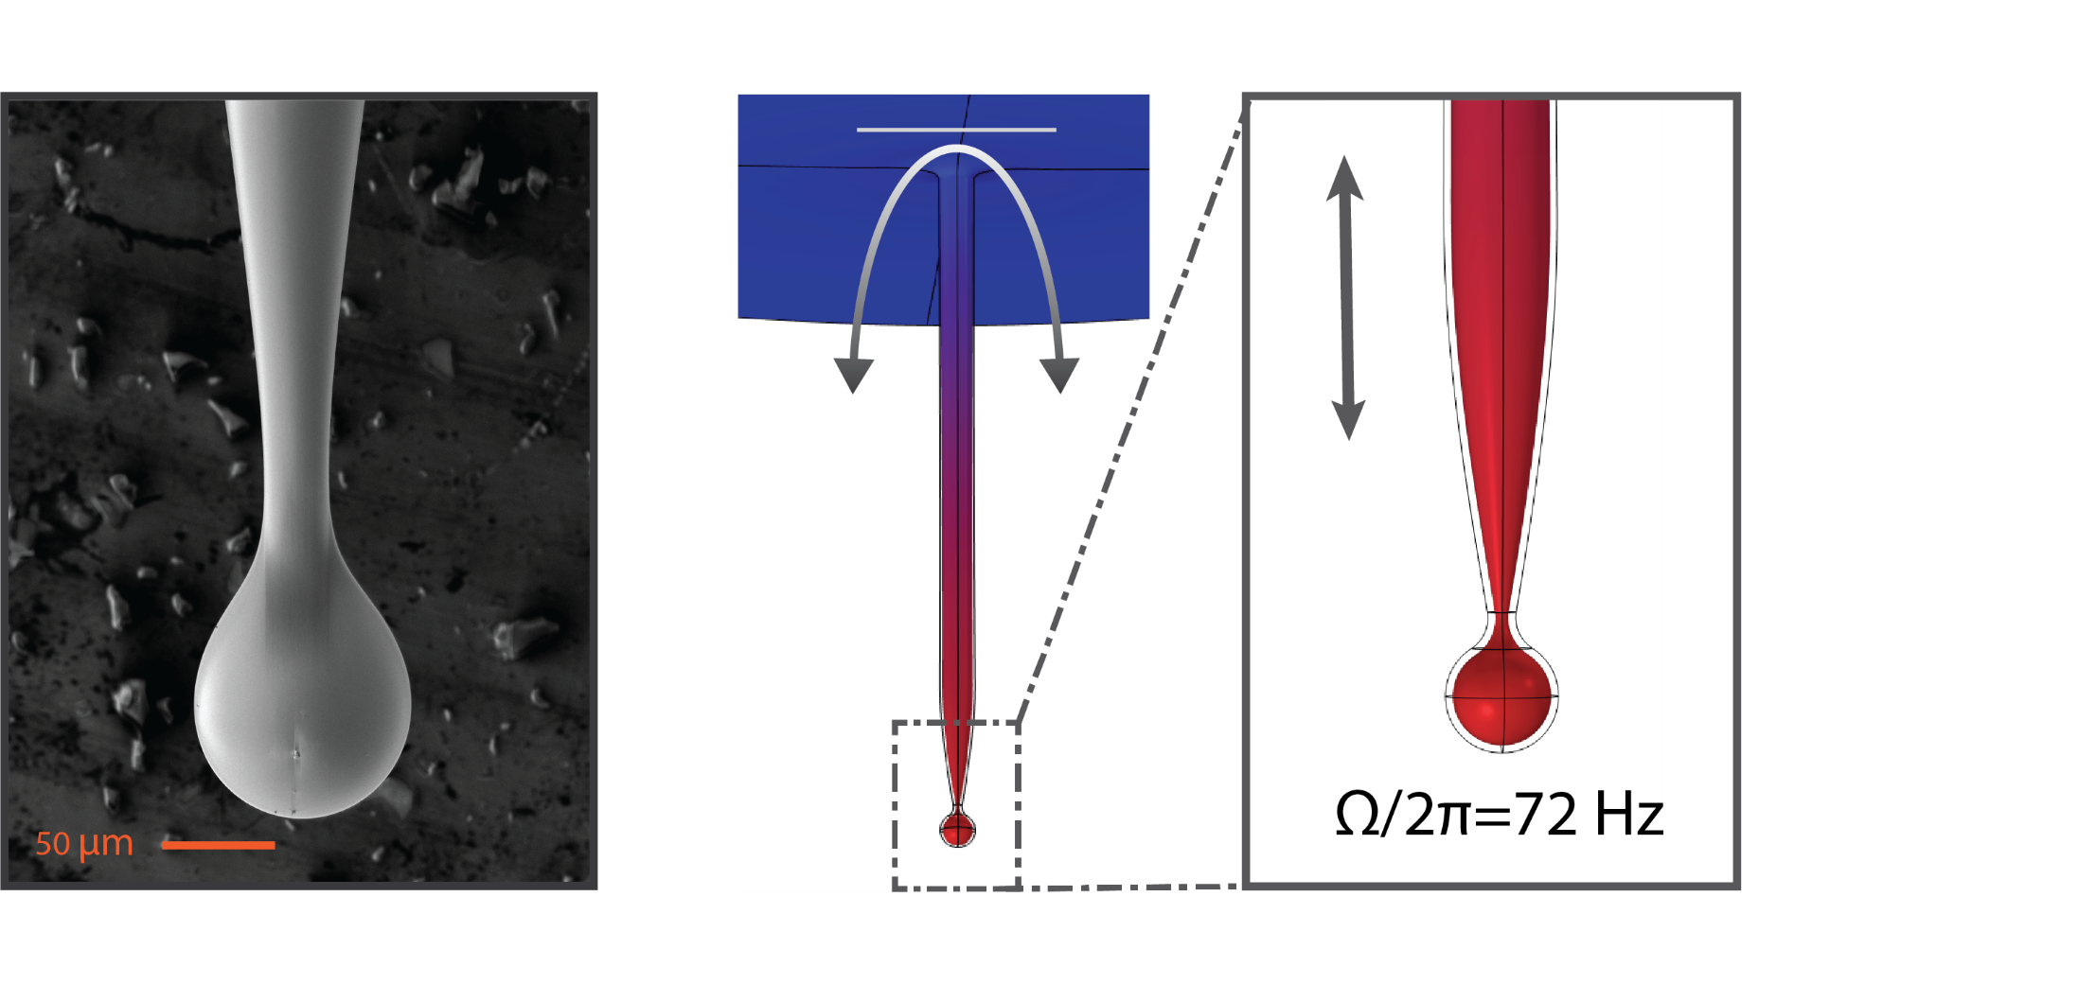
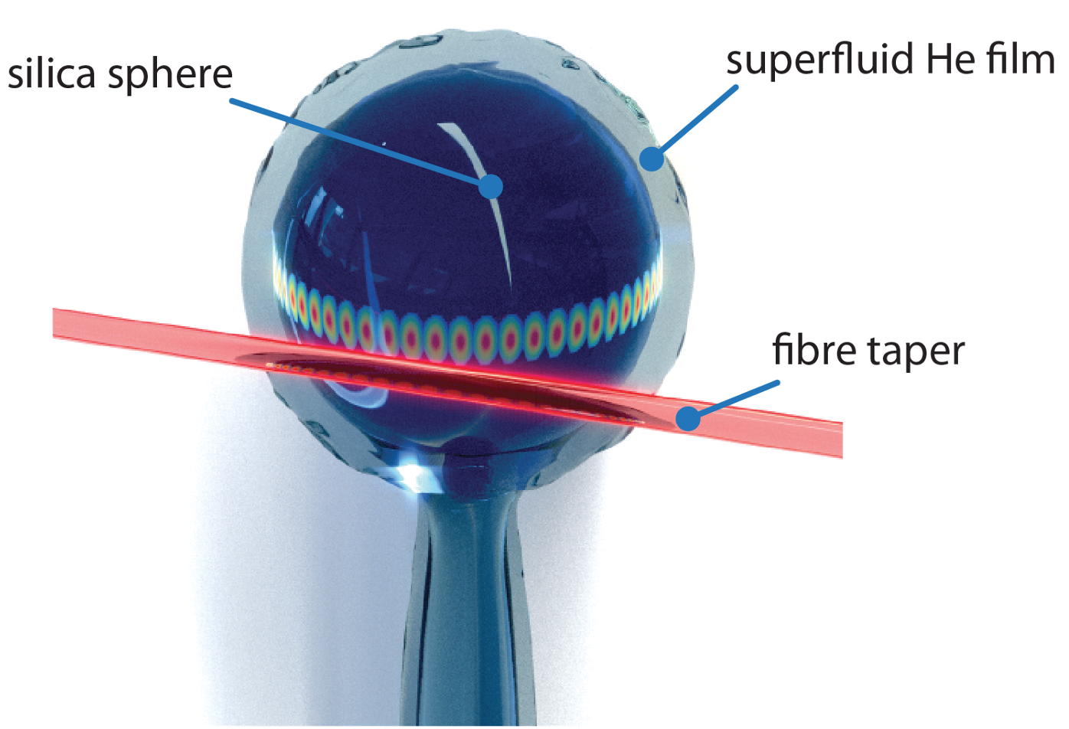
Superfluid optomechanical system
A. Sawadsky, R. A. Harrison, G. I. Harris, W. W. Wasserman, Y. L. Sfendla, W. P. Bowen, and C. G. Baker, Engineered Entropic Forces Allow Ultrastrong Dynamical Backaction, arXiv:2208.05660, Aug (2022).
AIP/ANZCOP 2022

Slide 21
Superfluid optomechanical system – Helmholtz mode
A. Sawadsky, R. A. Harrison, G. I. Harris, W. W. Wasserman, Y. L. Sfendla, W. P. Bowen, and C. G. Baker, Engineered Entropic Forces Allow Ultrastrong Dynamical Backaction, arXiv:2208.05660, Aug (2022).
AIP/ANZCOP 2022

Slide 22
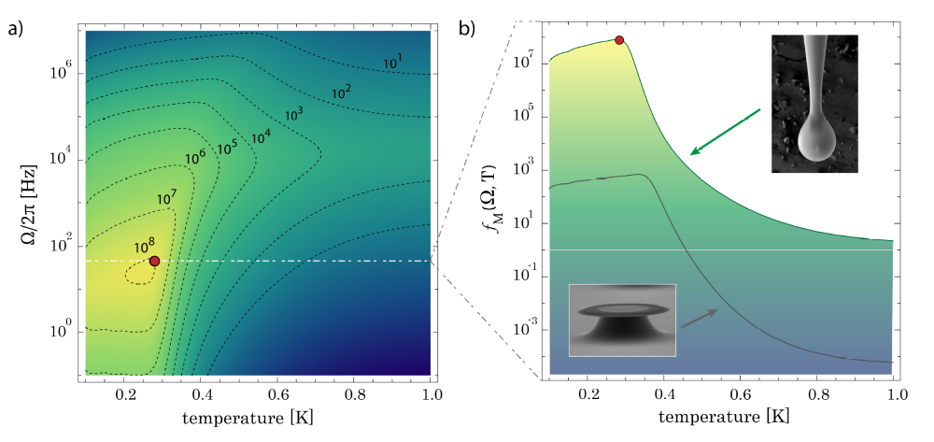
Fountain/radiation pressure
A. Sawadsky, R. A. Harrison, G. I. Harris, W. W. Wasserman, Y. L. Sfendla, W. P. Bowen, and C. G. Baker,
Engineered Entropic Forces Allow Ultrastrong Dynamical Backaction, arXiv:2208.05660, Aug (2022).
AIP/ANZCOP 2022
Notes:
Dot appears
A metric for the efficiency of the interaction is the so called phonon lasing threshold or regenerative oscillation threshold. It corresponds to the point at which the gain provided by the optomechanical interaction exceeds the intrinsic losses of the device

Slide 23
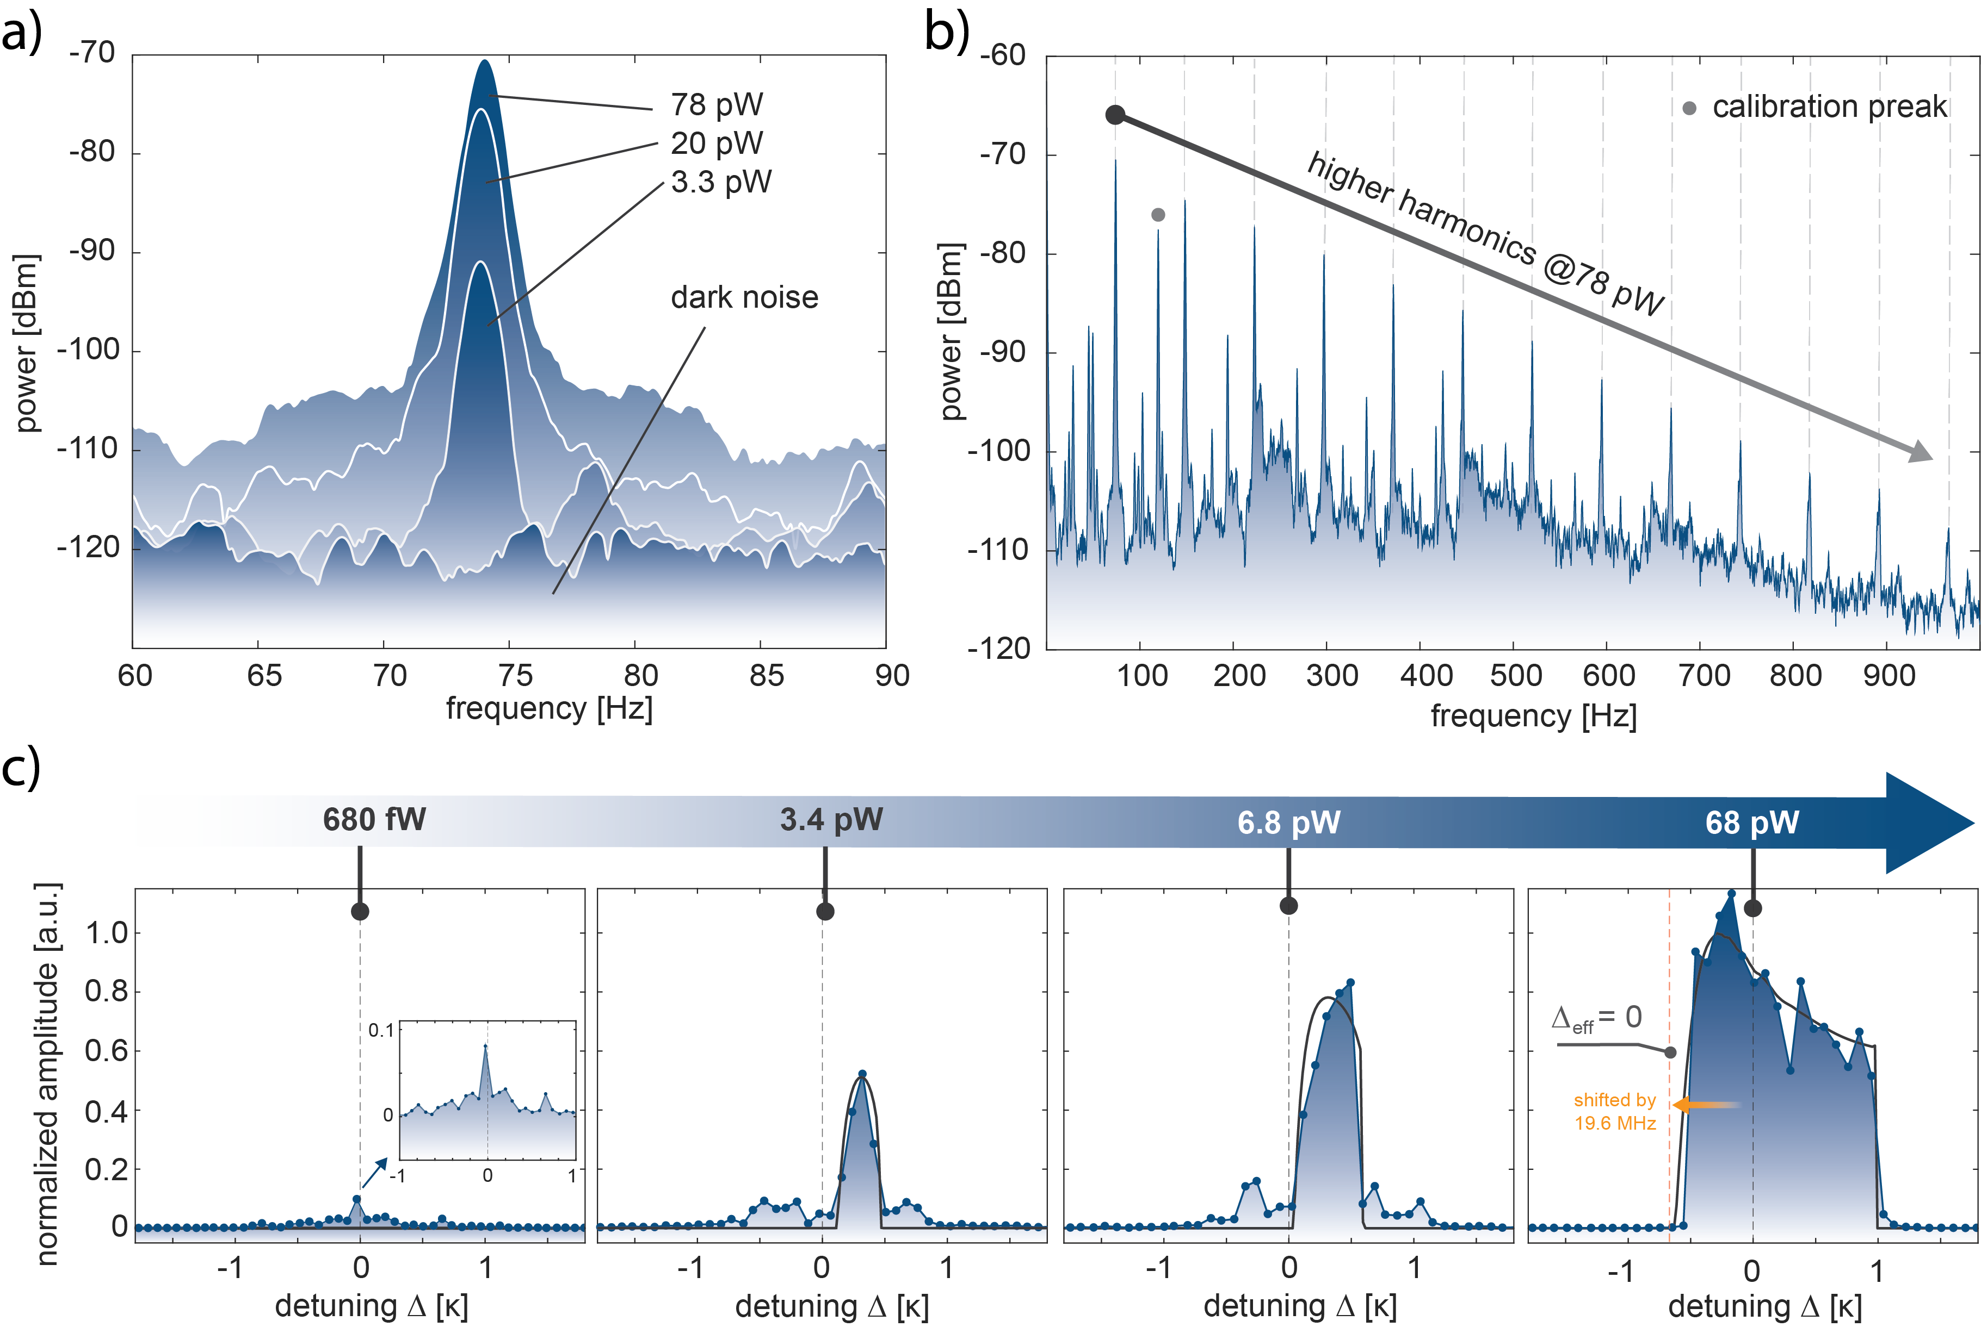
Ultrastrong Dynamical Backaction
A. Sawadsky, R. A. Harrison, G. I. Harris, W. W. Wasserman, Y. L. Sfendla, W. P. Bowen, and C. G. Baker, Engineered Entropic Forces Allow Ultrastrong Dynamical Backaction, arXiv:2208.05660, Aug (2022).
AIP/ANZCOP 2022

Slide 24
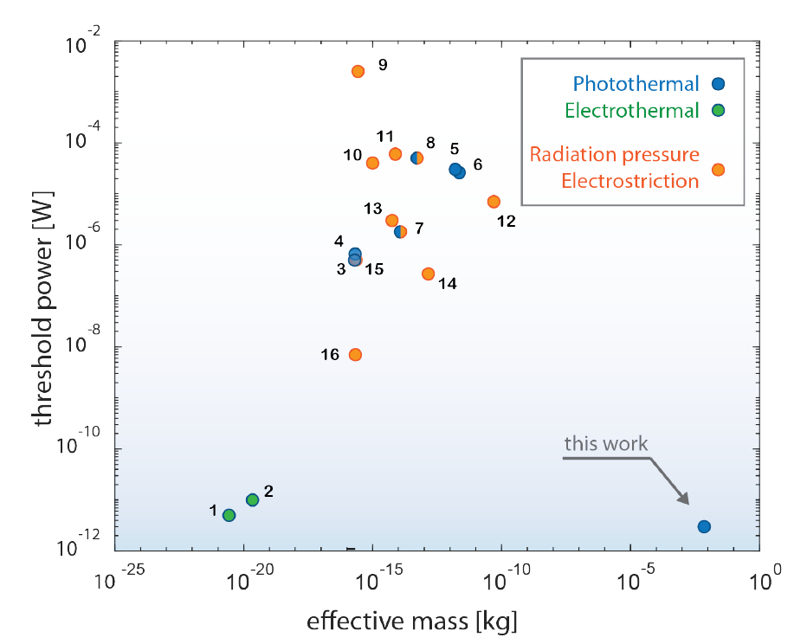
Ultrastrong Dynamical Backaction
Y. Wen, N. Ares, F. J. Schupp, T. Pei, G. A. D. Briggs, and E. A. Laird, A Coherent Nanomechanical Oscillator Driven by Single-Electron Tunnelling, Nat. Phys. 16, 75 (2020).
C. Urgell, W. Yang, S. L. De Bonis, C. Samanta, M. J. Esplandiu, Q. Dong, Y. Jin, and A. Bachtold, Cooling and Self-Oscillation in a Nanotube Electromechanical Resonator, Nat. Phys. 16, 32 (2020).
A. Sawadsky, R. A. Harrison, G. I. Harris, W. W. Wasserman, Y. L. Sfendla, W. P. Bowen, and C. G. Baker, Engineered Entropic Forces Allow Ultrastrong Dynamical Backaction, arXiv:2208.05660, Aug (2022).
AIP/ANZCOP 2022
Notes:
3 pW less than one single photon inside the resonator driving at any given time.

Slide 25

Ultrastrong Dynamical Backaction
Superfluid is highly compliant
Superfluid fountain pressure is a strong optical force
These systems can be engineered
arXiv preprint
A. Sawadsky, R. A. Harrison, G. I. Harris, W. W. Wasserman, Y. L. Sfendla, W. P. Bowen, and C. G. Baker, Engineered Entropic Forces Allow Ultrastrong Dynamical Backaction, arXiv:2208.05660, Aug (2022).
AIP/ANZCOP 2022

Slide 26
What to do with this extreme compliance?
AIP/ANZCOP 2022
Notes:
The acoustic modes were defined by the pre-existing acoustic boundary conditions of the geometry. What we would to explore is a regime where the interaction is sufficiently strong that the acoustic modes are defined by light itself.

Slide 27
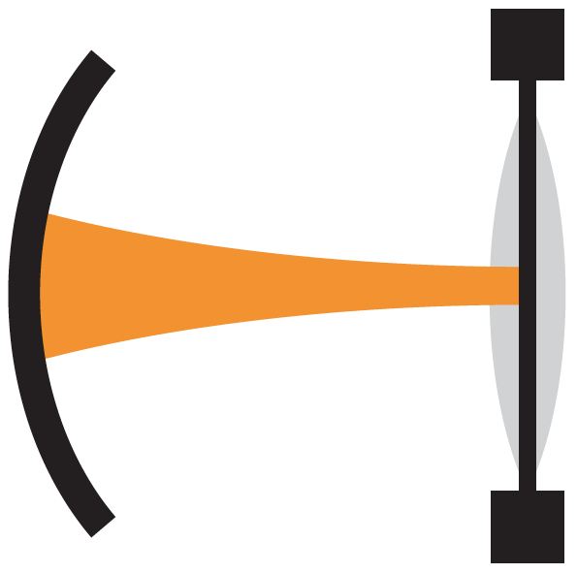
Eigenmode optomechanics
AIP/ANZCOP 2022
Notes:
What would this look like in practice? Referring back to our previous example,

Slide 28
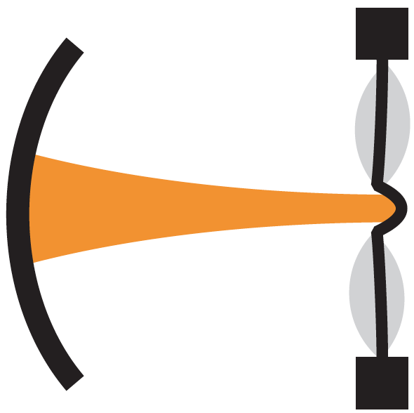
Eigenmode optomechanics
AIP/ANZCOP 2022

Slide 29
New Regime for Optomechanics
Can light define mechanics?
Need light to locally change speed of sound
AIP/ANZCOP 2022

Slide 30
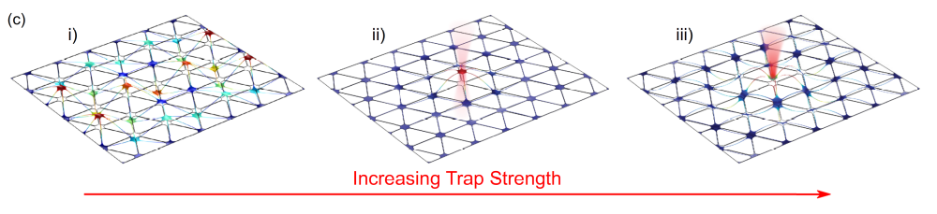
New Regime for Optomechanics
Can light define mechanics?
Need light to locally change speed of sound
Devices have been proposed
Not yet achieved
Barasheed, A. Z., Müller, T. & Sankey, J. C. Optically defined mechanical geometry. Phys. Rev. A 93, 053811 (2016).
AIP/ANZCOP 2022

Slide 31
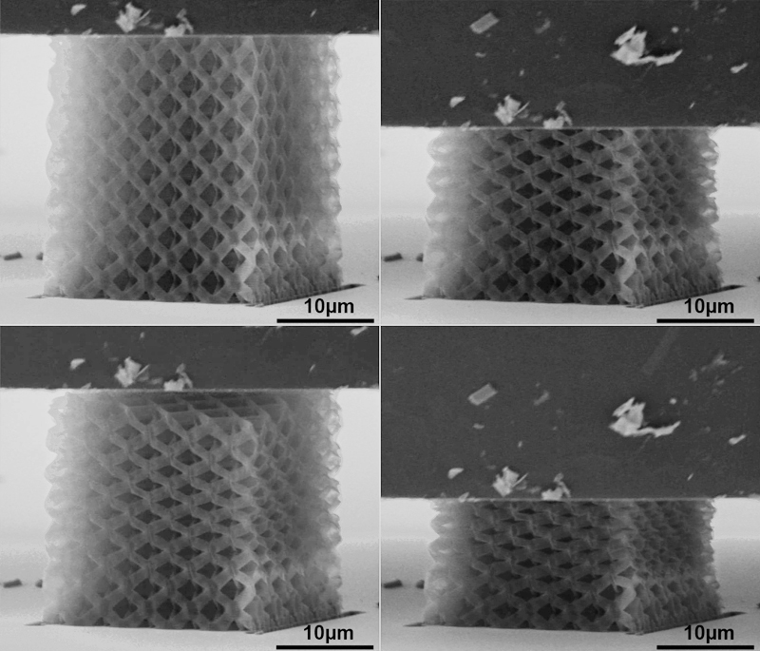
Trapping sound with light
radiation pressure
AIP/ANZCOP 2022

Slide 32
Trapping sound with light
radiation pressure
AIP/ANZCOP 2022

Slide 33
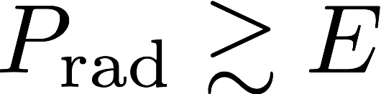
Trapping sound with light
Radiation pressure
Young’s Modulus
radiation pressure
AIP/ANZCOP 2022
Notes:
In continuum mechanics, how would define an acoustic boundary. Roughly speaking, you would like a significant change in acoustic impedance provided the light. That would correspond to appreciably changing the density and speed of sound. This condition can be reached

Slide 34
Trapping sound with light
Radiation pressure
Young’s Modulus ~ 300 GPa (SiN)
radiation pressure
AIP/ANZCOP 2022

Slide 35
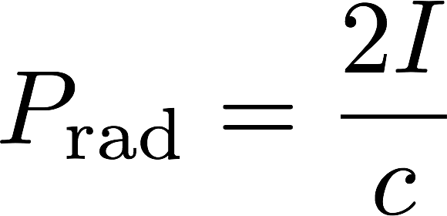
Trapping sound with light
Optical intensity
Radiation pressure
Young’s Modulus ~ 300 GPa (SiN)
radiation pressure
AIP/ANZCOP 2022

Slide 36
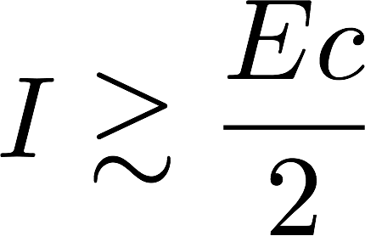
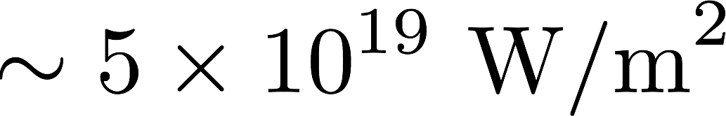
Trapping sound with light
Optical intensity
radiation pressure
AIP/ANZCOP 2022

Slide 37
Trapping sound with light
intensity if all light reaching earth from sun focused to 10 cm²
Optical intensity
radiation pressure
AIP/ANZCOP 2022
Notes:
Alternatively, since we are talking about miniaturized/micro devices this corresponds to roughly 1GW of incident power on an area of 1 um^2

Slide 38
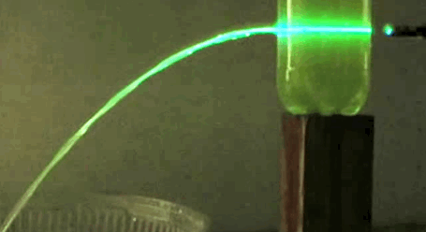
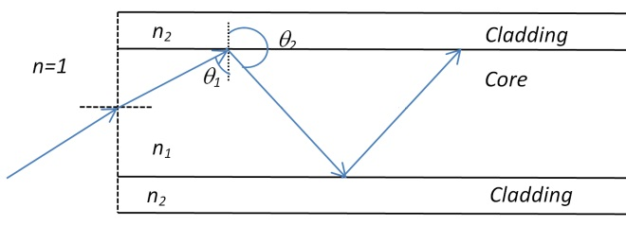
Waveguides
AIP/ANZCOP 2022

Slide 39
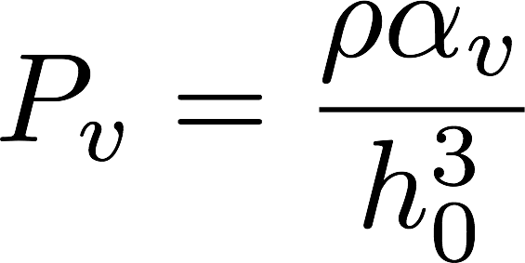
Trapping sound with light
Van der Waals coefficient
bare film thickness
AIP/ANZCOP 2022

Slide 40
Trapping sound with light
Van der Waals coefficient
bare film thickness
AIP/ANZCOP 2022

Slide 41

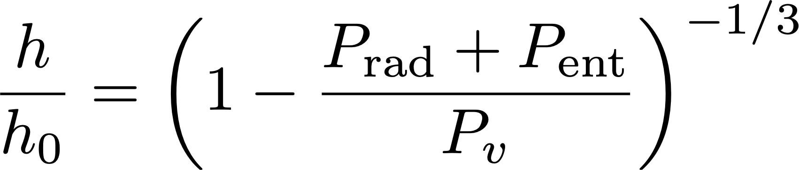
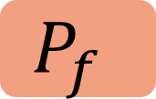
Trapping sound with light
Van der Waals coefficient
bare film thickness
fountain (entropic) pressure
relative bulging of film
$$P_{f}$$
Van der Waal
pressure
AIP/ANZCOP 2022

Slide 42
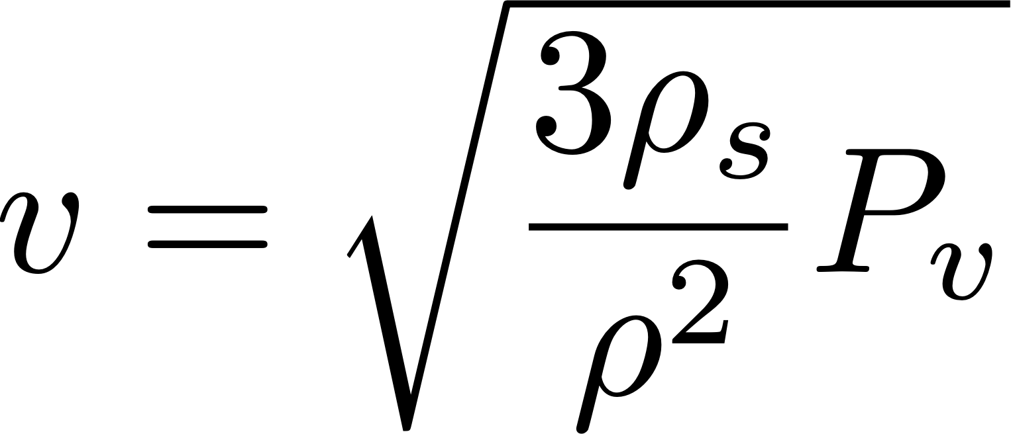
Trapping sound with light
Van der Waals coefficient
bare film thickness
fountain (entropic) pressure
relative bulging of film
$$P_{f}$$
$$P_{f}$$
Sound velocity
Van der Waal
pressure
Van der Waal
pressure
AIP/ANZCOP 2022

Slide 43
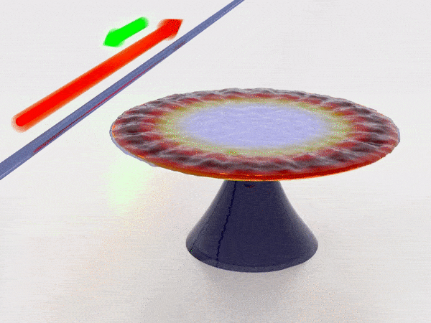
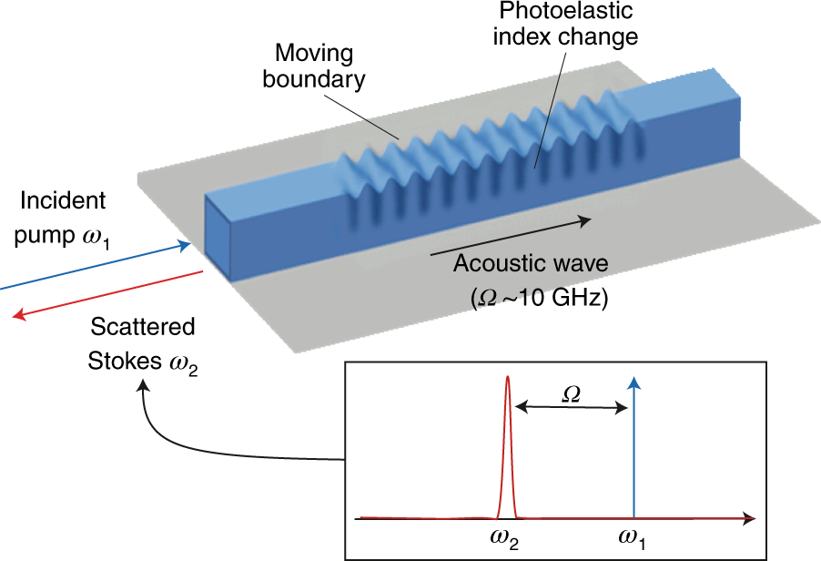
Brillouin scattering
He, X., Harris, G. I., Baker, C. G., Sawadsky, A., Sfendla, Y. L., Sachkou, Y. P., ... & Bowen, W. P. (2020). Strong optical coupling through superfluid Brillouin lasing. Nature Physics, 16(4), 417-421.
Eggleton, B. J., Poulton, C. G., Rakich, P. T., Steel, M., & Bahl, G. (2019). Brillouin integrated photonics. Nature Photonics, 13(10), 664-677.
AIP/ANZCOP 2022

Slide 44
Optically defined eigenmodes
Requires highly compliant medium
Local change in speed of sound guides acoustics

Slide 45
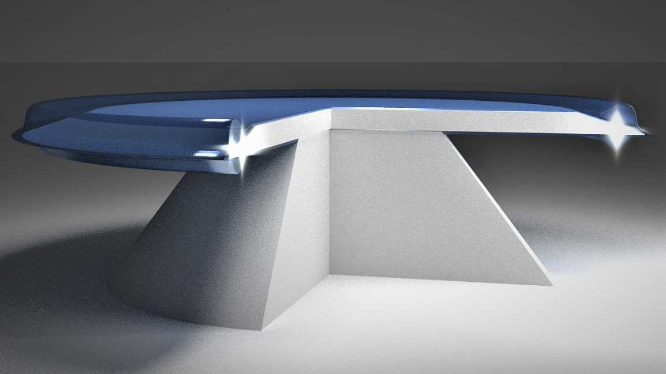
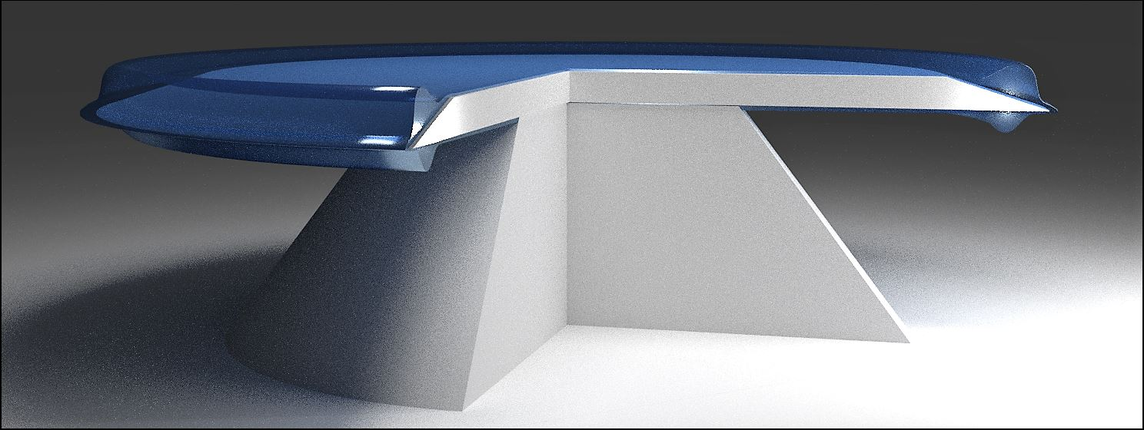

Thin Film Bulge on Disk
Past experiment showed large bulging!
What caused this mode?
Harris, G. I. et al. Nature Phys. 12, 788–793 (2016).
McAuslan, D. L. et al. Phys. Rev. X 6, 021012 (2016).
X. He, et al. Nature Phys. 16, 4 (2020).
AIP/ANZCOP 2022

Slide 46


Thin Film Bulge on Disk
X. He, C. Baker, Y. Sachkou, A. Sawadsky, S. Forstner, Y. Sfendla, and W. Bowen, “PhononConfinement by the Force of Light,” in CLEO Pacific Rim Conference, (Hong Kong), p. Tu3F.3, OSA, 2018
AIP/ANZCOP 2022

Slide 47


Thin Film Bulge on Disk
X. He, C. Baker, Y. Sachkou, A. Sawadsky, S. Forstner, Y. Sfendla, and W. Bowen, “PhononConfinement by the Force of Light,” in CLEO Pacific Rim Conference, (Hong Kong), p. Tu3F.3, OSA, 2018
AIP/ANZCOP 2022
Notes:
Difficult to unambiguously rule this out.

Slide 48


Integrated Photonic Chips
AIP/ANZCOP 2022

Slide 49
Design - Boundary-free acoustic resonator
Si Waveguide
220 nm
SOI integrated photonics
HSQ planarization
r = 70 μm
HSQ ~ 300 nm
Silica 3 μm
Si 670 μm
AIP/ANZCOP 2022

Slide 50


Simulations
Si Waveguide
220 nm
SOI integrated photonics
HSQ planarization
r = 70 μm
HSQ ~ 300 nm
Silica 3 μm
Si 670 μm
AIP/ANZCOP 2022

Slide 51

Simulations
AIP/ANZCOP 2022

Slide 52

Simulations
AIP/ANZCOP 2022
Notes:
Define acoustic index
Compare change in acoustic index to optical fibers
Compare microwatts of 1000 ncav to previous example of the irradiance of the sun.

Slide 53


Simulations – Low Frequency Modes
AIP/ANZCOP 2022

Slide 54

Simulations – High Frequency Modes
AIP/ANZCOP 2022
Notes:
Azimuthal order is twice the optical mode is Brillouin mode

Slide 55

Fabrication
Coated with HSQ
Surface topology ~ 10nm/20μm
Glued Fiber
Resonator
AIP/ANZCOP 2022

Slide 56

Fabrication
Coated with HSQ
Surface topology ~ 10nm/20μm
Glued Fiber
HSQ
Si
Resonator
AIP/ANZCOP 2022

Slide 57


Thank you
christophergbaker.com
AIP/ANZCOP 2022

