Slide 1

Optomechanical sensing
Dr Christopher Baker
EQUS Autumn School, Noosa, May 9th 2024

Slide 2


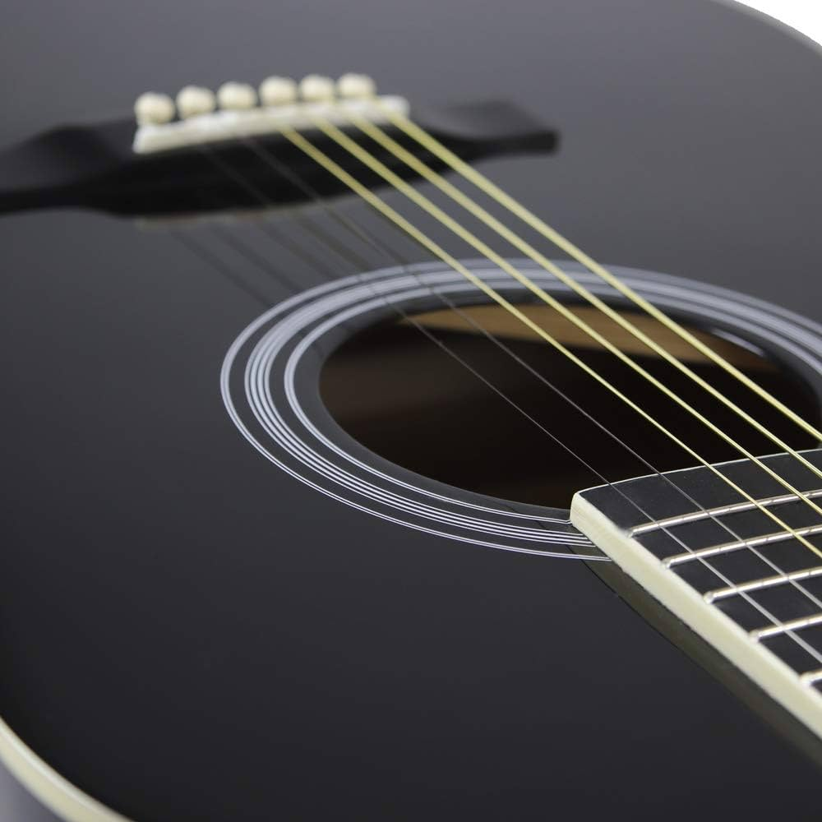
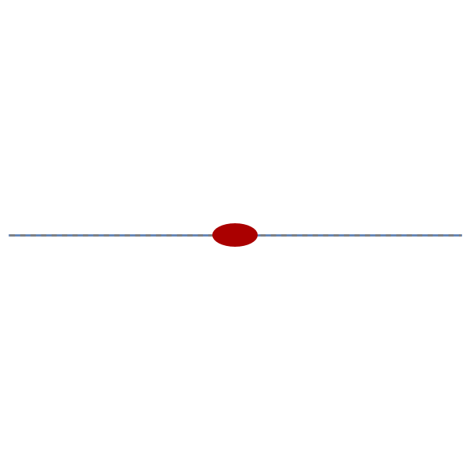


Basics of resonant sensing
Bare resonator
$$f↓$$
Added mass
$$f↑$$
Added tension

Slide 3
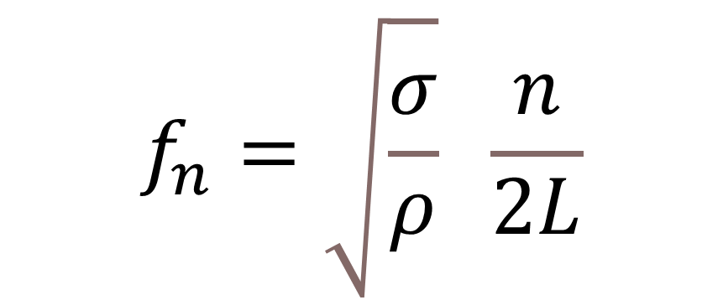
Resonant sensing
$$f_{n}=\sqrt{\frac{σ}{ρ}} \frac{n}{2L}$$
The resonance frequency of the string is sensitive to changes in density and tension

Slide 4
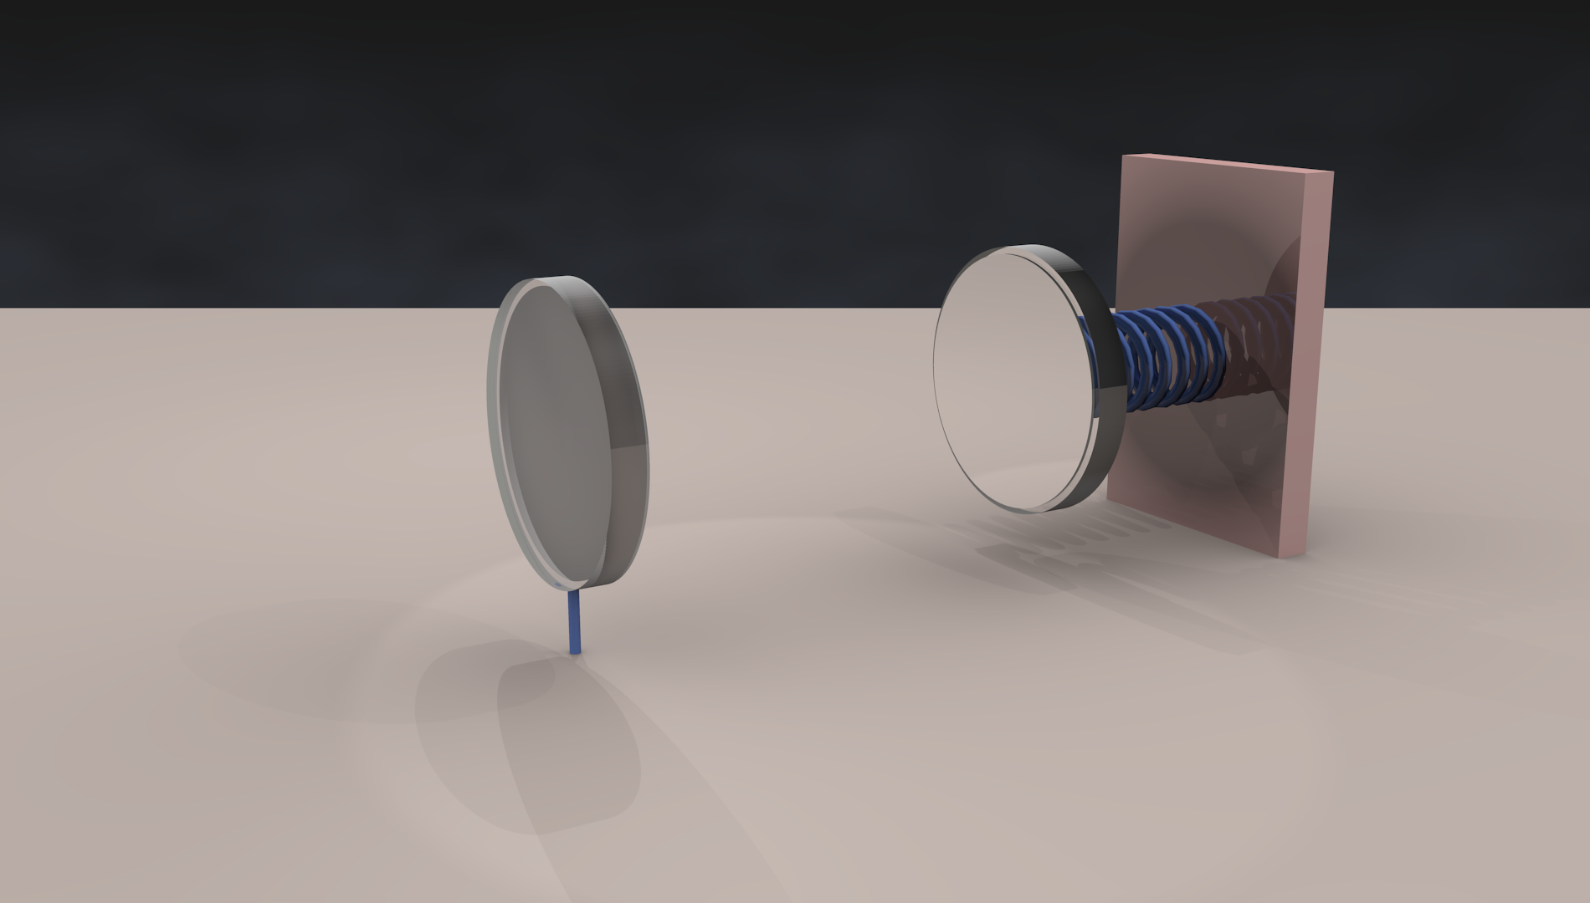

Slide 5
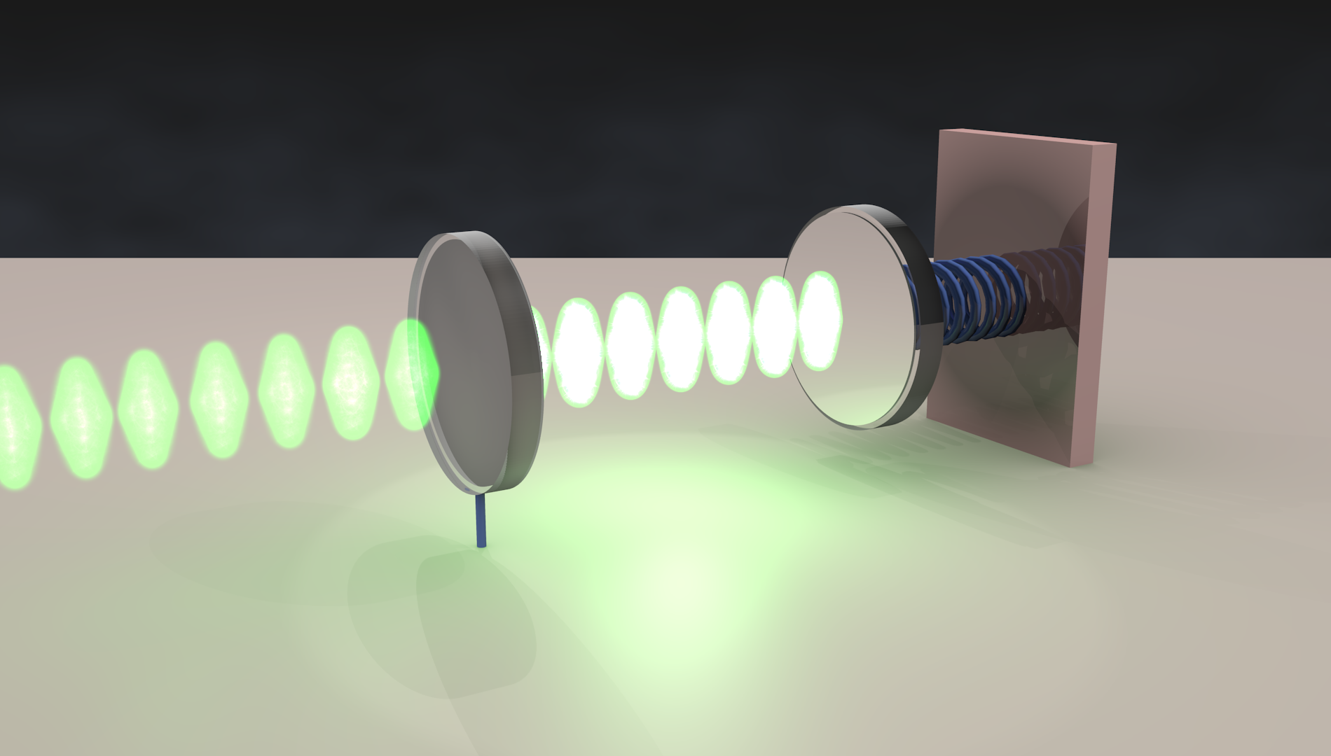
Mechanical element can be functionalized to be made to interact with a wide range of stimuli
Sensitive to extremely minute changes in optical path length (separation between the mirrors)
Notes:
Use of precision interferometric readout provide greatly enhanced sensitivity
Mechanical elements can be functionalized to be made to interact with a whole host of stimuli

Slide 6

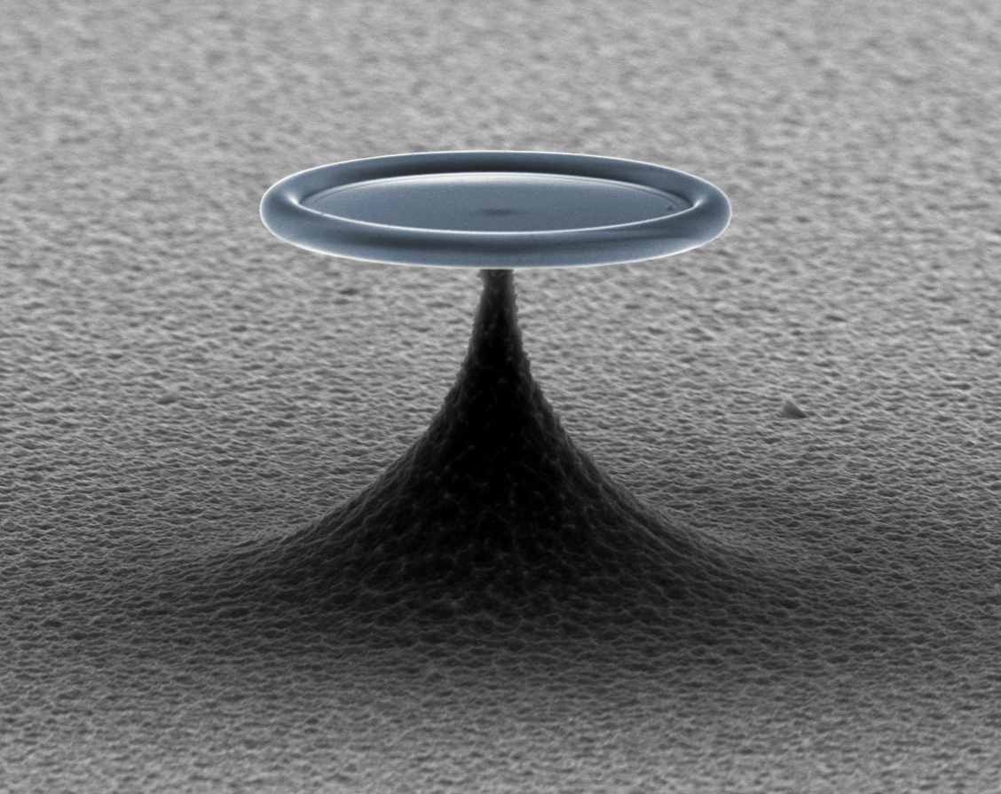
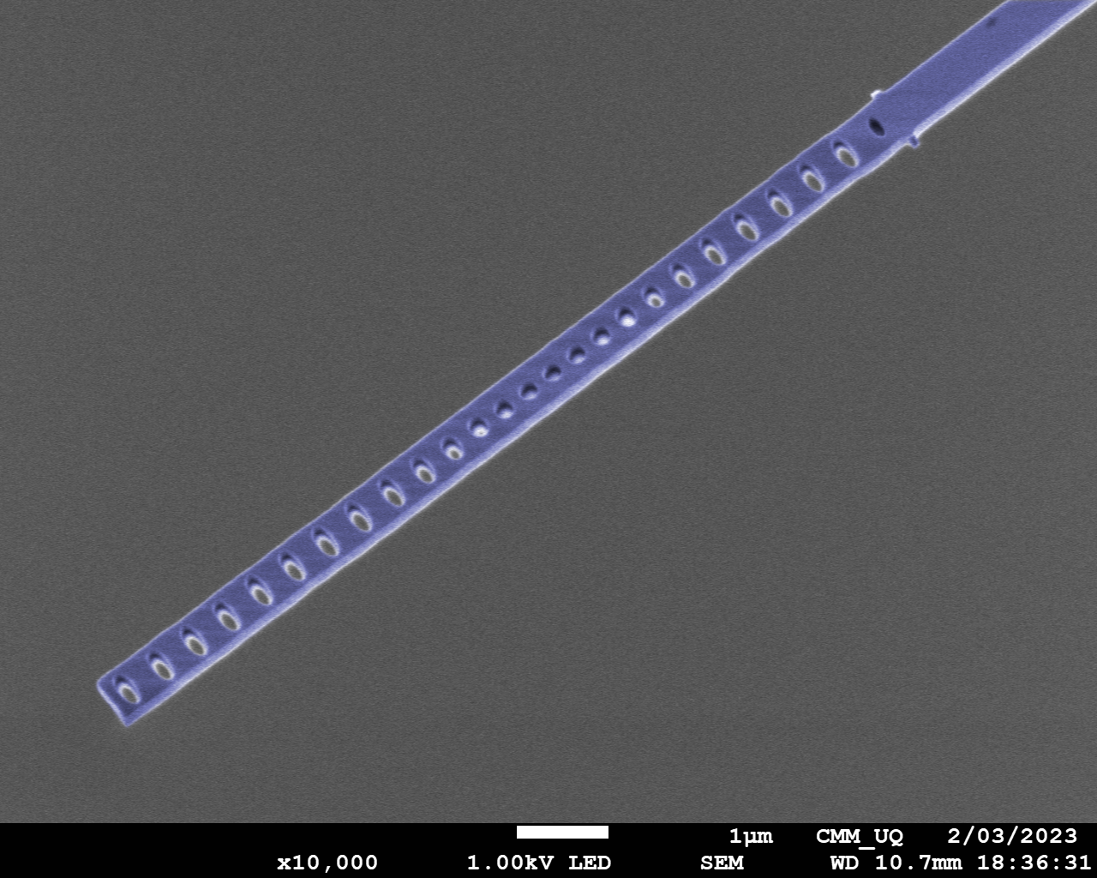
Optical resonators come in various forms
Fabry-Perot cavities
Whispering gallery mode (WGM) resonators
Photonic crystal cavities

Slide 7
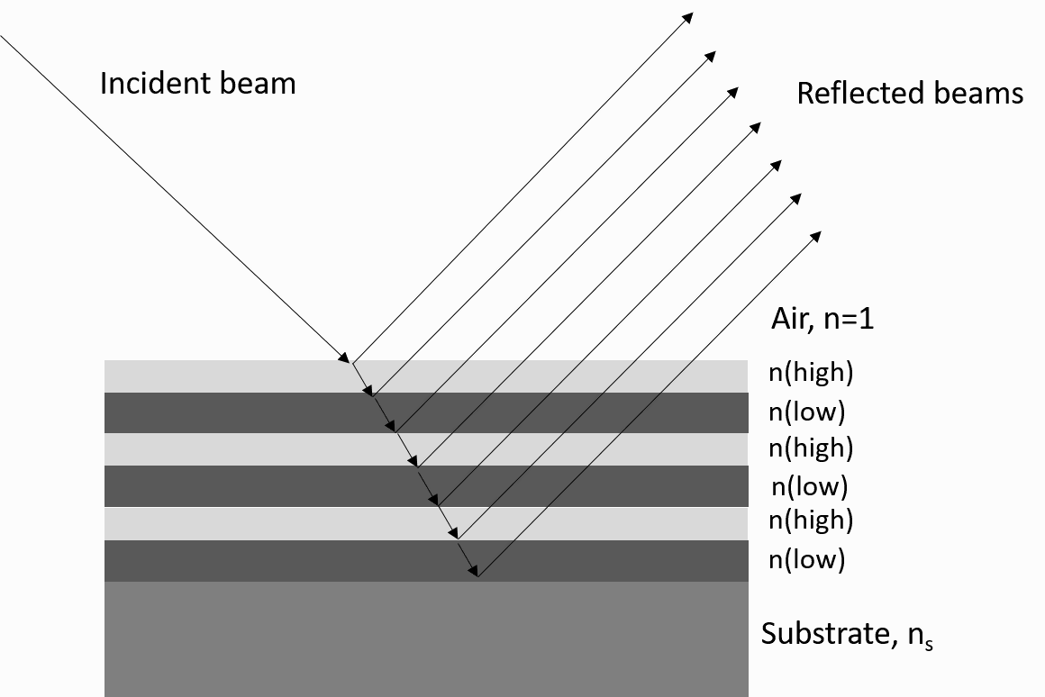
Photonic crystal
mirror
mirror
cavity
Notes:
1D photonic crystal cavity

Slide 8
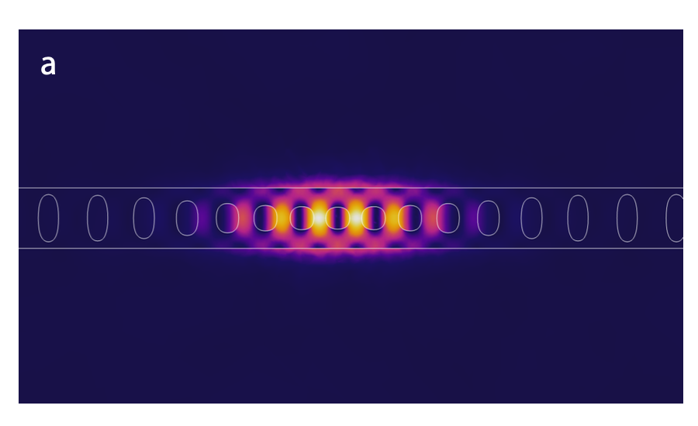
1D photonic crystal cavity
mirror
mirror
cavity
reflection
wavelength

Slide 9
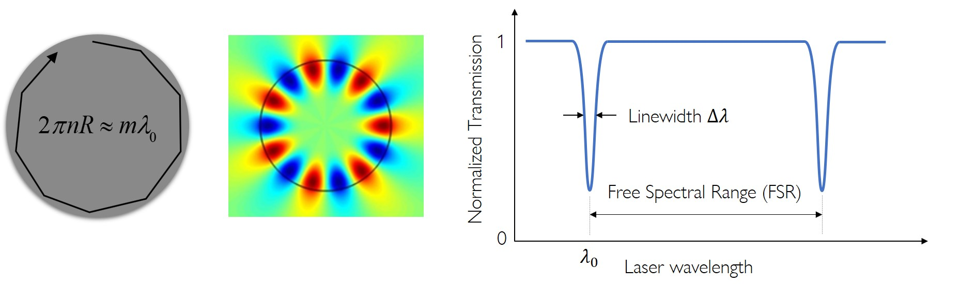
Whispering gallery mode resonators

Slide 10
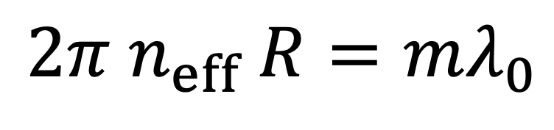
Whispering gallery mode resonators
$$2π{ n}_{eff} R=mλ_{0}$$
Force
Acceleration
Magnetic fields
Electric fields
Temperature
Gases
Ultrasounds
Gravitational waves
Viscosity
Biological particles…
transmission
wavelength

Slide 11
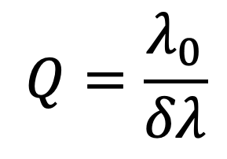


Optical quality factor
transmission
$$δλ$$
$$λ_{0}$$
wavelength
$$Q=\frac{λ_{0}}{δλ}$$
→ Higher optical Q leads to improved sensitivity

Slide 12
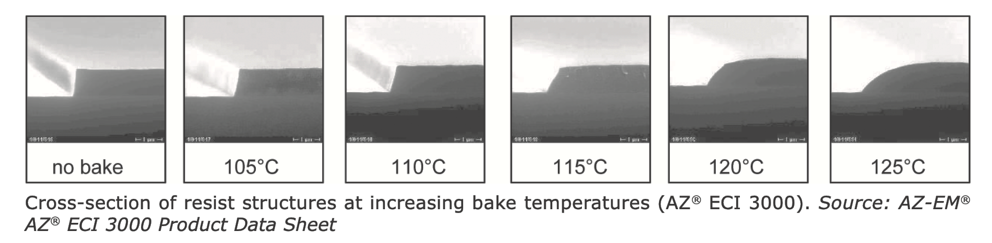
Optical quality factor
Material absorption Choose low loss material
Bending losses Use larger bend radius/ use higher refractive index material
Surface losses Control surface state (piranha, HF treatments, ALD…)
Sidewall roughness Multipass exposure, resist reflow…

Slide 13
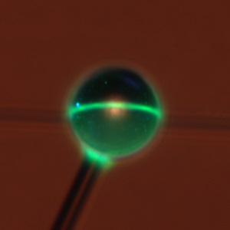
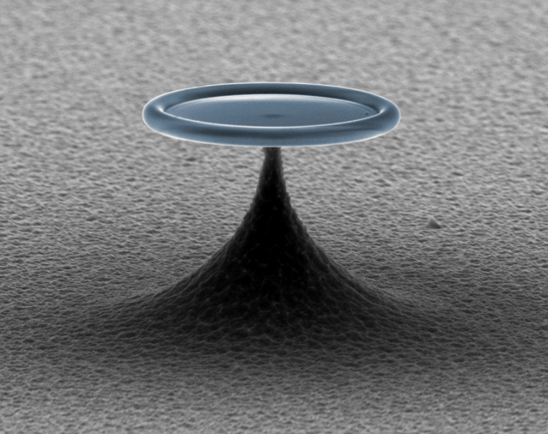
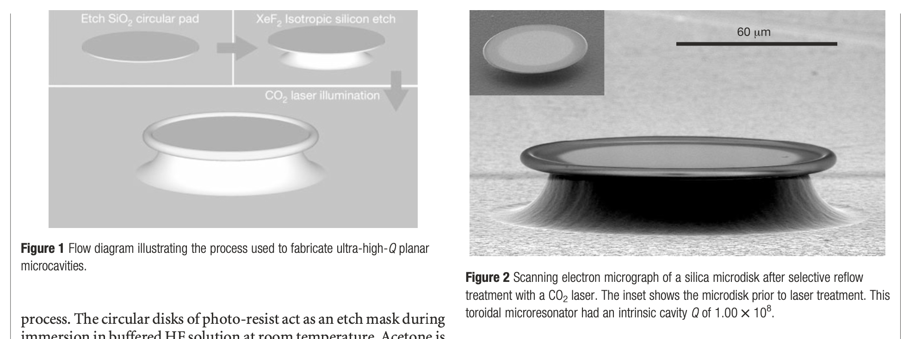
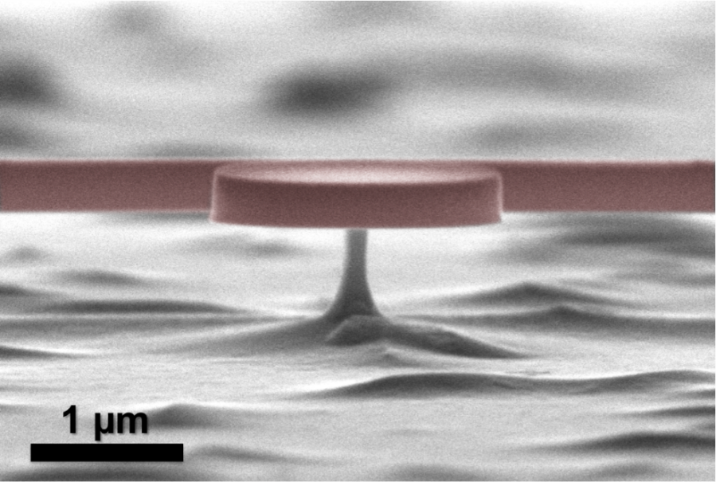
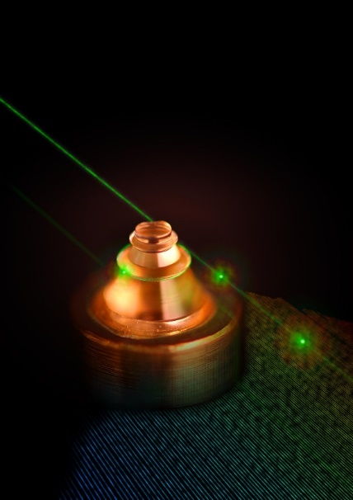
Material reflow
Silica microsphere
Silica microtoroid
GaAs microdisk
CaF2 resonator
Armani, D. K., Kippenberg, T. J., Spillane, S. M. & Vahala, K. J. Ultra-high- Q toroid microcavity on a chip. Nature 421, 925 (2003).

Slide 14
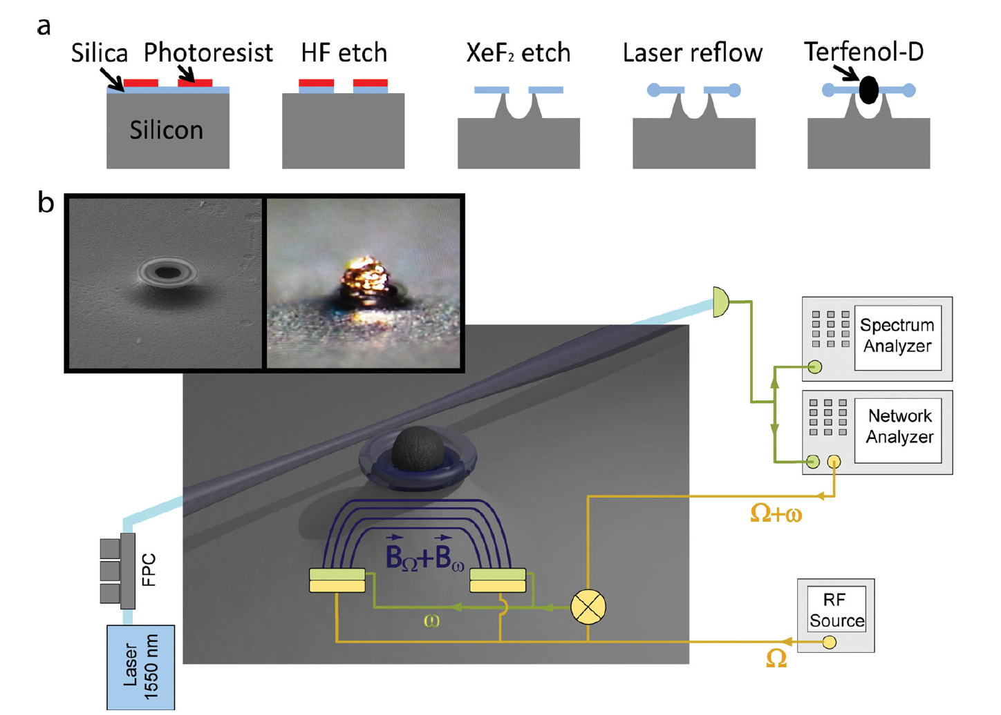
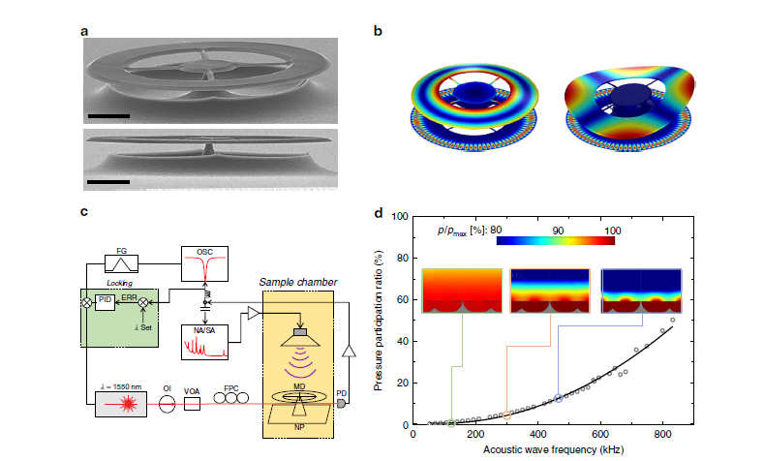
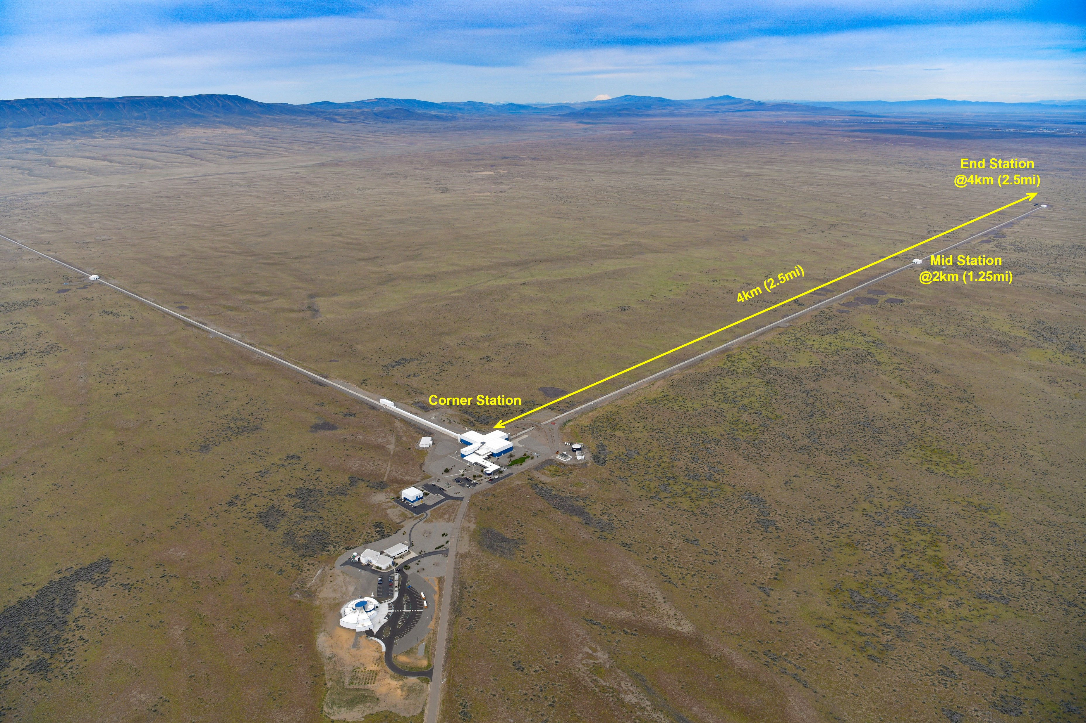
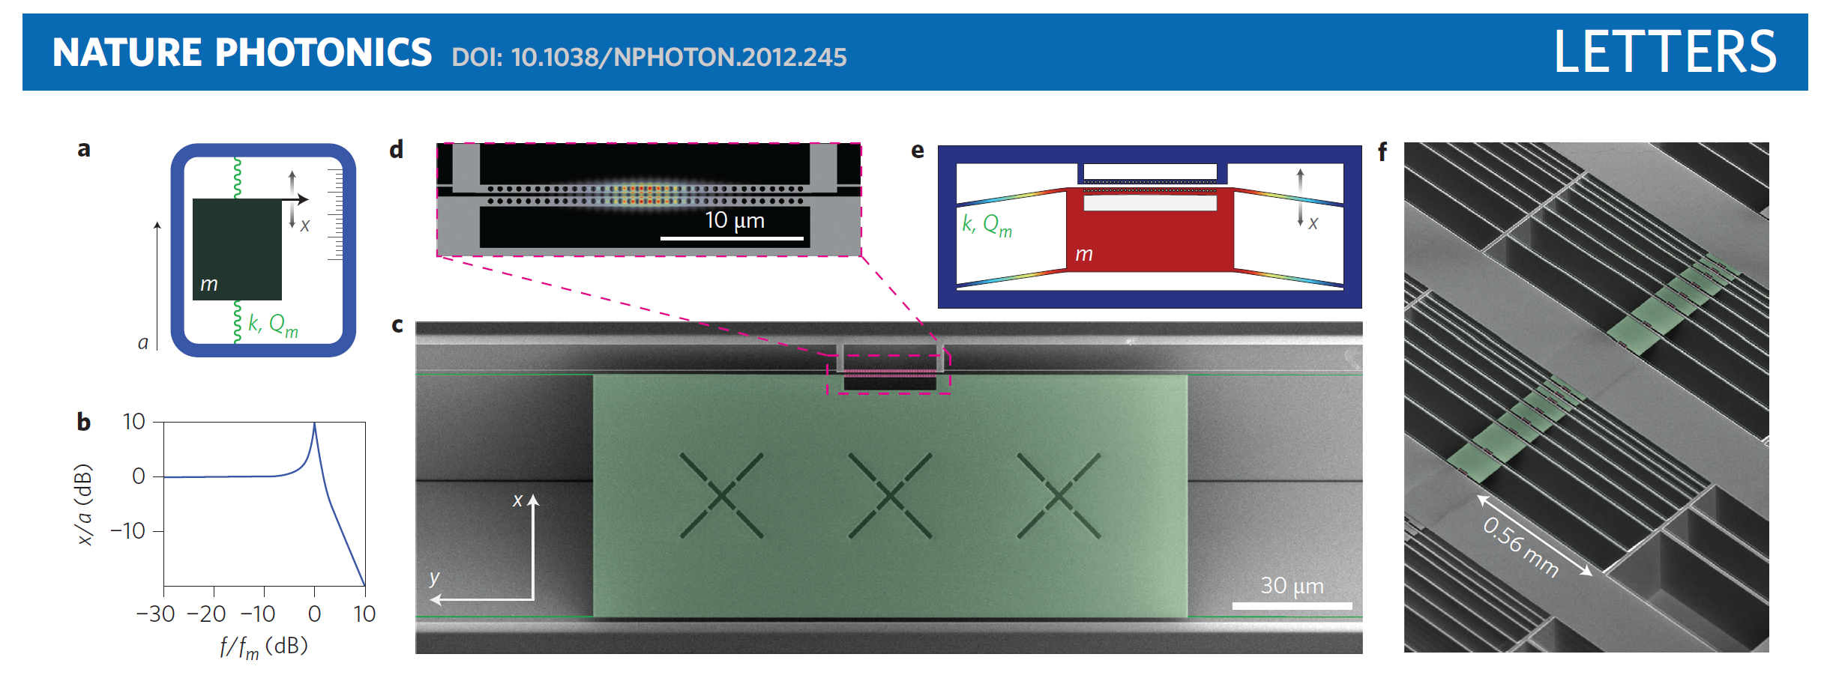
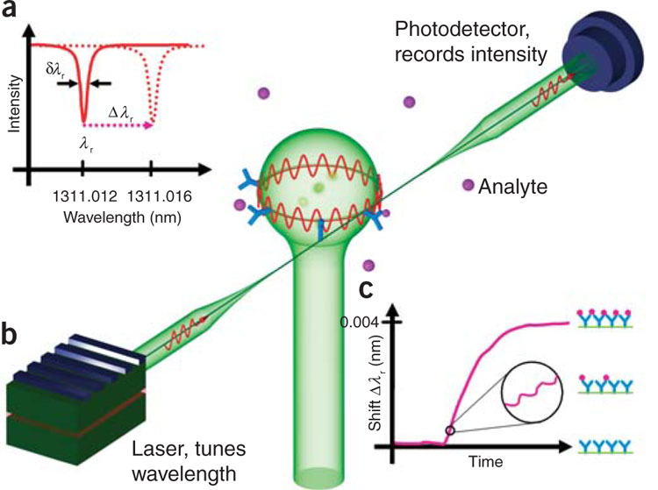
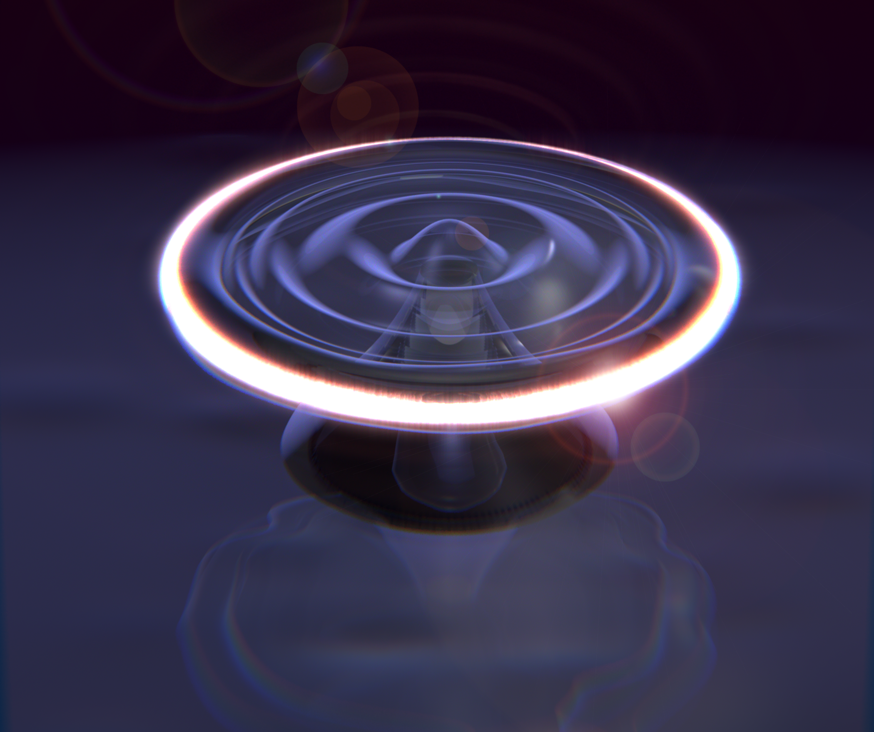
Sensors
Magnetic fields
ultrasounds
Gravitational waves
acceleration
biosensors
Superfluid waves

Slide 15
Signal
Change in optical path length
Readout

Slide 16
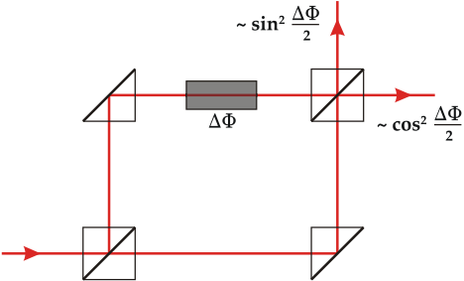
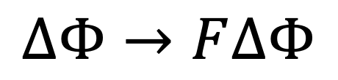
Why use a resonator?
$$∆Φ→F∆Φ$$
Notes:
The resonator resonantly enhances the small phase shift occurring caused by the signal to be detected

Slide 17
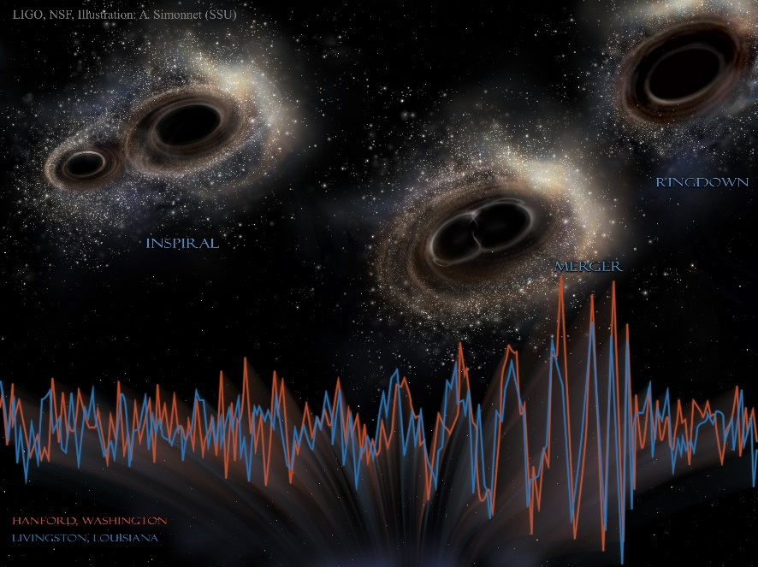
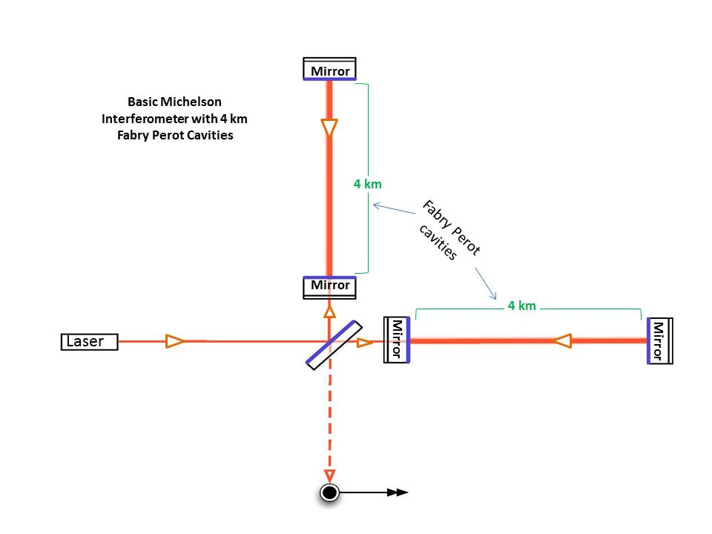
Gravitational waves
LIGO Scientific Collaboration and Virgo Collaboration et al., “Observation of Gravitational Waves from a Binary Black Hole Merger,” Phys. Rev. Lett., vol. 116, no. 6, p. 061102, Feb. 2016.
Notes:
measure a change in distance 1,000 times smaller than the width of a proton

Slide 18
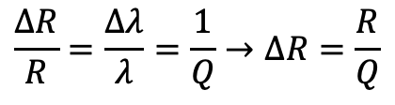
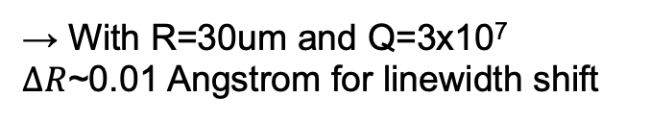
magnetometry
$$\frac{∆R}{R}=\frac{∆λ}{λ}=\frac{1}{Q}→∆R=\frac{R}{Q}$$
→ With R=30um and Q=3x10⁷
$∆R$~0.01 Angstrom for linewidth shift
B.-B. Li, J. Bílek, U. B. Hoff, L. S. Madsen, S. Forstner, V. Prakash, C. Schäfermeier, T. Gehring, W. P. Bowen, and U. L. Andersen, Quantum Enhanced Optomechanical Magnetometry, Optica, OPTICA 5, 850 (2018).
S. Forstner, S. Prams, J. Knittel, E. D. van Ooijen, J. D. Swaim, G. I. Harris, A. Szorkovszky, W. P. Bowen, and H. Rubinsztein-Dunlop, Cavity Optomechanical Magnetometer, Phys. Rev. Lett. 108, 120801 (2012).
S. Forstner, E. Sheridan, J. Knittel, C. L. Humphreys, G. A. Brawley, H. Rubinsztein-Dunlop, and W. P. Bowen, Ultrasensitive Optomechanical Magnetometry, Adv. Mater. 26, 6348 (2014).

Slide 19
accelerometry
A. G. Krause, M. Winger, T. D. Blasius, Q. Lin, and O. Painter, A High-Resolution Microchip Optomechanical Accelerometer, Nat Photon 6, 768 (2012).

Slide 20
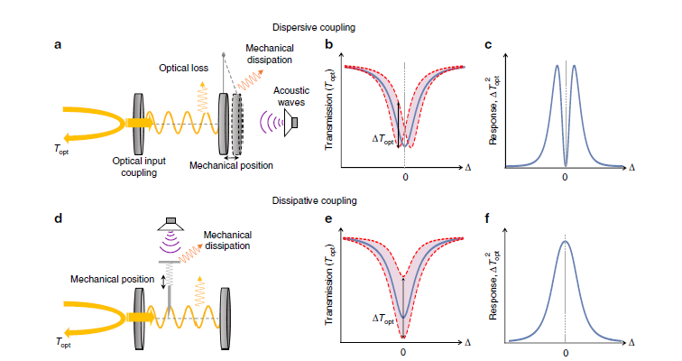
Ultrasound sensing
S. Basiri-Esfahani, A. Armin, S. Forstner, and W. P. Bowen, Precision Ultrasound Sensing on a Chip, Nature Communications 10, 132 (2019).

Slide 21
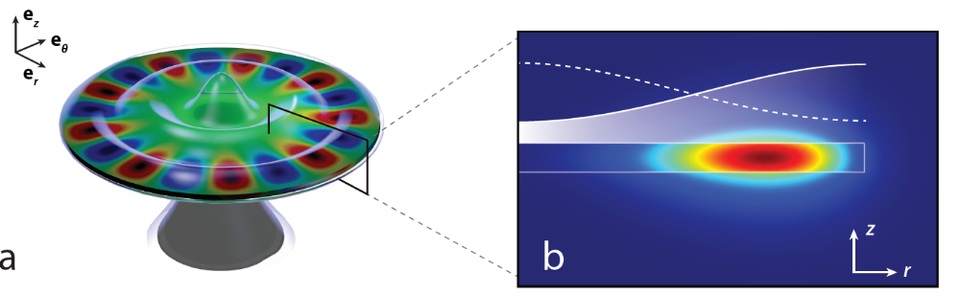
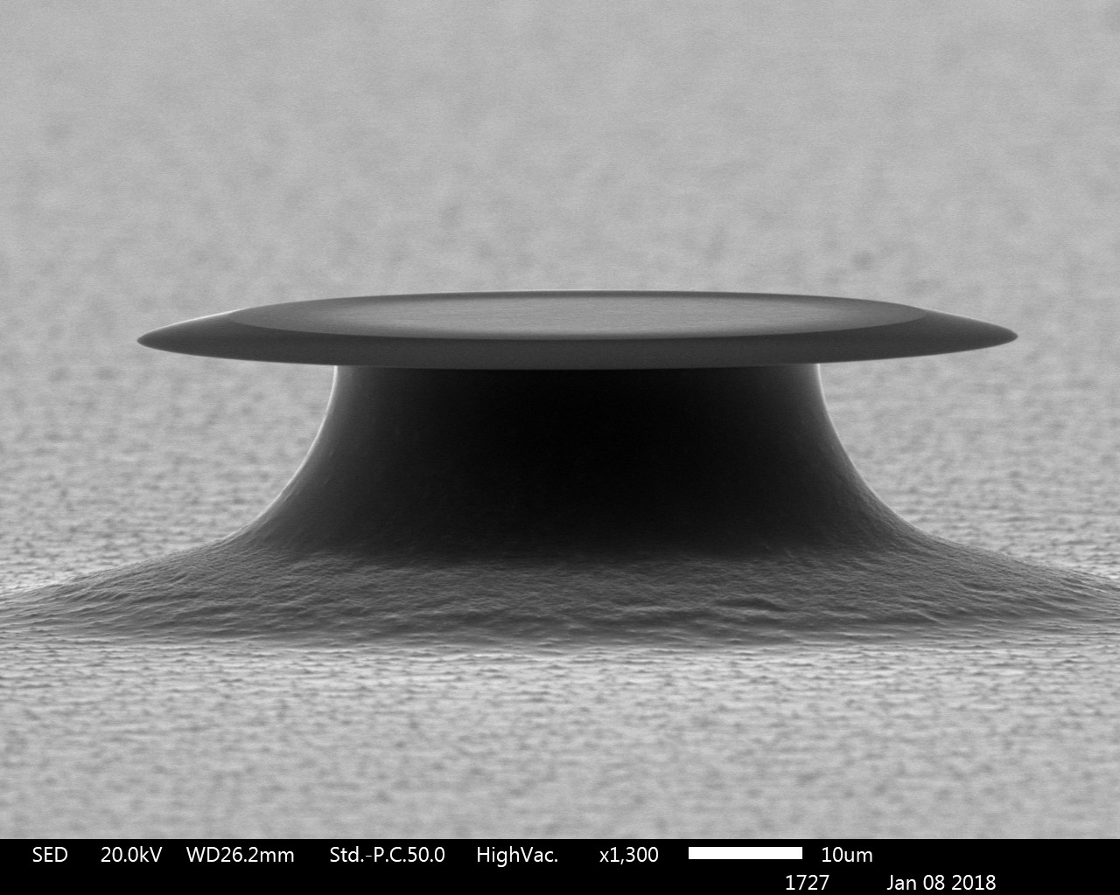
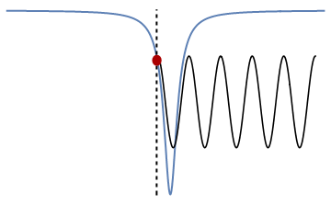
Superfluid sensing
10 μm
New Journal of Physics, 18(12):123025, 2016

Slide 22
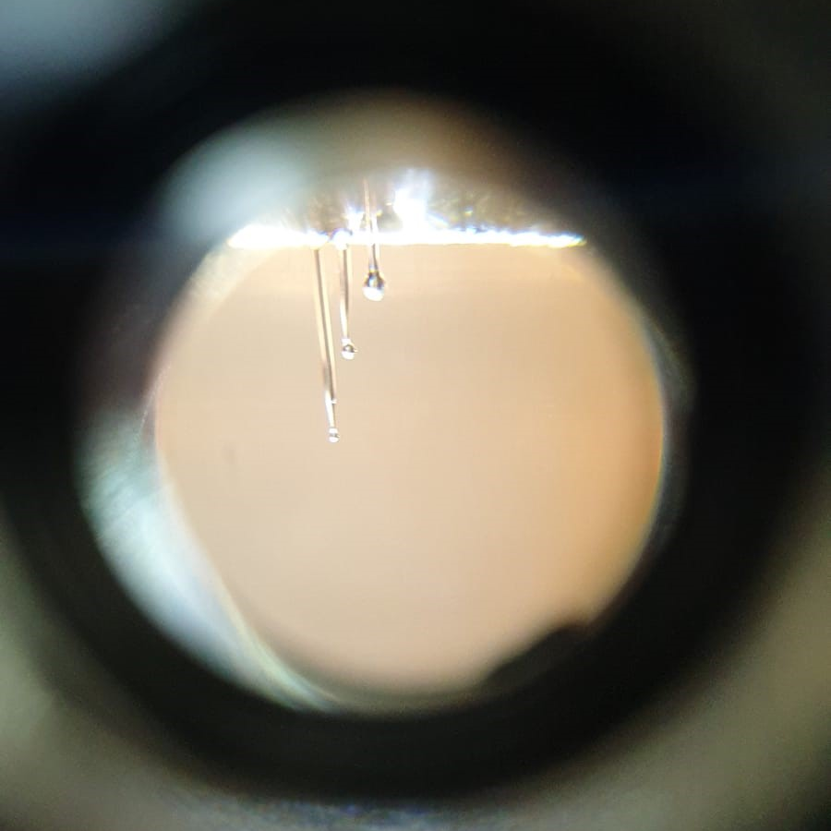
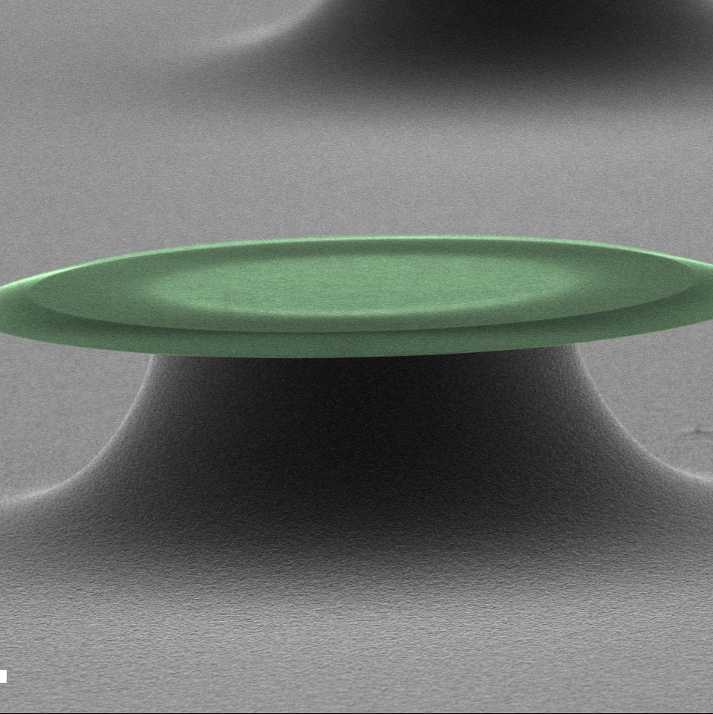
Nature Physics 12, 788, 2016
Physical Review X, 6:021012, 2016
New J. Phys. 18, 123025, 2016.
New J. Phys. 21, 053029, 2019.
Science 366, 1480, 2019.
Nature Physics 16, 4 2020.
Optics Express, 28, 22450 2020.
Npj Quantum Information 7, 1 2021.
Optics Express, 30, 30822 2022.
Science Advances 9 eade3591, 2023.

Slide 23
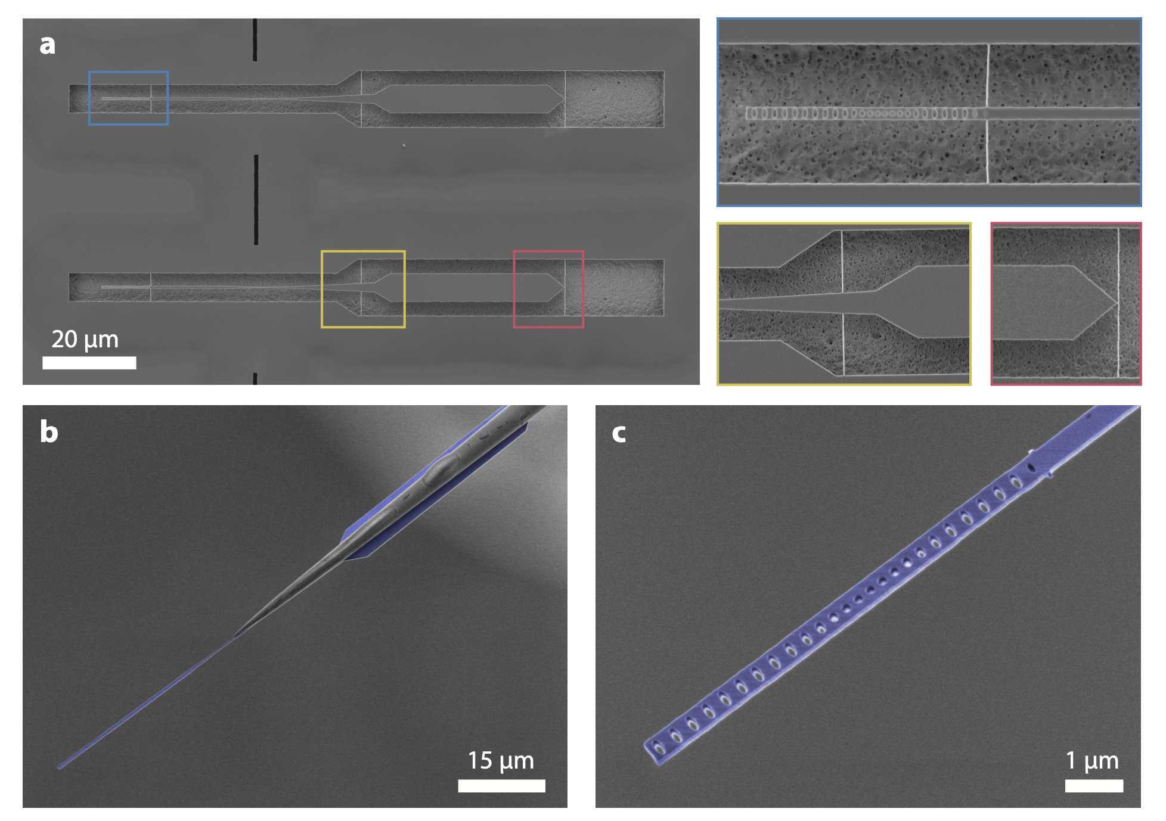
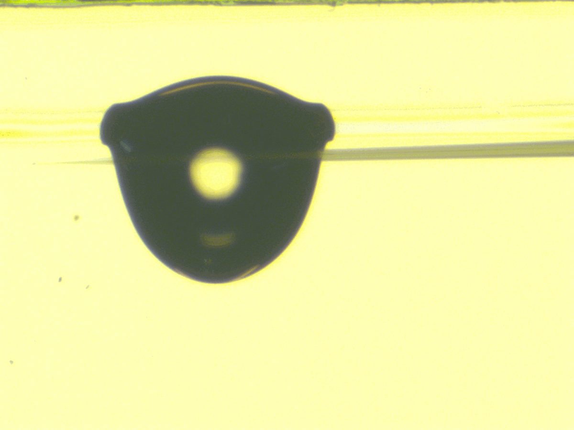
W. W. Wasserman, R. A. Harrison, G. I. Harris, A. Sawadsky, Y. L. Sfendla, W. P. Bowen, and C. G. Baker, Cryogenic and Hermetically Sealed Packaging of Photonic Chips for Optomechanics, Optics Express, 30, 30822 Aug (2022).

Slide 24
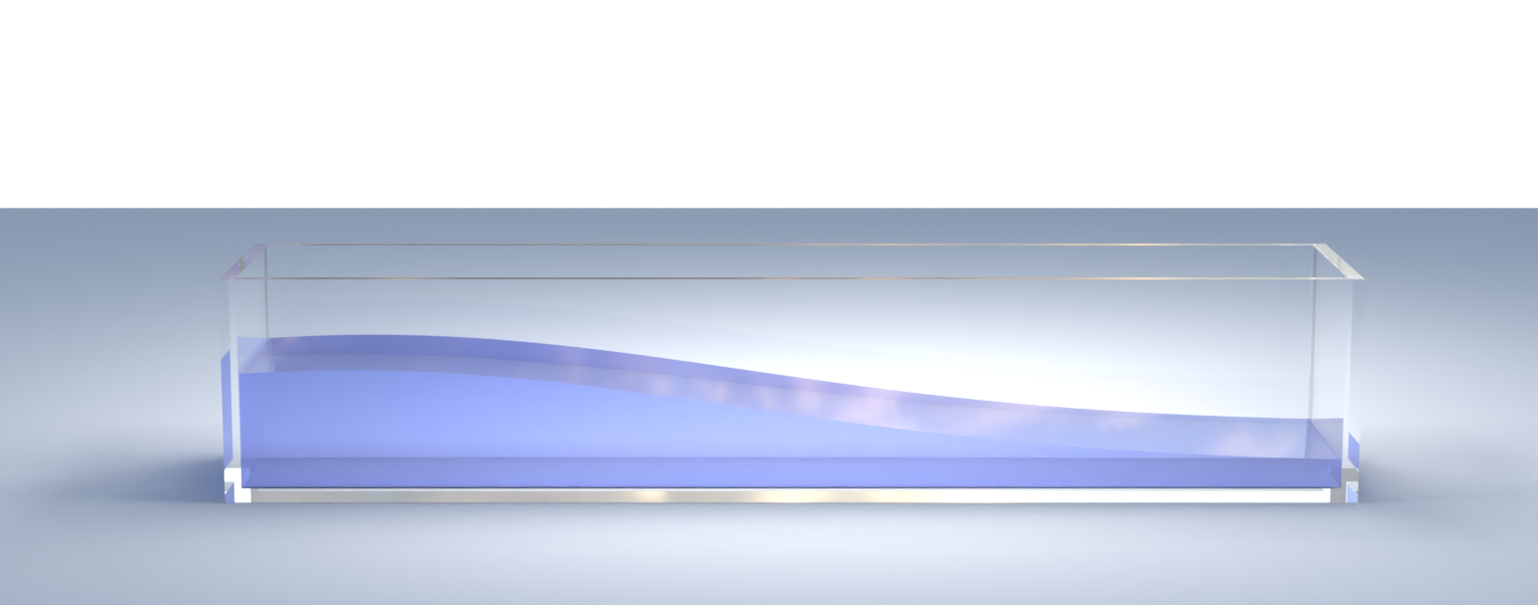
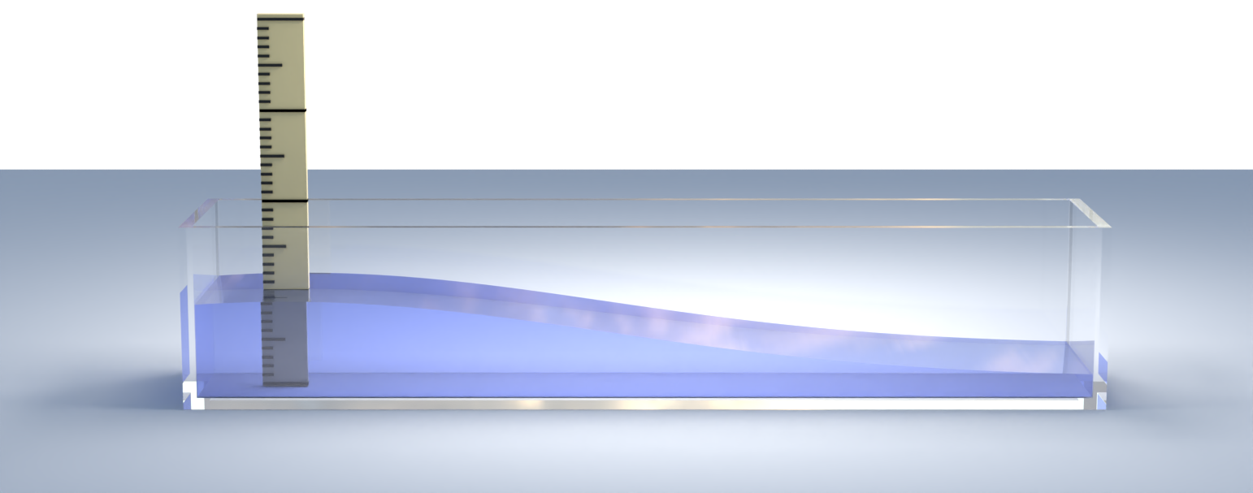
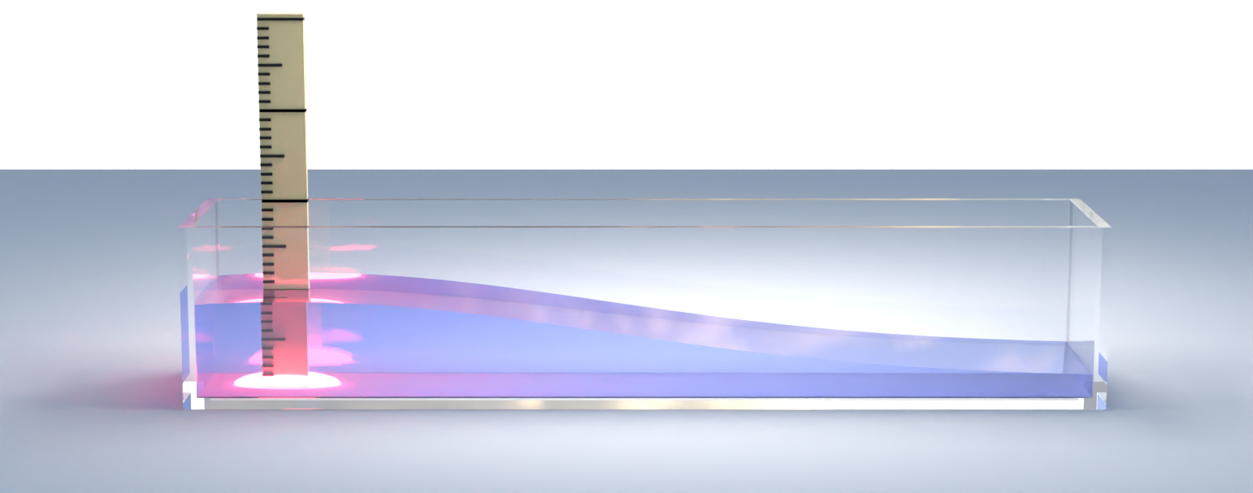
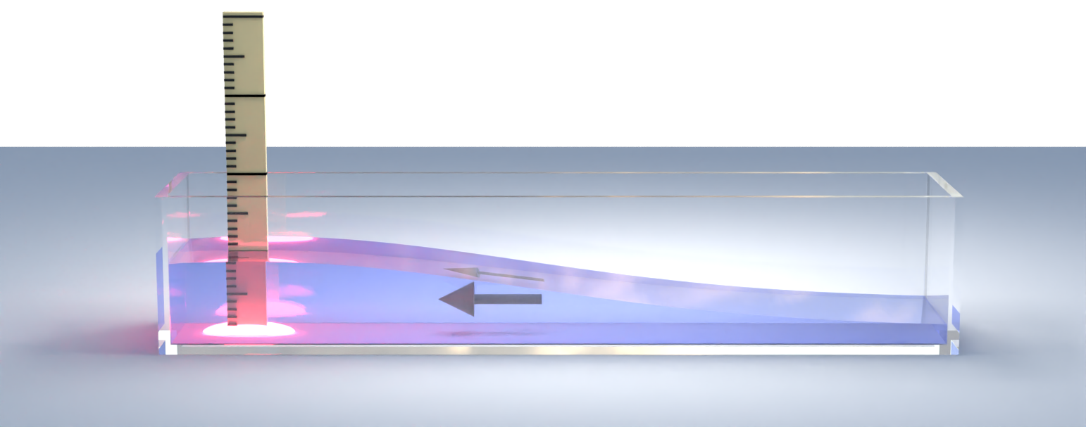
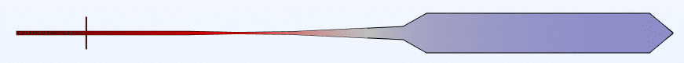
Superfluid wavetank

Slide 25
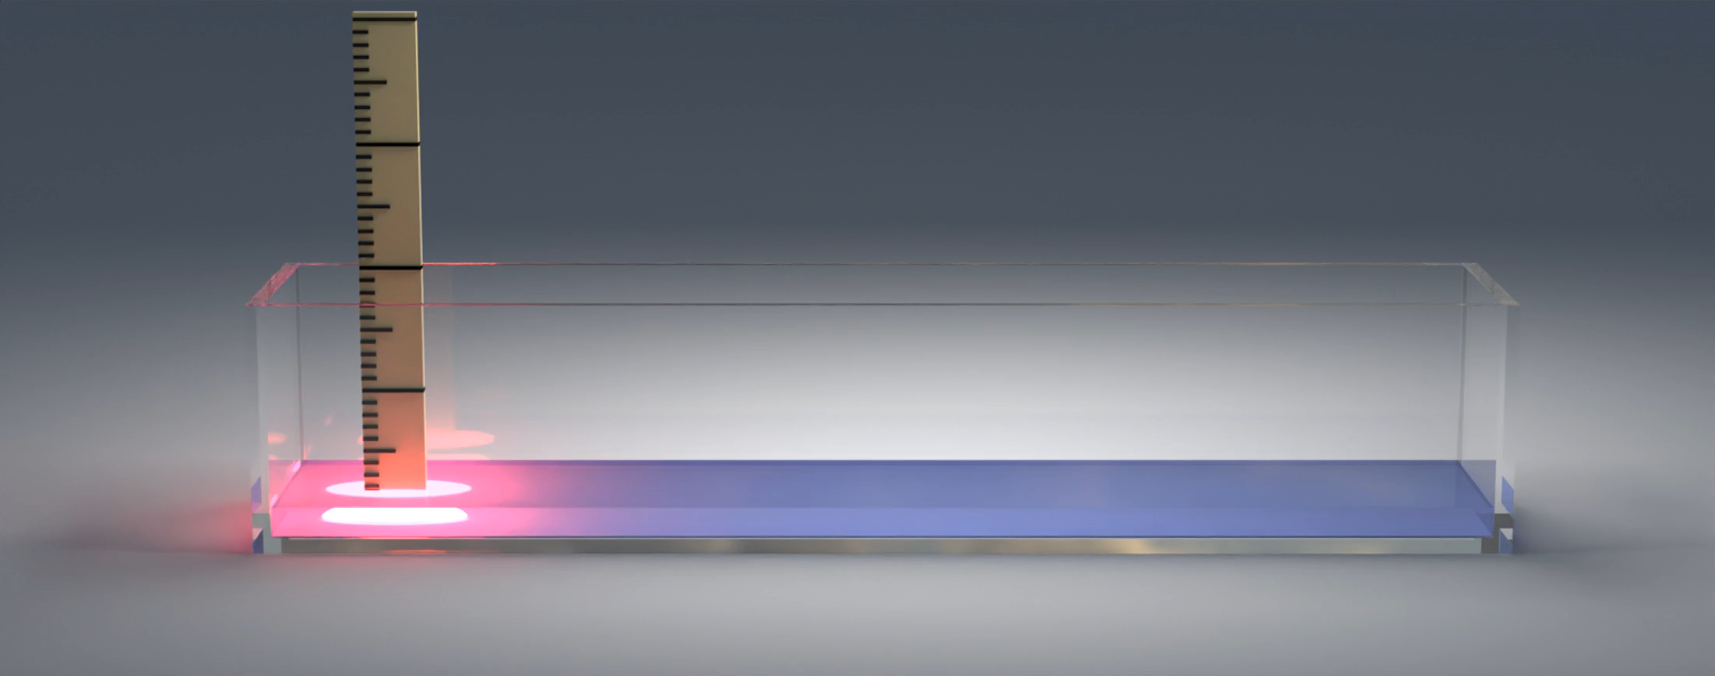

Slide 26
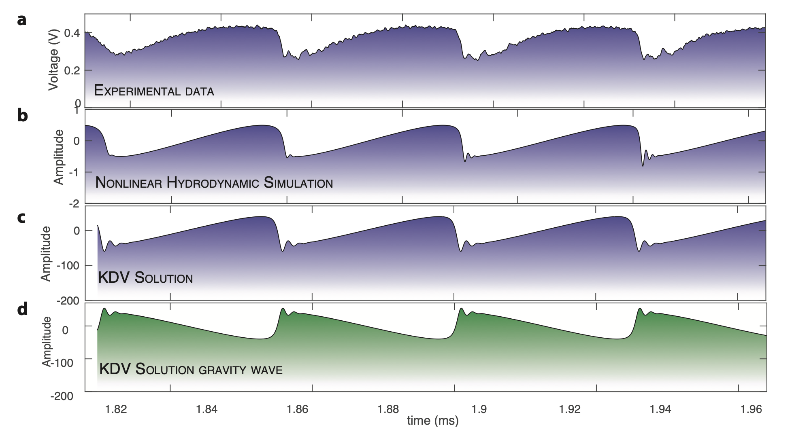
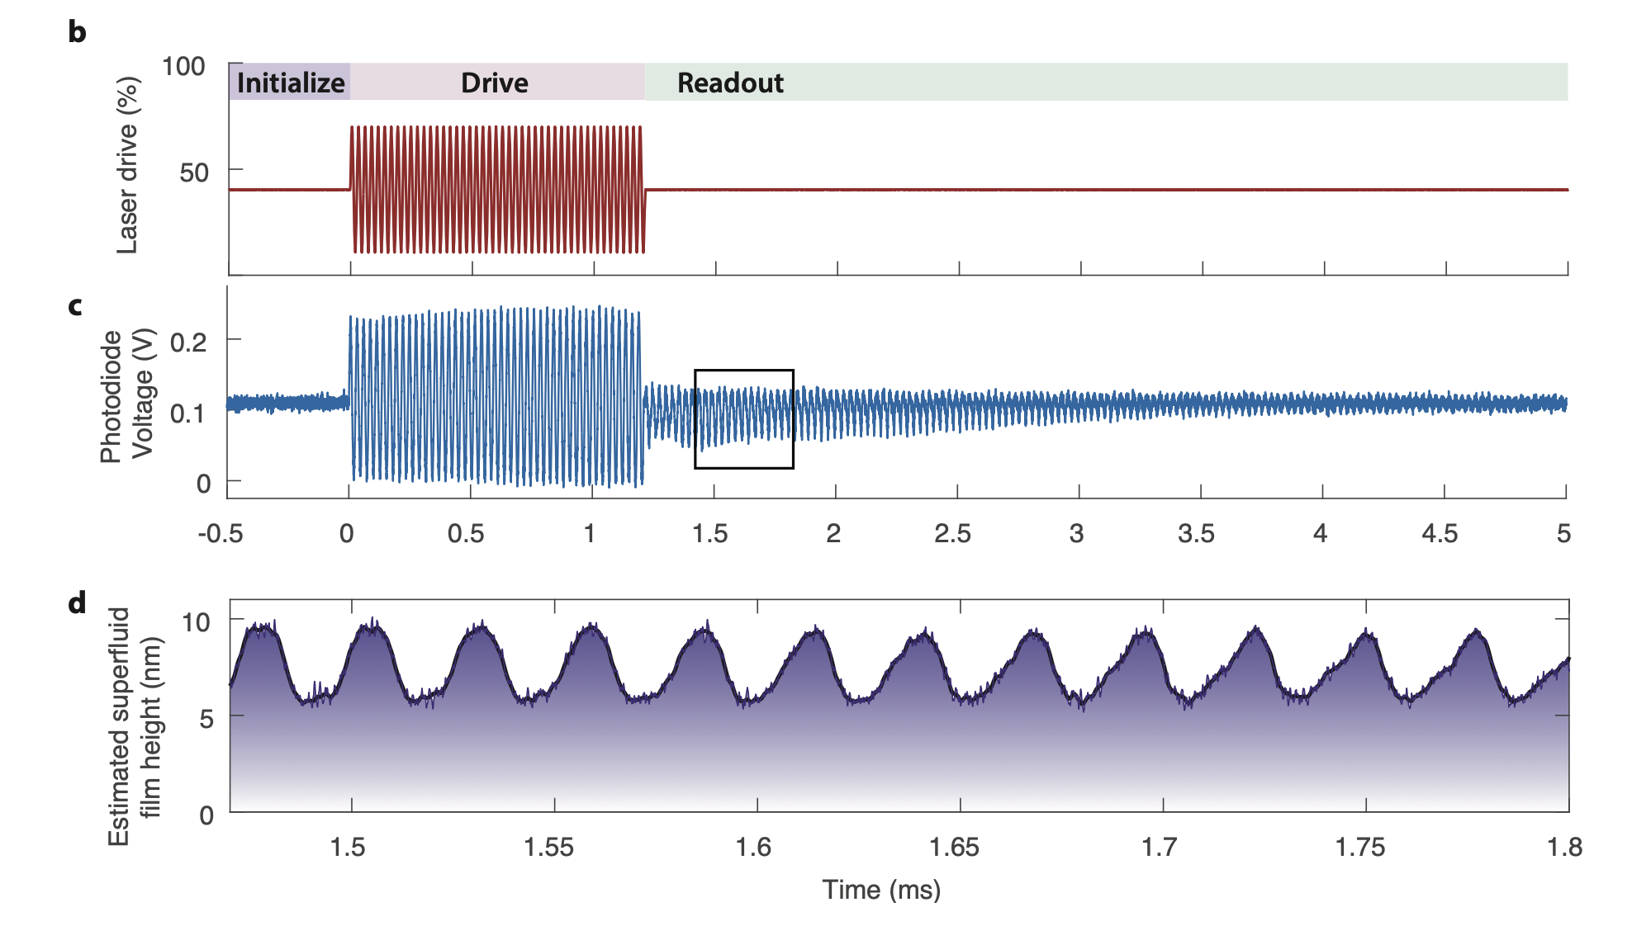
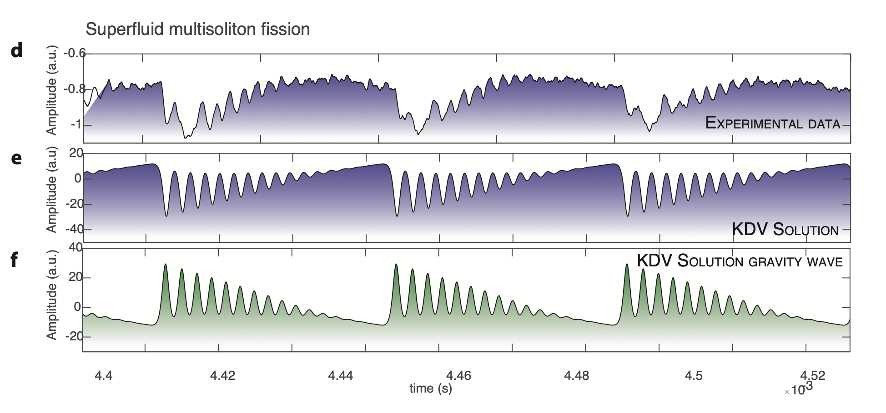

Slide 27
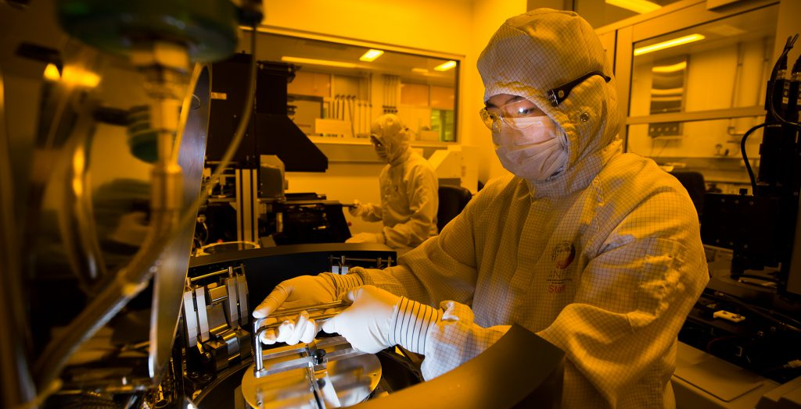
Why use cleanroom nanofabrication?

Slide 28
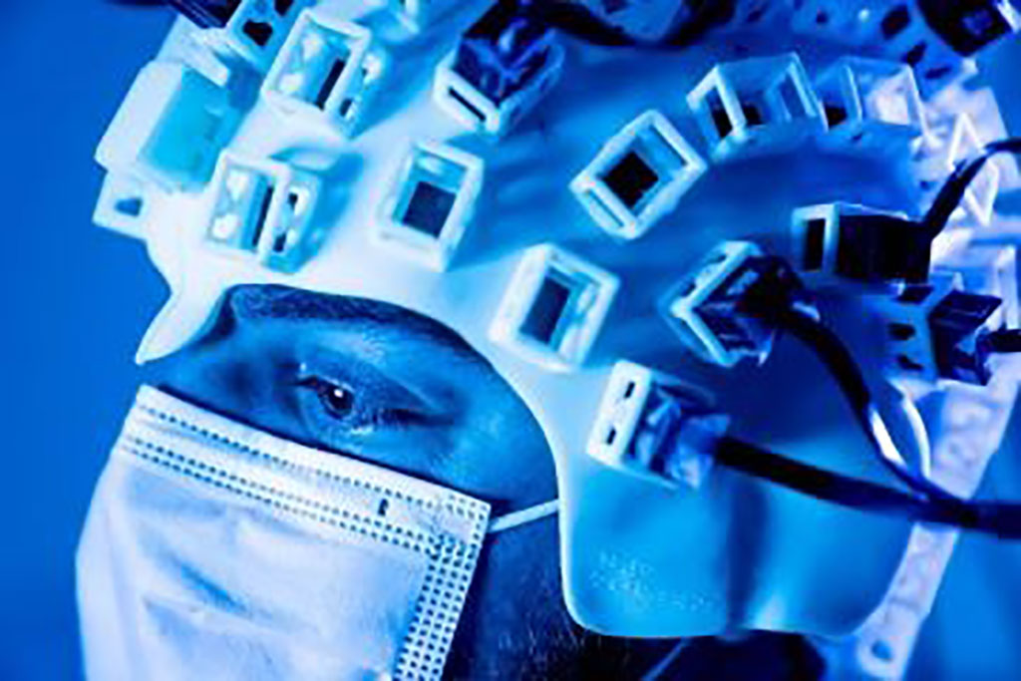
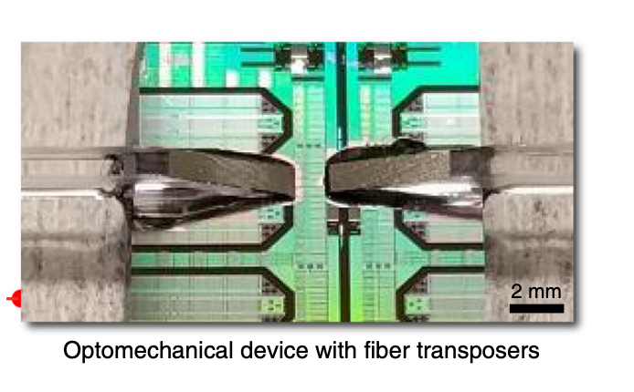

Why miniaturize?
Scalability / cost and power reduction & integration
Higher spatial resolution
Higher bandwidth
Higher sensitivity
Sansa, M. et al. Optomechanical mass spectrometry. Nature Communications 11, 3781 (2020).

Slide 29



Biological/particle sensing using optical resonators
Frequency shift approach
Particle lands on resonator
→ Change in effective size
→ Dispersive shift
(fundamentally analogous to cavity optomechanics !)
particle
r

Slide 30


Biological/particle sensing using WGM resonators
Frequency shift approach
Answer: 1- increase optical Q. 2- Decrease mode volume → High Q/V ratio
Example: use plasmonic resonance
Label-Free Detection of Single Protein Using a Nanoplasmonic-Photonic Hybrid Microcavity Venkata R. Dantham et al
E. Kim, M. D. Baaske, I. Schuldes, P. S. Wilsch, and F. Vollmer, “Label-free optical detection of single enzyme-reactant reactions and associated conformational changes,” Science Advances, vol. 3, no. 3, Mar. 2017.

Slide 31


Small mode volume dielectric cavities
Hu, S. et al. Experimental realization of deep-subwavelength confinement in dielectric optical resonators. Science Advances 4, eaat2355 (2018).

Slide 32


Choice of optical polarization
Choice of TE/TM modes
Baker, C. G. et al. New J. Phys. 18, 123025 (2016).

Slide 33



Maximizing modal overlap
Almeida, V. R., Xu, Q., Barrios, C. A. & Lipson, M. Guiding and confining light in void nanostructure. Opt. Lett., OL 29, 1209–1211 (2004).
Harris, G. I. et al. Proposal for a quantum traveling Brillouin resonator. Opt. Express, OE 28, 22450–22461 (2020).

Slide 34
Review articles
B.-B. Li, L. Ou, Y. Lei, and Y.-C. Liu, Cavity Optomechanical Sensing, Nanophotonics (2021).
Ward, J. & Benson, O. WGM microresonators: sensing, lasing and fundamental optics with microspheres. Laser & Photonics Reviews 5, 553–570 (2011).
Jiang, X., Qavi, A. J., Huang, S. H. & Yang, L. Whispering-Gallery Sensors. Matter 3, 371–392 (2020).

Slide 35
Quantum limits to sensitivity
Standard quantum limit (SQL)

Slide 36

Radiation pressure of light

Slide 37




Radiation pressure
Kepler (1619)
Notes:
Add mirror

Slide 38


Radiation pressure
Kepler (1619)
Notes:
Add mirror

Slide 39

Radiation pressure
Kepler (1619)
Photons carry momentum
$$p=\frac{h}{λ}$$
Notes:
This mechanism arrises because, although they have no mass, photons carry momentum.

Slide 40



Radiation pressure
Kepler (1619)
$$\frac{h}{λ}$$
$$\frac{2h}{λ}$$
Photons carry momentum
$$\frac{h}{λ}$$
$$p=\frac{h}{λ}$$
Notes:
This mechanism arrises because, although they have no mass, photons carry momentum.

Slide 41








Radiation pressure
-Radiation pressure of sunlight (I=1 kW/m²) striking the earth at normal incidence,
Case 1: Absorbed
Case 2: Reflected
$$F_{rad}=\frac{dp}{dt}=\frac{I}{hν}×\frac{h}{λ}=\frac{I}{c}=\sim \frac{{10}^{3}}{3{∙10}^{8}}\sim 3 μN$$
$$p=\frac{h}{λ}$$
$$E=hν$$
$P_{rad,abs}=3 μ$Pa
→~10¹⁰ times smaller than atmospheric pressure
$P_{rad,reflection}=6 μ$Pa
Notes:
Irradiance approx. 1 kW/m^2

Slide 42

Experimental detection of radiation pressure
Crookes radiometer (1873)
Notes:
The Crookes radiometer, also known as a light mill, consists of an airtight glass bulb, containing a partial vacuum. Inside are a set of vanes which are mounted on a spindle. The vanes rotate when exposed to light, with faster rotation for more intense light, providing a quantitative measurement of electromagnetic radiation intensity
Invented by a chemist, William Crookes in 1873

Slide 43

Experimental detection of radiation pressure
Which direction do the blades spin in ?
Crookes radiometer (1873)
Notes:
Not radiation pressure.
Wrong rotation direction
Works best around p=1Pa, Stops working in very high vacuum

Slide 44





Experimental detection of radiation pressure
Peter Lebedev
Experimental detection
Nichols and Hull, 1901
E. F. Nichols and G. F. Hull, ‘The pressure due to radiation," Proceedings of the American Academy of Arts and Sciences, vol. 38, no. 20, pp. 559-599, 1903.
Lebedew, P. (1901). "Untersuchungen über die Druckkräfte des Lichtes". Annalen der Physik. 311 (11): 433–458
Notes:
Torsional balance

Slide 45

Standard quantum limit

Slide 46

Standard quantum limit (SQL)
Normalized transmission
λ_{L}
Wavelength
Measured photodetector intensity
→ resonator position
T. J. Kippenberg and K. J. Vahala, Cavity Optomechanics: Back-Action at the Mesoscale, Science 321, 1172 (2008).

Slide 47
Standard quantum limit (SQL)
Normalized transmission
Normalized transmission
λ_{L}
λ_{L}
Wavelength
Wavelength
Measured photodetector intensity
→ resonator position
T. J. Kippenberg and K. J. Vahala, Cavity Optomechanics: Back-Action at the Mesoscale, Science 321, 1172 (2008).
!
Influence of shot noise
Notes:
Shot noise also occurs in photon counting in optical devices, where shot noise is associated with the particle natureof light.
n optics, shot noise describes the fluctuations of the number of photons detected (or simply counted in the abstract) because they occur independently of each other. This is therefore another consequence of discretization, in this case of the energy in the electromagnetic field in terms of photons.

Slide 48



https://10m.aei.mpg.de/standard-quantum-limit-sql/
https://www.kth.se/social/files/5e8685f338d153ef15d4ee30/lecture-2-photon-statistics.pdf

Slide 49



Standard quantum limit (SQL)
$$SNR=\frac{N}{\sqrt{N}}=\sqrt{N}$$
Photodetector intensity
Photons imparts a random kicks, effect on momentum and position grow as $\sqrt{N}$ = ‘backaction noise’
Shot noise
→ At the SQL, detector noise and quantum back-action noise contribute each a position uncertainty equal to half of the zero-point motion.
Time
Notes:
From AKM, Rev Mod Phys: The fluctuating radiation-pressure force (again, due to the photon
shot noise) imprints an unavoidable jitter on the mechanical
motion. Each of the photons imparts a random kick, and their
overall effect on the momentum and position will grow like
root N, as in a random walk. That effect is called backaction noise
and counteracts the increase of phase readout precision at large
N. Thus, there is an optimum at intermediate photon numbers,
where the sum of the two effects is minimal.
Standard quantum limit for continuous measurement
At the SQL,
detector noise and quantum back-action noise contribute
each a position uncertainty equal to half of
the zero-point motion of the mirror, where the latter
is given

Slide 50


Observation of back-action noise
Purdy, T. P., R. W. Peterson, and C. A. Regal. “Observation of Radiation Pressure Shot Noise on a Macroscopic Object.” Science 339, no. 6121 (February 15, 2013)
Notes:
Optical detection needs to be shot noise limited (technical noise, laser noise) this is ideal case but generally as power is increased unwanted effects, heating, etc cite Regal paper
However, for typical objects, the scale of quantum
back-action is small compared with thermal
motion or classical probing noise. In this Report,
we observe RPSN on a solid macroscopic (visible
to the naked eye) mechanical resonator by
using an optical interferometric measurement of
its vibrational motion.

Slide 51


Photonic chip demo

Slide 52

Gröblacher, S., Hill, J. T., Safavi-Naeini, A. H., Chan, J. & Painter, O. Highly efficient coupling from an optical fiber to a nanoscale silicon optomechanical cavity. Appl. Phys. Lett. 103, 181104 (2013).

